Slide 1
Far Cry Dunia Engine Shader Pipeline
Long-term Vision & Lessons Learned

Slide 2
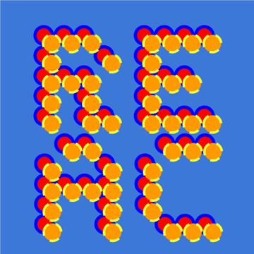
About us
Jendrik Illner
Senior Rendering Engineer at Santa Monica Studio since 2022
This talk is about my time at Ubisoft, junior 3D programmer on FC Primal in 2015 to 3D technical lead on FC6 in 2021
Cong Hao He
3D Programmer at Ubisoft Montreal since 2019
Coming from a background of graphics driver and SDK development, this talk is about my first AAA production experience.

Slide 3
Presentation Overview
Challenges from a legacy codebase
Long-term tech vision and planning
Architectural & workflow preparation during Far Cry 5
Executing the vision
Improving the Architecture and getting ready for production
Fine-tuning User Experience

Slide 4
Let's go back in time a bit

Slide 5
Far Cry 4 + D3D12 announcement
D3D12 Announcement 2014
FC3
FC4
2012
2014

Slide 6
Far Cry 6 + D3D12 support
D3D12 Announcement 2014
D3D12 Support 2021
FC3
FC4
FC Primal
FC5
FC New Dawn
FC6
2012
2014
2016
2018
2019
2021

Slide 7
Why did it take so long?

Slide 8
Far Cry Code Challenges
Aimed at D3D11 level architecture
Dynamic states, set from code, combined just before the draw call
Art is free to arbitrarily apply shaders to all kind of meshes
But front-end system also in need of upgrade
Terrain, Water, GI, Sky ….
Updating to physical based lighting …

Slide 9
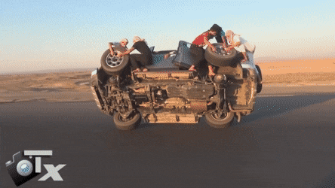
What we need to achieve
Update the backend for new APIs
+
Develop new features
+
Keep shipping on a regular schedule

Slide 10
Long-term Technical Vision and Planning

Slide 11
Long-term Technical Vision and Planning
The rest of the talk is about how we solved these
D3D12 architectural challenges can be broken into three groups
This talk will mostly focus on the shader state side
Resource States / Barriers
Render State Management (PSO)
Memory Management

Slide 12
PSO Refresher
What’s in a Pipeline State Object?
Easier to say what is not:
Resource bindings
Viewports
Scissor
Blend factors
Depth/Stencil reference values
Topology
► Everything else is part of the PSO
Shader bytecode
Stage descriptors
Flags
…
…

Slide 13
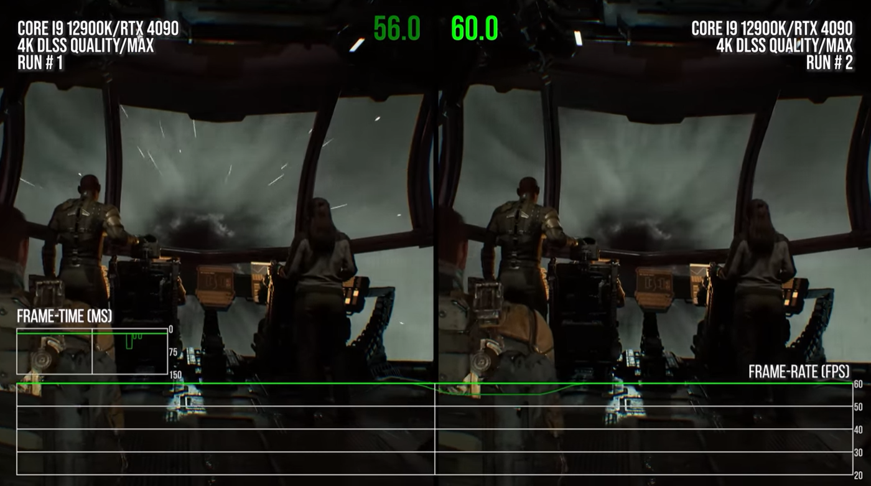
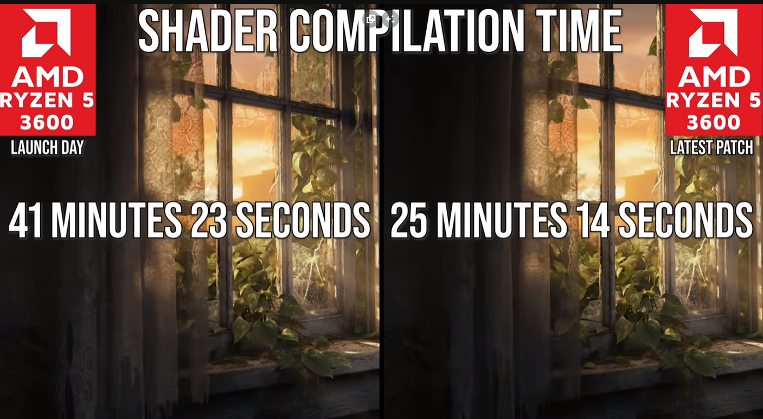
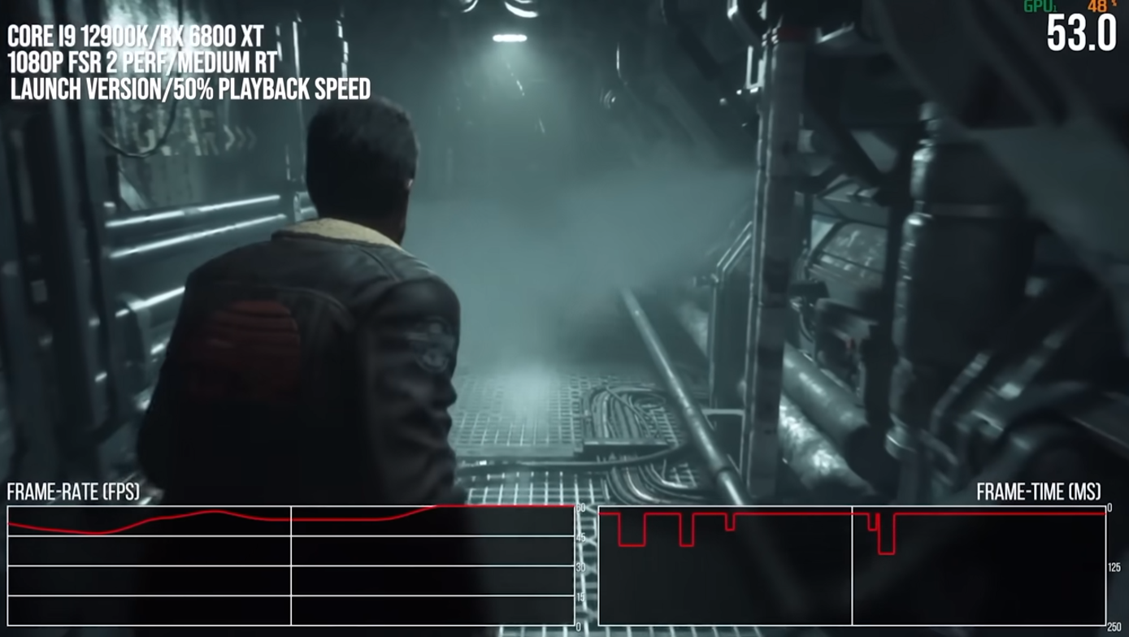
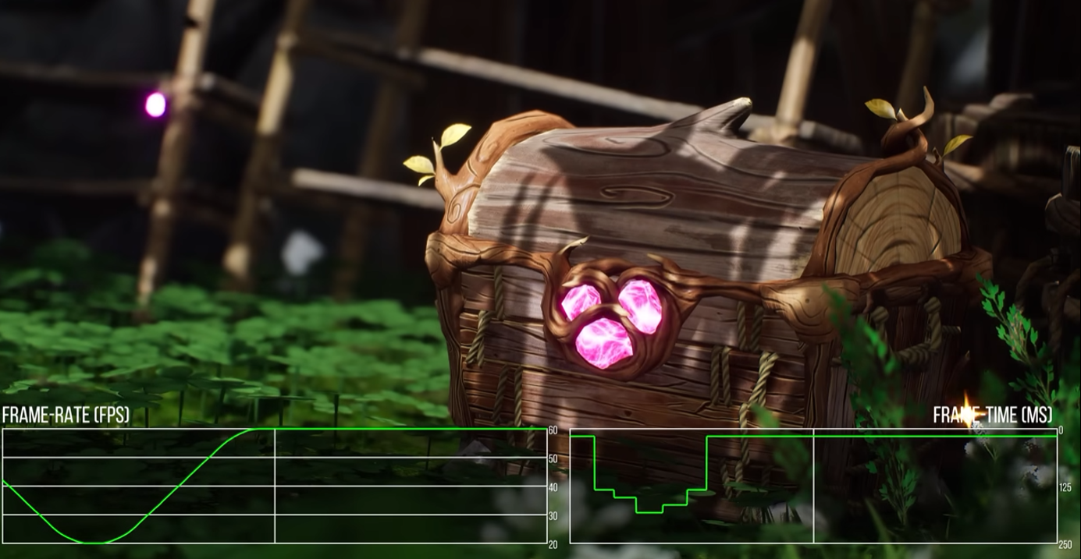
Why talk about this today?
(By the way) You Can Use Vulkan Without Pipelines Today ...
Image source: Digital Foundry

Slide 14
Dunia Shader Authoring

Slide 15
Expressing Material connections
Our shaders are authored as Shader Families
Group of shaders that implement similar material responses
Skin, Car Paint, Vegetation, Weapons, ….

Slide 16
FC6 - Shader ID to PSO transition
Each shader has a ShaderID: a 32-bits uint
Composition:
This ShaderID is referring to a pair (vertex/pixel) or compute shaders
ShaderID = shaderFamilyBitMask | shaderOptionBitMask | shaderVariationBitMask
[Based on family name] [Per global defines] [Per family defines]
[Name string hashed, bitwise shift and OR] [bit shift based on previous masks]

Slide 17
Shader Pipeline Goal
Goal: “Each ShaderID in the engine maps to a PSO”
Reduce the runtime overhead
Reduce possibility for mistakes in state getting out of sync
commandList.Draw( ShaderID, DrawCallBindingInfo );

Slide 18
Identify the challenges to reach the goal
Shader and Pipeline state is fully separate
Shaders are in Data (hlsl) and Pipeline state is in Code (C++)
No Art restrictions
Every model could be used with any shader and it was kinda expected to work
Nearly every object in the world could switch to a fully different and unrelated shaders at any point in game

Slide 19
The Plan
Extend the shader compiler to allow state parsing
Move PSO states into each family
technique {
BlendOp0 = Add;
RenderTargetFormat0 = R8_UNORM;
….
}

Slide 20
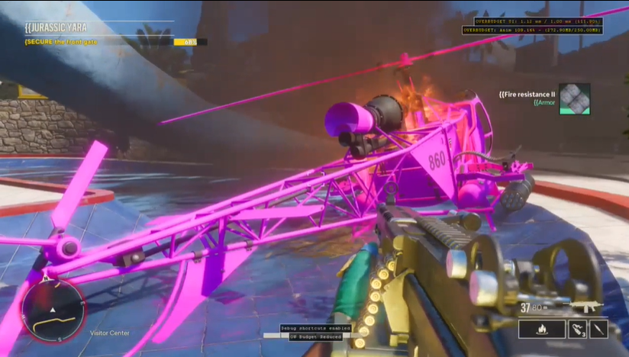
Can Art Help?
Define clear rules for shader and mesh combinations
Shaders define supported vertex format, only models with matching layout can use a shader
Only shaders from the family can be switched on the same model
If a rule is broken, shaders will be replaced with a placeholder material in development builds
► The clearly defined restrictions gave the teams enough time to adjust
Art pipelines for AAA are long
Need as much time to adjust as possible
Adjust workflows before it’s needed!

Slide 21
Long-term Technical Vision and Planning
Have a plan for FC5 to get closer to solve PSO challenges
What about barriers?
That’s a topic for another talk, but here is a brief overview
Resource States / Barriers
Render State Management (PSO)
Memory Management

Slide 22
Barrier Work (Overview)
One of FC5’s main task
Annotate resources as it flows through the frame in the form of:
Resource Stage + Resource Usage
High-level barrier system based on explicit binding model
Each time a user would request a new binding for a texture, render-target, buffer etc.
Explicitly specify the usage
Resolve dependencies just before draws/dispatches to issue correct barriers
Pros: Simple to debug, lightweight system
Cons: Manual annotation is time consuming and error prone
INSERT_TRANSITION( trackingContext, gBufferRT0, ResourceUsage::PIXEL_SHADER_WRITE );

Slide 23
- Release

Slide 24
Tech Milestone
D3D12 compatible barrier system in place, and functional on consoles
Not used on PC (but validation system is running in development builds)
Data restrictions in place and respected by artists
The shader system prepared for the introduction of PSO state
Data builder pipeline complete, data loading infrastructure
First pass of render state in shader files

Slide 25
- Production Begins

Slide 26
FC6 challenges
New lead studio (Ubisoft Toronto instead of Montreal)
Lots of technical must haves:
D3D12 for PC
Vulkan for Stadia
PS5
D3D12 for XBSX
What is available:
D3D11 for PC, XBox
PS4
► Lots of work ahead, but we are prepared and have a plan

Slide 27
High Level Plan
Start working on a PC Platform (either Vulkan or D3D12)
Our PC/Stadia team picked Vulkan as they would be responsible for Stadia as our first external technical milestone
New Targets (PS5/XBSX/Stadia) followed shortly after (had to get the engine up-and running on the targets first)
…. Do general porting work
Barrier system from FC 5 is ready for the task!
Huge time saver for FC 6
Not perfect immediately, cases not caught, custom validation layer disagrees etc
+ Developers already well aware of working with barriers
Once we had a basic version working, it’s time to take advantage of the new APIs

Slide 28
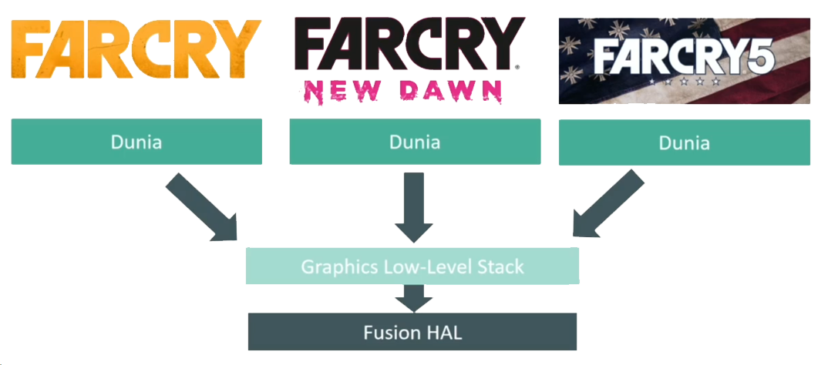
FC6 - Transition to Modern APIs
New APIs: Vulkan, D3D12 and AGC
New Platform: Stadia, XBSX, PS5
How to approach this with limited resource?
Shared Ubisoft initiative (Fusion):
A low-level API abstracting common APIs
“Port” once to this new API
Platform specific work can be shared
Reuse between games & engines

Slide 29
On Demand PSO
At this time we had implemented the obvious PSO integration
Cache all render state; calls from the runtime
On each Draw Call, hash the whole state + look up PSO in a Dictionary
If not ready, skip the draw call until the PSO is ready at some point in the future
► Never stall rendering, but certain objects might be missing for few frames

Slide 30
Skipping Draw Calls
Dunia Philosophy:
If Dispatch or Draw shaders are not ready, do not stall. Skip the call
Compute shader dispatch
Draw Shader
// Shadow tiles
bool isSuccess = device.Dispatch(BuildTiles);
if (isSuccess)
isSuccess = device.Dispatch(BuildIndirectArgs);
if (isSuccess)
isSuccess = device.DispatchIndirect(ResolveShadow);
// A class monitoring shader readiness
ShaderMonitor monitor;
device.Draw(ShaderID_0);
device.Draw(ShaderID_1);
bool isSuccess = monitor.AnyShadersNotReady();
if (isSuccess)
// Do something
Sidenode: UE5 supports a similar way now since 5.2 (for draw calls)

Slide 31
Expanding Skipping Draw Calls
Very helpful when porting to a new API as well
Hook up the validation system to the skip conditions
If a draw call triggers a warning/error, skip the draw call instead of potentially hanging the GPU
We had allow lists of errors that we know are “safe”

Slide 32
Iterative Improvements
We focus on making iterative improvements
We have a system that does a decent job of getting the game running
QA can test, we can develop and improve all systems from here in parallel

Slide 33
Improve Shader Variations
Started with a long list of variations
All of same importance, but that’s not true
Variations
Vertex Formats
Output Formats
Burning
Wetness
Wind influence
Skinning
…..

Slide 34
Improve Shader Variations
Started with a long list of variations
All of same importance, but that’s not true
Variations
Vertex Formats
Output Formats
Burning
Wetness
Wind influence
Skinning
…..

Slide 35
Essential vs Optional
Essential
Vertex Formats
Output Formats
Skinning
Optional
Burning
Wetness
Wind influence
Anything that only adds additional information to an object is marked as optional
For example when a object starts burning we don’t mind if the shader is not swapped for a couple of frames. As the objects gets burned slowly over time anyway
QA will flag cases where this might be cause undesirable artifacts

Slide 36
Fallback to less specific PSOs
Now when we hash the PSO, start looking for fallback options if it’s not ready
Try to remove optional defines and see if we can find a match
If we find one, use it instead
Otherwise keep searching
If we don’t find a match, we are back to skipping draw calls

Slide 37
Map ShaderID to PSO - The Journey begins

Slide 38
Transition Start
Start with work on Xbox Series X
Why? AAA reality of our team in Montreal owning the xbox platform
And we had the time in the schedule set aside and we thought it was important
Less worried about regressions as it’s the least “tested” platform at this stage

Slide 39
Two Sets of States
Runtime Shader
Shader State
Output Formats
Output Formats
Blend States
Blend States
Primitive Topology
Primitive Topology
…
…
…
…
The two sets should match, but of course they don’t as the Shader State was setup during FC5 but unused up to this point!
Validation system needed to catch the mismatches

Slide 40
Validation System
Introducing a state validation system
Different validation mode available:
Validate state & prefer runtime state
Validate state & prefer runtime state & log warning
Validate state & prefer data state & log warning
Validate state & skip draw call & log warning
Only use Data state
► We want to get to Level 5 but had to start with level 1

Slide 41
Turn on & hope for the best
… And >90% cases are falling back to the runtime state
What are the most common issues?
Render Target Formats, Blend Settings
Fix these up
Sounds bad, but most state is in common include files
Keep on iterating on this on programmer only
Until we can boot and play the game for a couple of minutes
technique {
#include "BlendedStates.inc.fx"
#if defined(TWO_SIDED)
CullMode = None;
#endif
}

Slide 42
Expanding the Test Audience
At this stage we were more confident and started enabling a warning on screen if a mismatch is detected
First on a small number of testers machine (the local 3D Programmer QA)
Expanded globally once local QA didn’t see any warnings regularly
Now QA would record information into JIRA as any other bugs

Slide 43
Automatic QA Helper
Most issues resolved via code change near the end of production
But there are a couple of cases left that need art to resolve
We want to provides technical directors with enough information to track down the causes and assign issues to the right person without programmer involvement

Slide 44
JIRA Generation
Custom internal API to generate a Jira from runtime code on any platform
We validate geometry layout vs. what the shader expect
Mismatch information directly available in Jira bug report
One JIRA for each geometry + shader combination
Directly assigned to the responsible Technical Director
<Geometry Name>
Geometry Layout
<Shader Name>
Expected Shader Layout
Name
Index
Stream
Format
Offset
Classification
Instance step rate
?
==
Name
Index
Stream
Format
Offset
Classification
Instance step rate

Slide 45
Final Testing and Validation

Slide 46
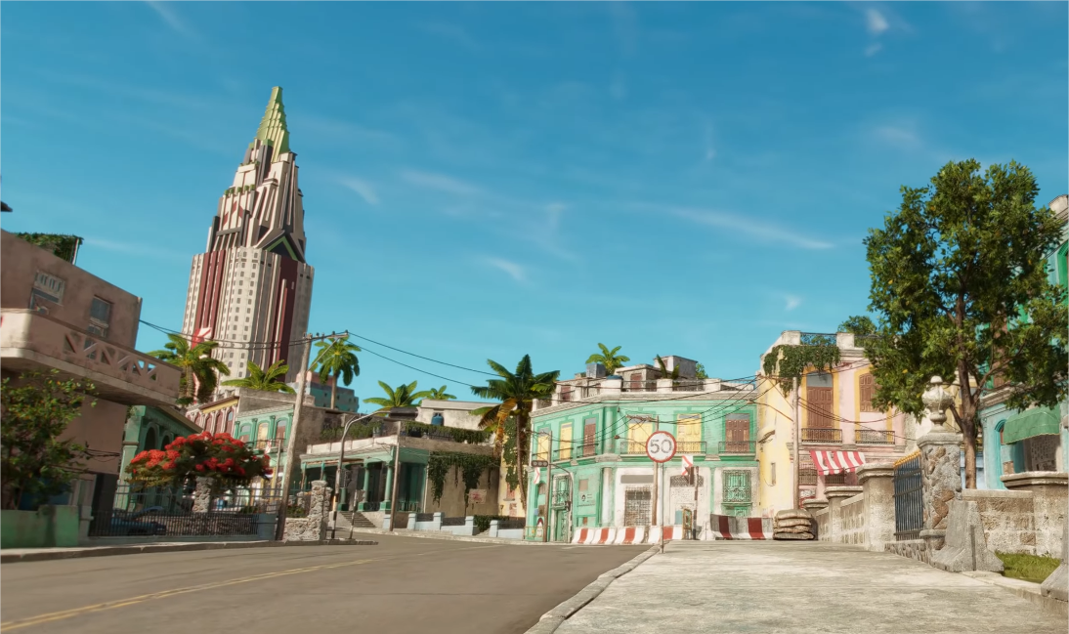
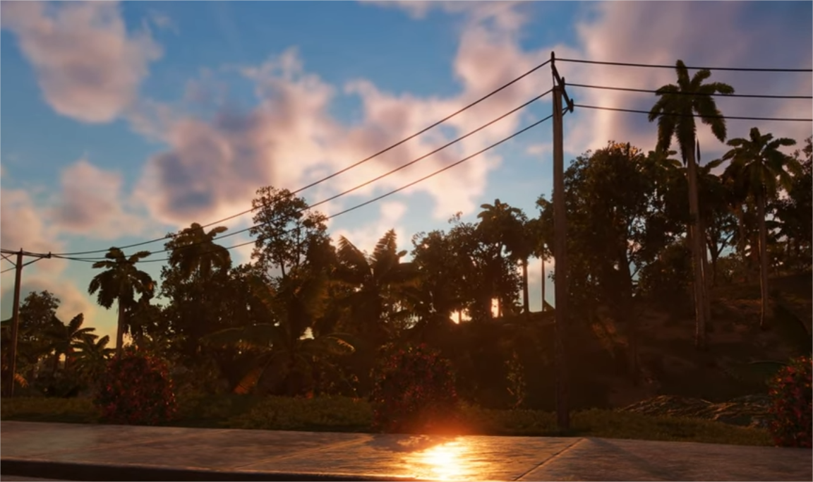
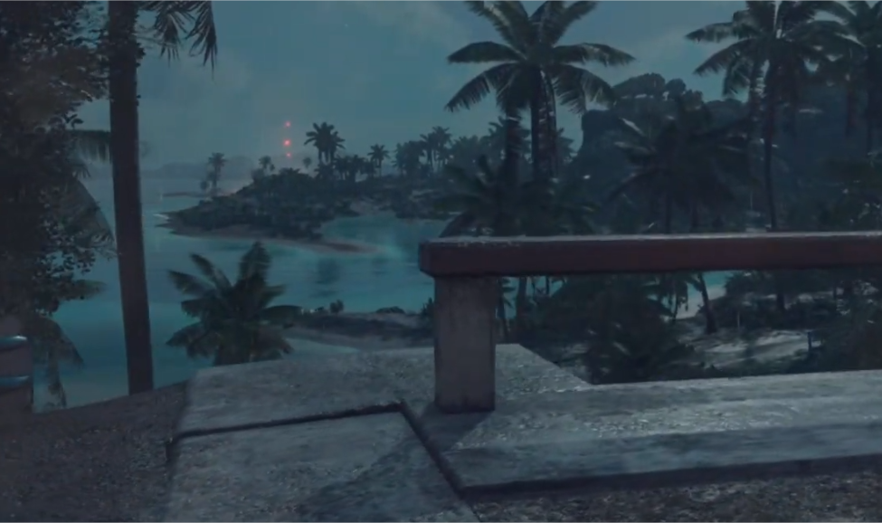
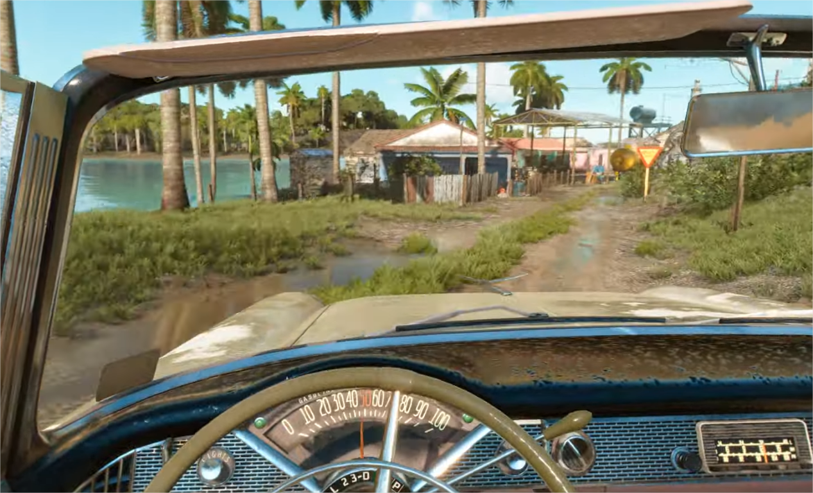
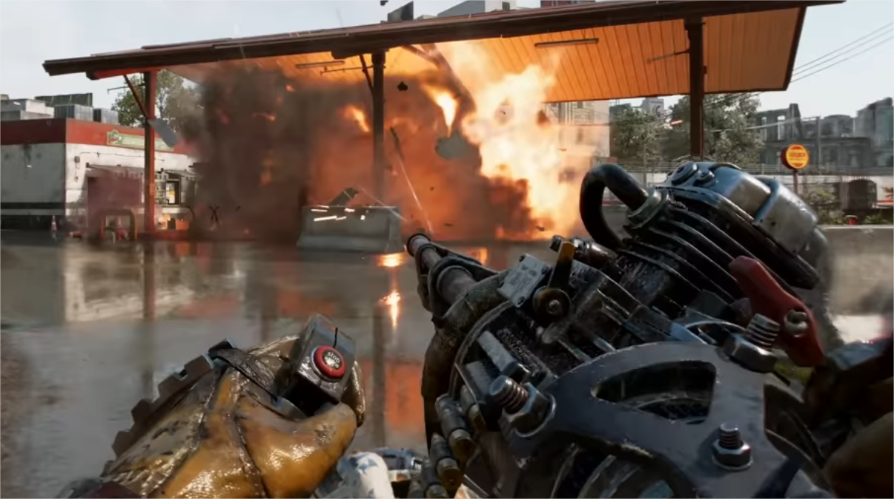
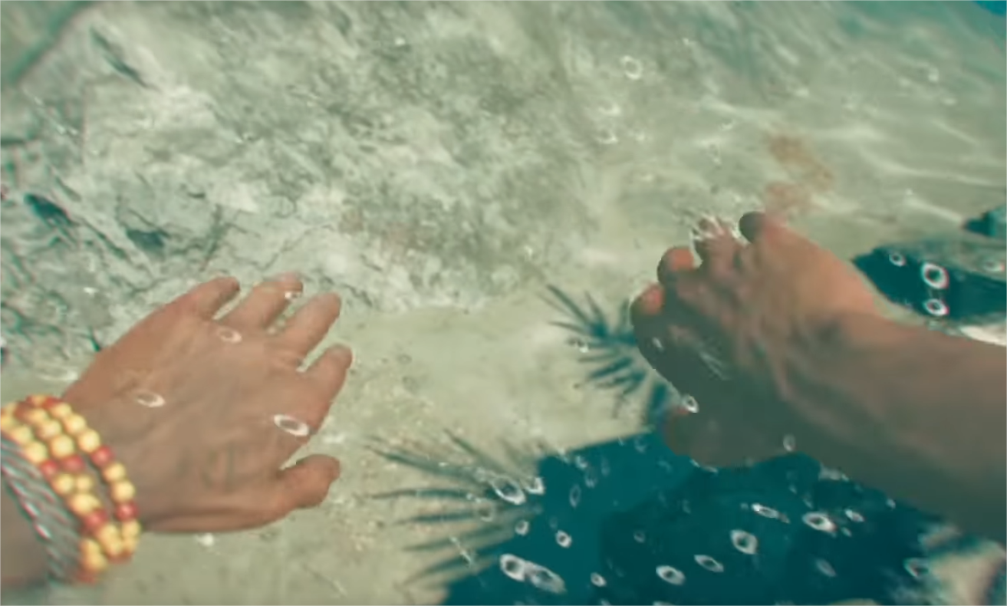
Test Coverage
Environments
Urban, dense vegetation, open field, etc. in day/night time and various weather conditions
Gameplay settings

Slide 47
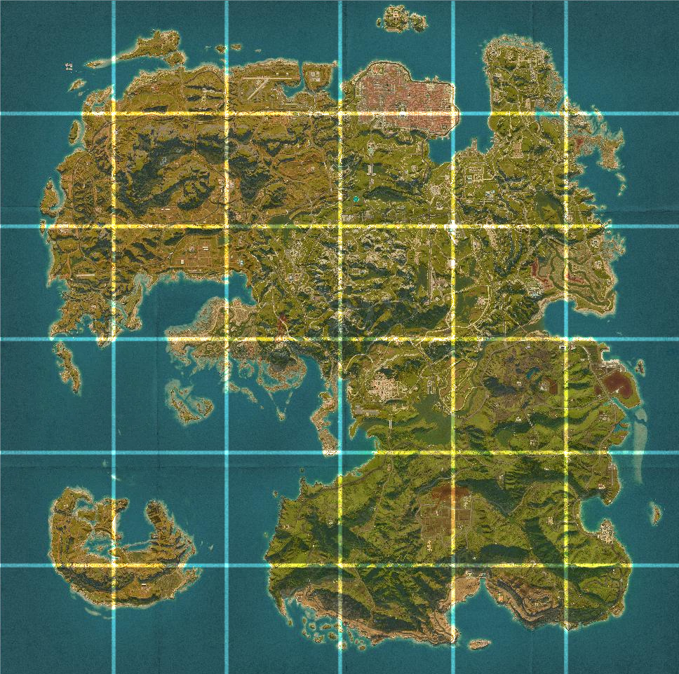
Automatic Testing
Spawn at fixed locations, deterministic
Automatically collects screenshots, profiler perf captures, and Pix captures
Spawn in all map sectors, bot randomly playing the game
Catch regressions, also perfect for detecting shader state mismatch

Slide 48
Final Testing Process
A combination of manual testing by QA team and (mostly) automatic scripts
QC team: mission, cutscenes, game menu
Automation: all map sectors and environment setting permutations
An iterative process to detect and fix most of state issues
1
QA playthrough
&
Auto-test passes
3
2
Fix and validation
Shader state mismatch, Jira ticket generation

Slide 49
Interesting Edge Cases
Noticed a common pattern, whenever we would aim at an enemy we would get an assert with mismatch
What was this all about?
Outline shader!
Effect that bypasses the shader override system
And needs to be applied to all kinds of model formats
Add a variation for each vertex format?

Slide 50
Custom Vertex Fetch
Decoupling the Vertex Format from the format the shader expects
Using Programmable Vertex Pulling
The Shader only needs to to know Position + Normal
Doesn’t care if it has two set of normals, tangent space or anything else
Each Model exposes a Structured Buffer View onto the data streams
The C++ logic can query the mesh and bind these for the outline shaders
If it gets applied to an object that doesn’t offer the views a dummy stream will be bound
► Designed for reduced shader variation count but proved to be a very flexible architecture as a side effect

Slide 51
Each ShaderID in the engine maps to a PSO!
This was a great amount of work, we are grateful we broke this work down over multiple games
The runtime is super simple, most cases will never need to deal with render state
All state is managed centrally in a couple of common header files
Shaders own the whole state in a single place
No more state leaking
Really worth the effort and an engine architecture is better if designed for it
Large AAA games can do it, we proved that!

Slide 52
Fine-tuning User Experience

Slide 53
Shader Pre-compilation Process
We have all the runtime side of things in-place, but how to improve the first start experience?
We have a couple of more techniques
Collecting runtime PSO usage
Compiling Shaders on first load

Slide 54
Collecting PSO Usage
Large amount of Variations that could be used, but most aren’t
Each run connected to a database
Track what kind of shaders are used
Consolidated all runs into a single set of PSOs
Final list of the ~10k “most used” PSOs
Some forced shaders added manually (e.g. copy shaders, clear shaders)
All shaders are compiled on boot of the game and are ready by the time main menu loads

Slide 55
Priming during loading screens
The second part happens during each loading screen
At the end of the loading process, don’t immediately hide the loading screen even when the player is loaded into the world
Render the world behind the loading screen
Spinning the character around itself
This primes the virtual textures and shader variations
Remove the loading screen only once both parts are done
► This way we can be sure all shaders for the new location and virtual textures are ready before the player can see them

Slide 56
Conclusion

Slide 57
Lessons Learned
When major technology change is required, identify and tackle the architectural changes needed first
Start setting up the supporting systems early
See restrictions as an opportunity for better design, not annoyances
Use iterative design process, each step gets closer to a shippable solution
Think long term, don’t limit yourself to current project timeframe

Slide 58
Acknowledgements
Special thanks to all members of 3D graphics team who contributed over the years to make Far Cry games possible.

Slide 59
Thank You & Questions

Slide 60
Sources
Advanced Graphics Summit: 'Marvel's Spider-Man' Remastered: A PC Postmortem - gdcvault - video
The Challenges of Rendering an Open World in Far Cry 5 - advances.realtimerendering
OpenGL Insights - Programmable Vertex Pulling
UE5 Release Notes - unreal engine 5.2 release notes

Slide 61
Extra Slides

Slide 62
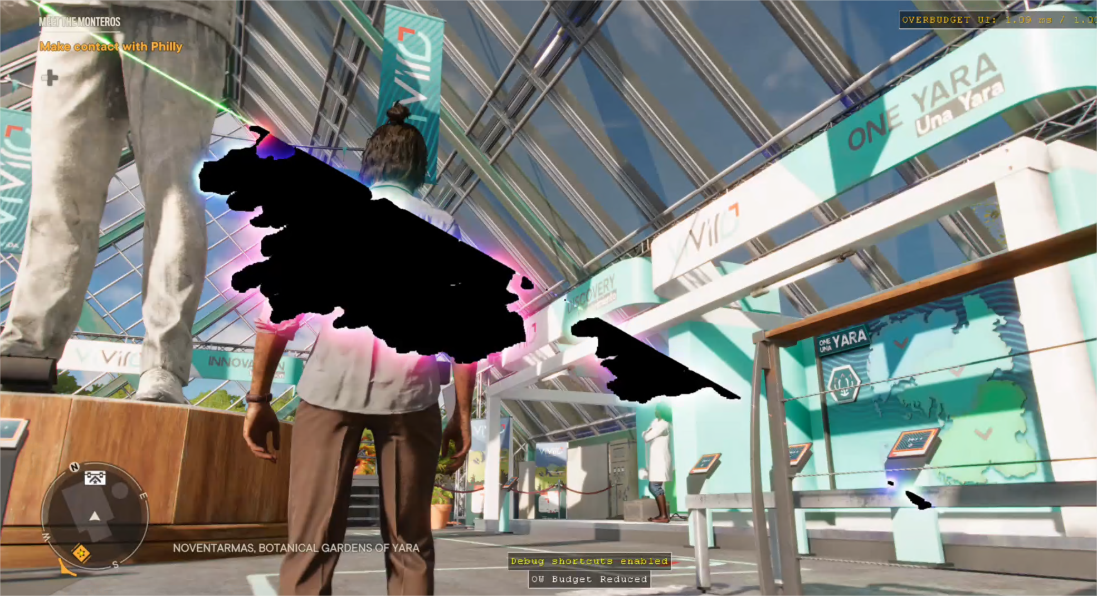
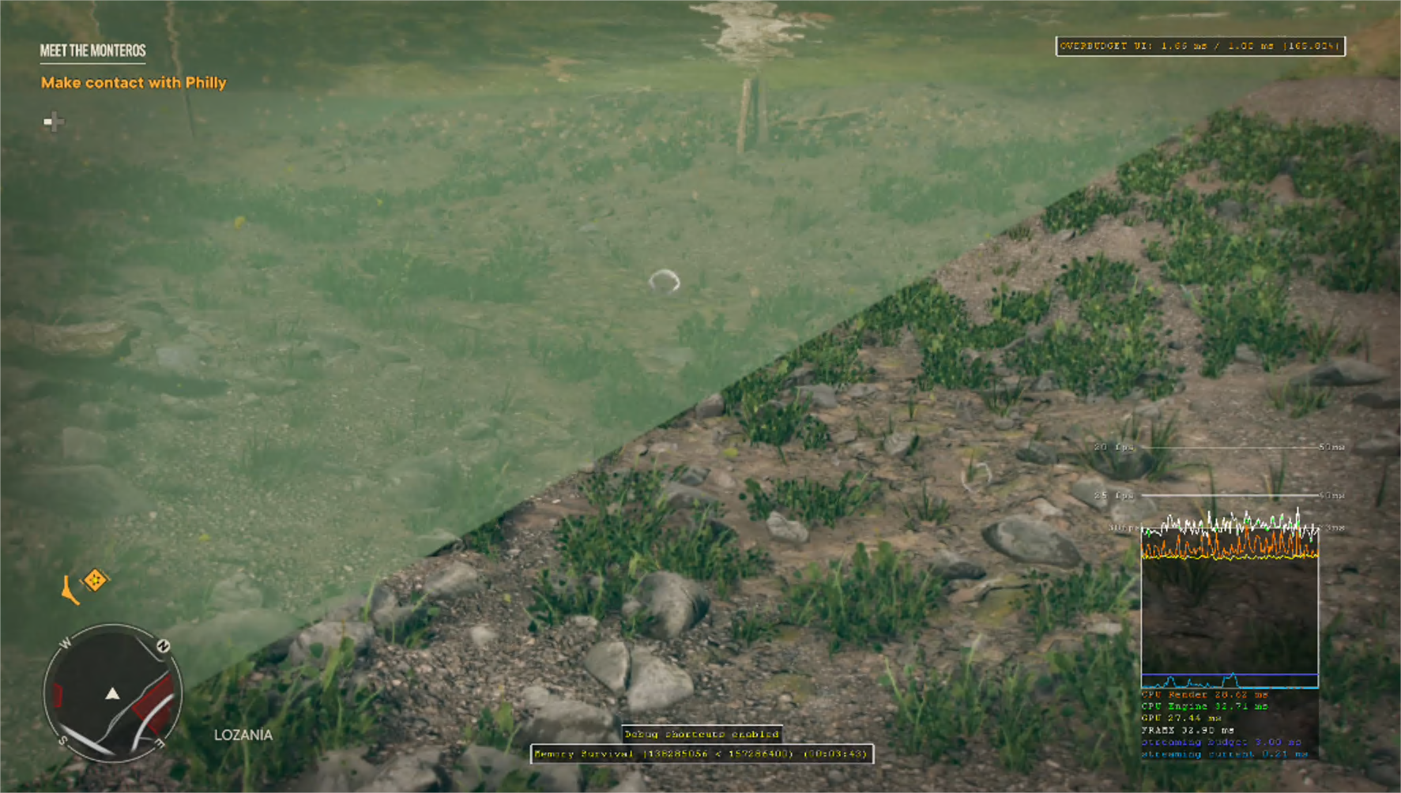
Interesting Edge Cases
Hard to debug issues
Inspecting captures and pixel history does not yield relevant information
What is common? Triangular portion of the image corrupted
Wrong pipeline state. Triangle list vs. quads

Slide 63
Switching
Once we were sure enough that we had caught all cases we swapped over to validation, but preferring state from disk
This revealed a good more chunks of test cases, especially related to swapping between HDR outputs

