Slide 1
Ray Tracing in Diablo IV
Kevin Todisco
Principal Software Engineer, Blizzard Entertainment
Notes:
Hello! Welcome to REAC 2024. My name is Kevin Todisco, I'm a Principal Software Engineer at Blizzard working on graphics for Diablo IV, and today I'd like to present the work we did to bring ray tracing to the game. I also want to apologize for not being able to be here the day of the conference to answer questions, but my colleague – coincidentally named Keven – has graciously offered to stand in to field questions at the end of the talk.

Slide 2
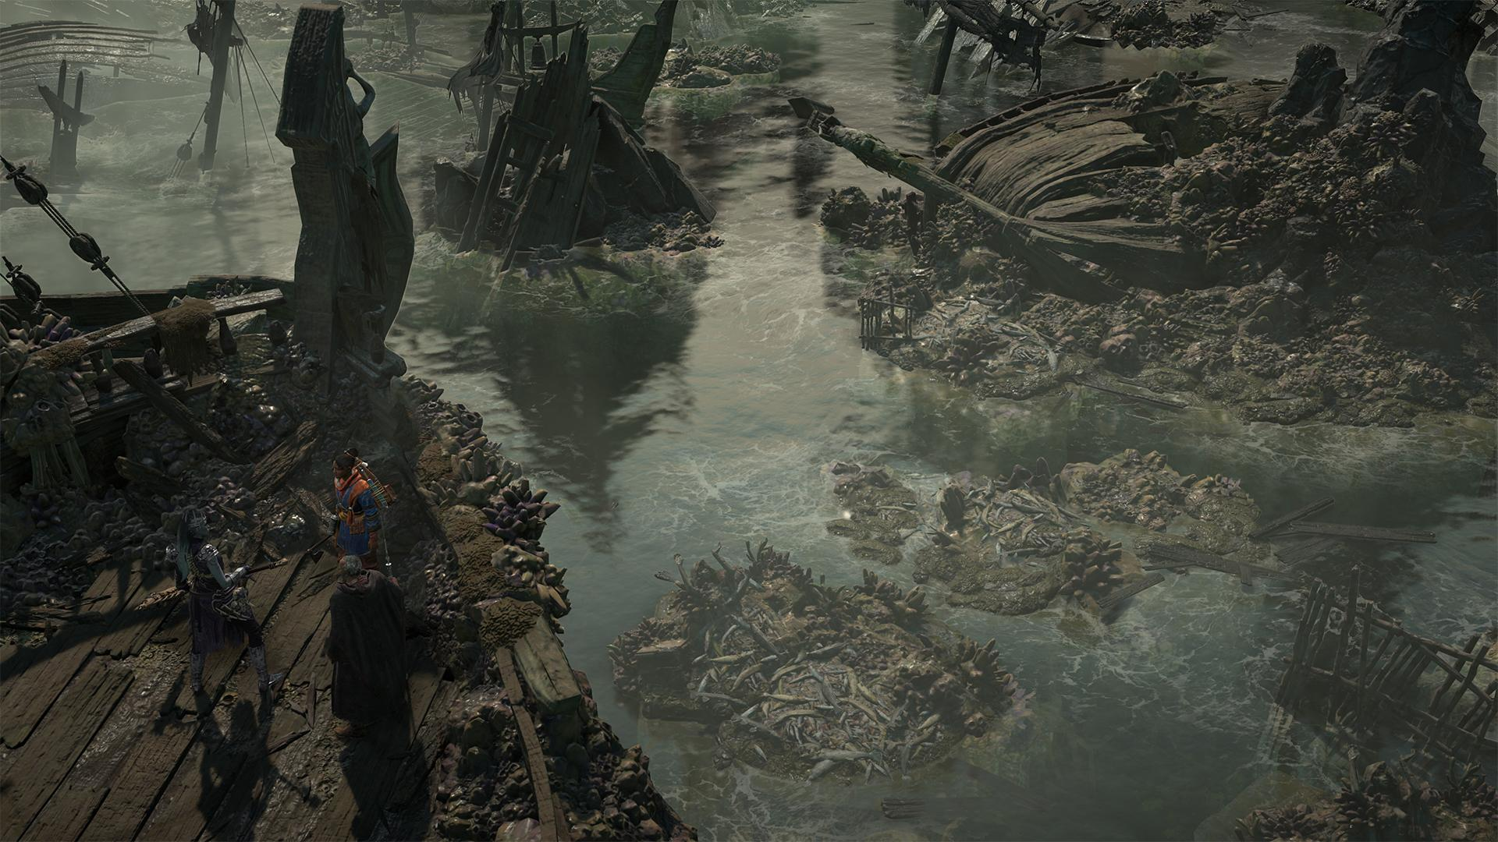
Notes:
The advent of real-time ray tracing is a really exciting opportunity for graphics on Diablo, because of how much it can add to pretty shots like this one here. But the major challenge we faced was that the game was not art directed, nor architected, with ray tracing in mind. As I hope to show, this has a significant impact on the decisions surrounding the feature, and on how it is implemented.

Slide 3
Agenda
Phases of Ray Tracing Development
Constraints and Strategy
Implementation Details and How Challenges Shape Architecture
Fitting to the Content
Summing Up
Notes:
Here's a general outline of what lies ahead. I'll start at the high level – how ray tracing came to be in the project and the eventual decision making process for determining how we would utilize it and what features we would target for release. I'll then dive into the low level details of what it took to implement, in particular how the architecture was influenced by the challenges of adapting it to the technology we have. Then I'll come back to a higher level again and talk about what implications it had for the content and how we found the middle ground that satisfied all our constraints. And finally, I've give some last thoughts about the work as a whole.
I'll caution up front that this is not a comprehensive deep dive into raytracing in the game; a few details about how things work are omitted. Instead this talk aims to highlight the evolution of the feature and how it and the decision making behind it are influenced by factors like art direction, technology direction, and the engine it's being added to.

Slide 4
Chronology
Began as engineering R&D with no release timeline
Sat latent for a while
Picked up once release window came into focus
Plus, partnership with NVIDIA
Goes from side project to "how do we ship this?"
Nearly all of what's discussed here is from that second stage.
Notes:
Ray tracing's inclusion in Diablo can be very much separated into two stages: R&D and full production. I think that the complete picture is probably more complex than that but separating it into two distinct times is best for our purposes here. The first inclusion of ray tracing was done with some general intention to ship it… someday. It was an engineering-driven experiment done well before Diablo IV had a release date and was tackled largely to incorporate the technology so that perhaps it could be utilized to a greater extent later in development. It was, by all means, not a shipping solution. But it did work.
The implementation sat around for a time, atrophied slightly, and then as the release window for the game came into focus it gained renewed attention. This is a feature we wanted to include in the game, the question became what kind of work would be necessary to do it. And, in addition to our independent intention to add ray tracing, we also developed a partnership with NVIDIA as the game would obviously be a fine addition to the lineup to promote their ray tracing technology.
In an extremely watered down view of things, this feature goes from a side project taken on almost solely by one engineer and turns into "ok, how do we actually get this thing out the door?"
Just about all of what I'm about to cover in this talk is around that second part – how do we get this thing out the door. Some of what follows may sound like they were considered in sequence but that's mostly to help with presentation. There was often a lot of overlap of the development of different pieces.

Slide 5
Decision Making
Notes:
We'll start by talking about the decision making that went into how we incorporate ray tracing.

Slide 6
What to ray trace?
Art Direction
Time
Art Support
Team Experience
Performance Headroom
Notes:
When looking at how a feature like this fits into a game like Diablo IV, there are a lot of factors to consider. What artistic goals can the feature support? What kind of experience do we have on the team? What kind of support do we have from the Art team? How much time do we have? How much performance headroom do we have?
Our inclusion of raytracing would be motivated by keeping up with technology trends, and shaped by the balance between resources available to invest in new technology and resources needed to complete the game.

Slide 7
Art Direction and Support
Not directed with ray tracing in mind
Diablo IV ships on a variety of hardware
PC min spec is a GTX 660 or R9 280
Xbox One and PS4
Want to enhance visuals, but not have a new look
Not wanting to change content
Good from the standpoint of asset management and maintenance
Challenge from the standpoint of implementation
Notes:
The game is not art directed with ray tracing in mind. One major reason for this is the variety of platforms we support, which include previous generation hardware – the Xbox One and the PS4 – which do not have any hardware ray tracing support, and on PC our min spec is set well before dedicated ray tracing hardware released. Our art team was not prepared for the game to diverge visually with ray tracing enabled, so much of the direction was to maintain the existing look of the game and merely have it augmented. "Tastefully," if you will. Ray tracing was looked at in part as a way to get rid of undesirable artifacts like light leaking. The feature would be considered a success from art's point of view if the visuals remained as they were but with fewer artifacts. If you're familiar with ray tracing work in other titles or in the differences between a ray traced scene and one lit with traditional baked lighting techniques, you'll know that the two don't often match up. And so the challenge to meet art direction becomes clear.

Slide 8
Time and Experience
No prior ray tracing technology in the stack
Good references, but no implementation
No prior ray tracing API experience on the team
Not just one API to consider
DXR (PC, Xbox) and PSR (PS5)
Defer release until after initial launch
Notes:
Given the artistic parameters within which we need to work, we then have to consider the kind of resources we have available. I just talked about how we would have little art support because content was not intended to change, but what do things look like for engineering? Time is a big consideration, and so is team experience. We had no prior experience shipping a real-time ray tracing feature and no formal experience working with real-time ray tracing in a AAA game engine, let alone on each of the different platforms we planned to release on. This itself is an important consideration because for our target platforms there are not one but two ray tracing APIs to work with – DirectX Raytracing (DXR) and PSR for the PS5. Ultimately, the release of ray tracing in the game was deferred until after game launch, allowing the team to focus on shipping the title first, then adding new technology after.

Slide 9
Performance Headroom
 | Xbox One | PS4 | Xbox Series X |  | PS5 |  | PC
Framerate | 30 | 30 | 60 |  | 60 |  | 30-60+
Output Resolution | 1080p | 1080p | 2160p |  | 2160p |  | 720p - 2160p+
Quality | Low | Low | Medium |  | Medium |  | Low - Ultra
Notes:
And on the performance front, we had to establish how ray tracing would fit into our landscape of platforms and specs. Here are the specs that Diablo IV launched with – the previous generation of consoles running at 30 frames per second in 1080p, the current generation of consoles running at 60 frames per second at 4K (lower internal resolution, upscaled with Fidelity FX Super Resolution 2), and PC at any range in between these or even above.
Because these are the specs the game was designed to ship with, you'd be correct to assume that content at release pushed the platforms right to the limit. What that leaves us with is no available overhead to fit in a resource-intensive feature like ray tracing while still maintaining 60 fps on consoles, without needing to make reductions in other areas.

Slide 10
Performance Headroom
 | Xbox One | PS4 | Xbox Series X |  | PS5 |  | PC
Framerate | 30 | 30 | 60 | 30 | 60 | 30 | 30-60+
Output Resolution | 1080p | 1080p | 2160p | 2160p | 2160p | 2160p | 720p - 2160p+
Quality | Low | Low | Medium | High | Medium | High | Low - Ultra
Ray Tracing | No | No | No | Yes | No | Yes | No - Yes
Performance
Quality
Notes:
So the next obvious choice is to introduce another mode of execution, a Quality mode, which could not only include ray tracing but also bump the quality of level of several other graphical features the game offers; and in turn, lower the target fps to 30.

Slide 11
Impact
Solves the most of Art's problems
Without changing too much
Enhances the visuals of the game
Without changing too much
Maximizes cost-to-benefit ratio
While changing enough to be an upgrade
Notes:
On the whole, when we think about the strategy that has the biggest impact on the game, it's one which solves the problems that Art looks at it to solve; one which offers an enhancement to the visuals of the game; and one which maximizes the cost of implementation to get the most benefit in both of those categories. All without changing too much to run afoul of direction, but still changing enough to be looked at as a desired upgrade.

Slide 12
Feature Set
Tried-and-true techniques: shadows and reflections
Lowers R&D cost
Shadows
Thematically relevant
Reflections
Straightforward to implement
Still need to account for variety of specs
Notes:
The tried-and-true techniques of shadows and reflections are the best fit in the face of all these criteria. They incur the least R&D cost since they are already known quantities in the field of ray tracing and perhaps the two most exercised applications of ray tracing.
When it comes to content, shadows could be considered the most important for a game in the style of Diablo; it's dark, gothic, and is meant to evoke feelings of horror and the occult. The game therefore is serviced by having high fidelity and detailed shadows to drive home that mood.
Reflections, on the other hand, are less thematically relevant, but extraordinarily straightforward in terms of implementation: fire a ray into the scene and reflect. At the outset, the expected time investment to stand up the technique is very little and has the least unknowns. It's perfect for a team with little ray tracing experience and less room to try something new.
Finally, these techniques were chosen in some part by the evolution of ray tracing within the engine itself. As I mentioned in the beginning, it was first added "on the side" by one of our engineers not long after the announcement of real-time ray tracing and release of the DXR API. It lived in the engine for some time before being given the attention a shipping feature would ordinarily get. The blueprints for shadows and reflections were there; completing them became the goal.
There is still more to figure out though, because these features are meant to ship on a few different platforms with varying capabilities. They need to be broken down in some way to make them scalable.

Slide 13
Feature Set
Shadows | Low | Medium | High
Directional Lights | ✔ | ✔ | ✔
Player Light | ✖ | ✔ | ✔
Local Lights | ✖ | ✖ | ✔
Reflections | Low | High
Roughness-based multi-ray | ✖ | ✔
Simple blur | ✔ | ✖
High Quality Denoise | ✖ | ✔
Notes:
We arrived at these tiers of each feature. For shadows we have low, medium, and high options which each add a new element into the mix. At the lowest tier we only ray trace the directional light – it's therefore only active during the daytime in outdoor scenes. At medium, we mix in one punctual light source – the player light. This means it's active now at nighttime and in dungeons, and augments the one punctual light you are sure to have around you at all times. Finally, high is the "enthusiast" tier. At this tier we ray trace every eligible light – that is, any point or spot light in the scene that is flagged to cast shadows, will be ray traced. For some content, it is a pretty significant jump in demand on the hardware. We would frequently refer to this as the "I have a 4090" tier.
Reflections were broken down into just two tiers, low and high. Low is a single-ray solution treating the reflective surface as a mirror and only factoring in the surface normal, while high can fire multiple rays based on the roughness of the hit point. Low uses a simple blur as a post process effect on the result, while high uses a higher quality denoise operation. The difference between the two is more subtle than with the shadow tiers.

Slide 14
Implementing a Foundation
Notes:
Ok, let's talk about implementation. Fair warning, for time purposes I'm not going to give an overview of real-time raytracing APIs here and how they work. Some familiarity with them will help here, but I will provide very brief explanations of terms where I can.

Slide 15
Tools
Data Definition
Runtime
Geometry Model
Asset Streaming
Resource Binding
DCC Tools
Art
Shader Model
Memory Management
Frame Layout
Shader Graph
Build Pipeline
Command Generation
Raster Techniques
Notes:
A major feature like ray tracing, I think intuitively, is going to touch many parts of a rendering engine. If I were to map out the many components of our rendering pipeline in a generic way, I'd make something like this here.

Slide 16
Tools
Data Definition
Runtime
Geometry Model
Asset Streaming
Resource Binding
DCC Tools
Art
Shader Model
Memory Management
Frame Layout
Shader Graph
Build Pipeline
Command Generation
Raster Techniques
Notes:
And here are the parts that ray tracing directly impacts. The most notable omission here is Art. A reasonable expectation would be that ray tracing would greatly impact the art in the game, but as I explained before, in our case it did not; our goal was to work to minimize impact here. But, many other components change.

Slide 17
Tools
Data Definition
Runtime
Geometry Model
Asset Streaming
Resource Binding
DCC Tools
Art
Shader Model
Memory Management
Frame Layout
Shader Graph
Build Pipeline
Command Generation
Raster Techniques
Notes:
And by the end of the whole effort, even our raster techniques would be affected which maybe one wouldn't expect up front. I'll cover this a bit later.

Slide 18
Shader Implementation Details
No bindless paradigm.
Hit group textures use register space 1
Vertex and index buffers start at slot 52, after raster bindings
Vertex processing is done on async compute
Results are cached
Two classes of assets: skinned actors and SpeedTree
This was (conveniently) done independent of ray tracing
SpeedTree precompute is only on when ray tracing is on
Increases required memory
Notes:
I'll begin by talking about shaders. On Diablo IV we don't use a bindless resource paradigm, instead a more traditional binding model on a per-draw basis. To support ray tracing, we take advantage of register spaces and access all hit group textures in register space one. The vertex and index buffers for barycentric calculations are bound in space zero after our traditional raster pipeline bind locations, beginning at register 52.
Since ray tracing does not provide any means for vertex manipulation, skinning and other vertex operations are precomputed on async compute early in the frame and then cached for use later. This was work that we tackled actually independently of the ray tracing effort, and it was simply serendipity that it was already done when the time came to leverage it in the ray tracing pipe. Interestingly though, only precomputed skinning results are used by default, while precomputed SpeedTree is only used when ray tracing is on. The reason for this was that performance results using precomputed SpeedTree vs. SpeedTree evaluated in vertex shaders were mixed on consoles, so the decision was made not to switch paths.
Of course, needing to precompute and store all vertex data has an impact on memory, so that's something to keep in mind when it comes to fitting in our performance headroom.

Slide 19
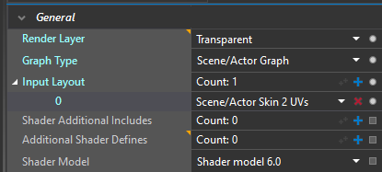
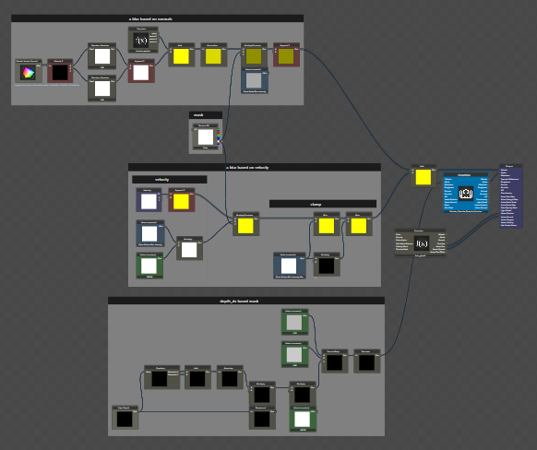
Shader Graphs
Shader Declaration
Input Bindings
Interpolators
Output Bindings
Notes:
We have a shader graph system which allows our technical artists to create custom shaders for the varied materials throughout the game. The shader graph system is fairly standard, so I won't really go into much detail here. The graph itself is processed during the build into HLSL and represents the "body" of a complete shader. It is joined with a header that define the inputs the graph is allowed to manipulate and the outputs that the graph writes to which are based on the pass it's intended to run in.

Slide 20
Shader Graphs
Shader Type
(AnyHit, ClosestHit)
Shader Declaration
Hit Group Input Bindings
Input Bindings
Barycentric Calculations
Interpolators
Texture Sampling
Output Bindings
Ray trace output target
Notes:
Extending this for ray tracing is fairly intuitive. The HLSL generated by evaluating the graph can be transplanted into a different type of shader – a ray tracing one. The header is now the hit group definition – a hit group is the collection of material and shader state for a particular object in the raytracing scene – and some boilerplate code to read from the vertex and index buffers, calculate barycentrics, perform some texture samples and then pass them to the graph body, just as if it had received them from interpolators in the traditional raster pipe. For output, the graph results can be connected to more boilerplate code that performs things like an alpha test for shadow rays or a lighting calculation and payload merging for reflections.
For the majority of shaders, there is only one pass that the shader belongs to and so only one graph for us to choose from when deciding which to incorporate in the compilation of the graph for ray tracing.

Slide 21
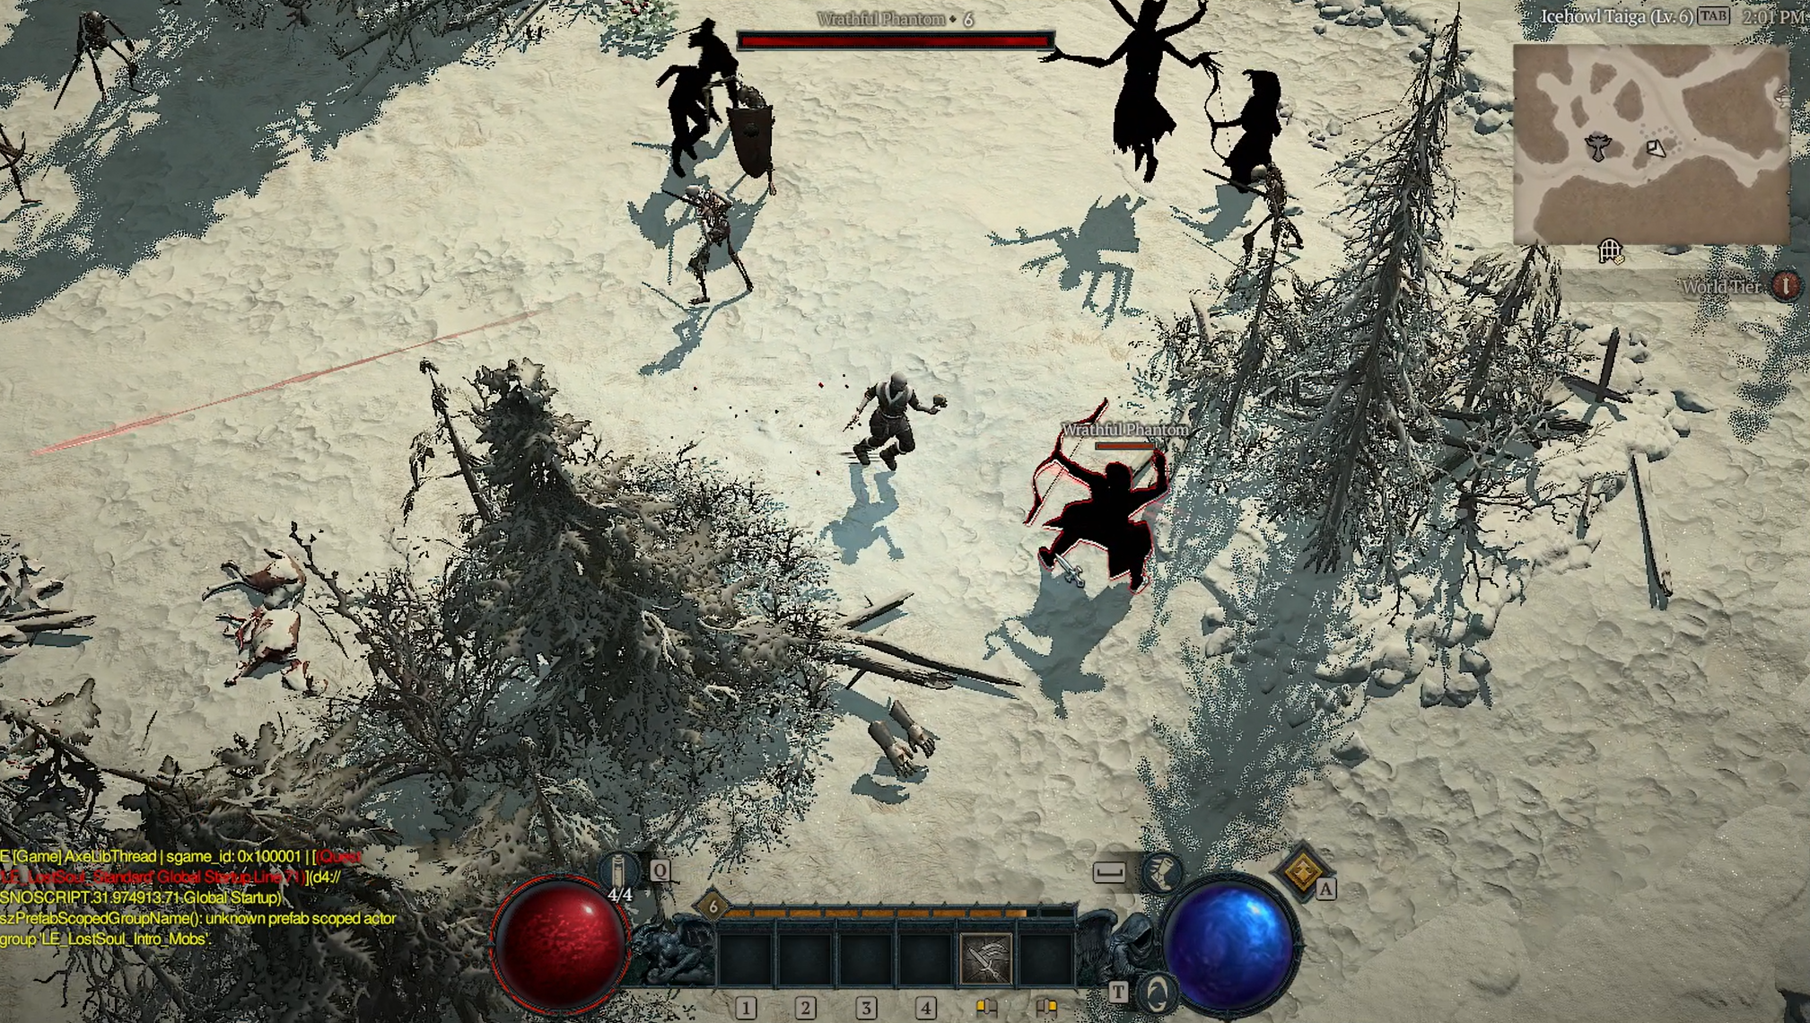
Notes:
However, for a handful of shaders that are multipass, the heuristic is not as easy. In this example, the phantom enemies are drawn with a multipass shader, and the first pass only writes an alpha value. It's not suitable to pick for ray tracing and as a result these enemies would appear with no color, as seen here. No good heuristic exists to programmatically determine the "intended" pass to use, so our solution was simply to add a means of selecting a specific pass in the graph to compile for ray tracing, and manually selecting it for multipass shaders.

Slide 22
Notes:
To help validate correctness of the ray tracing versions of our shader graphs, we have a debug render mode in which all primary visibility in the game is ray traced. This is it in action.

Slide 23
Render Work Generation
1 render thread, 4 render workers
Work is separated manually among workers
1 worker for early-frame work like shadows, 1 for gbuffer, 1 for post, etc.
Each worker has multiple state machines
Global state describing high-level state of the graphics pipe
Thread local state describing low-level details like active command lists and bound resources
Scene traversal modifies high-level and low-level state
Issuing a draw translates state into command list ops
State modification is a very hot path!
Ray tracing work is constructed similarly
Notes:
When it comes to generating work for a frame, we have one render thread and four worker threads. Diablo does not use a task-graph style system; instead, the work is manually separated amongst the render workers. Generally, each worker is given a specific chunk of responsibility that corresponds to a distinct, serial block of the frame. For example, one worker generates the commands for early work like shadows, another generates work for rendering the gbuffer, another scene lighting, and the last one post processing.
Each worker maintains two state machines. One of these state machine is stored in global space and contains high-level, engine-specific information about the state of the graphics pipe. Examples might be what the current parameters of our two types of fog are, what the state of the lighting pipeline is, what the state of the sky is, and so on. The other state machine is in thread-local storage and describes low-level details such as what command list object is currently active, what concrete resources are currently bound, and what values are contained in each constant buffer.
Traversing over the scene modifies both high-level and low-level state; typically, high-level state is modified first and then the push of a draw call flushes high-level state into low-level state and then flushes the low-level state to the command list.
The most important takeaway here is that this setting, transferring, and flushing of state is a very hot path.
Being the main architectural paradigm of the core graphics engine, it meant that the ray tracing work generation would naturally follow this path as well.

Slide 24
Building RT Shader Tables
New low-level thread-local RT state is added per worker
Tracks bound hit-group resources, PSO build, shader binding tables, and the active top-level acceleration structure
A top-level acceleration structure (TLAS) is built from beginning to end on one render worker.
One TLAS can not be built by multiple workers
PSO creation is deferred, and incremental build is used on supported platforms
Notes:
To support iterating over objects earmarked for raytracing, a new thread-local, low-level ray tracing state was added per render worker. It tracks things like currently bound hit group resources, the current pipeline state object and if it's being compiled or is available for use, the active shader binding table, and the active top level acceleration structure.
That structure – the scene into which rays are fired – or TLAS for short, is built in its entirety on a single render worker, they can't be built across multiple threads, but a single render worker could build more than one TLAS; it just has to do so serially.
Pipeline state object creation is deferred; if the PSO is not ready when we want to use a ray tracing technique, we simply don't perform the technique. For both shadows and reflections, we're able to fall back to raster in this situation until the PSO is ready for use. And on PC, which supports incremental build of PSOs, we use that.

Slide 25
Overview of Scene Traversal
Visibility tests bucket objects into different display lists
Display lists are enumerated, named lists, max of 64
Examples include Gbuffer, Transparent, Shadows, Reflections
Display lists are iterated over to issue pipeline state and draw commands
For ray tracing, each technique is executed in similar steps
GatherShaderLibraries - Assemble the pipeline object
GatherInstances - Assemble the top level acceleration structure
TraceRays
Gathering libraries and gathering instances must behave identically
Notes:
The other thing to talk about real quick is how scene traversal works in the engine. At a very high level, we bucket objects in the scene into different display lists – these can be techniques like the gbuffer, transparent pass, cascade shadows, punctual light shadows, and of course ray tracing techniques. Display lists are named enumerations, so they have a backing type which is a uint64, meaning we can support a maximum of 64 of them.
Each display list has a visibility test associated with it, and objects with materials or specialized logic that put them into a display list run that visibility test. The list of objects included in the display list for the frame is then iterated over to generate draw commands.
For ray tracing, each technique follows a common pattern of operations. First, we iterate over the objects in the display list to determine all of the raytracing shader libraries contributing to the shader binding table this frame; this helps us assemble or update the ray tracing pipeline state object. Then, the objects in the display list are iterated over again to build the top level acceleration structure and populate the shader binding table. These two steps have to be written such that they produce identical iterations; a mismatch would cause an object to point at the wrong material values, or worse, an invalid shader binding table entry.

Slide 26
Example Traversal
SM
SBT
TLAS
Traverse Object0
AddInstance()
Traverse Object1
AddInstance()
Traverse Object2
AddInstance()
…
Shader State
Shader Constants
Sampler State
Transform Matrices
Textures
Texture Constants
Texture Matrices
Vertex Buffers
Index Buffers
Light Probes
Notes:
Let's walk through an example of scene traversal to construct a shader binding table and fill out a top level acceleration structure.

Slide 27
Example Traversal
SM
SBT
TLAS
Traverse Object0
AddInstance()
Traverse Object1
AddInstance()
Traverse Object2
AddInstance()
…
Shader State
Shader Constants
Sampler State
Transform Matrices
Textures
Texture Constants
Texture Matrices
Vertex Buffers
Index Buffers
Light Probes
Notes:
As we iterate over the first object all of the object's relevant state is updated in the thread's state machine.

Slide 28
Example Traversal
SM
SBT
TLAS
Traverse Object0
AddInstance()
Traverse Object1
AddInstance()
Traverse Object2
AddInstance()
…
Shader State
Hit Group 0
BVH 0
Shader Constants
Sampler State
Transform Matrices
Textures
Texture Constants
Texture Matrices
Vertex Buffers
Index Buffers
Light Probes
Notes:
We then invoke the function call to add the instance to the shader binding table and the TLAS. This flushes the state machine which fills out the hit group entry in the shader binding table, and then adds the BVH for the object to the TLAS with a reference back to the new hit group entry.

Slide 29
Example Traversal
SM
SBT
TLAS
Traverse Object0
AddInstance()
Traverse Object1
AddInstance()
Traverse Object2
AddInstance()
…
Shader State
Hit Group 0
BVH 0
Shader Constants
Sampler State
Transform Matrices
Textures
Texture Constants
Texture Matrices
Vertex Buffers
Index Buffers
Light Probes
Notes:
We then repeat this process for each object following.

Slide 30
Example Traversal
SM
SBT
TLAS
Traverse Object0
AddInstance()
Traverse Object1
AddInstance()
Traverse Object2
AddInstance()
…
Shader State
Hit Group 0
BVH 0
Shader Constants
Hit Group 1
BVH 1
Sampler State
Transform Matrices
Textures
Texture Constants
Texture Matrices
Vertex Buffers
Index Buffers
Light Probes
Notes:
We then repeat this process for each object following.

Slide 31
Example Traversal
SM
SBT
TLAS
Traverse Object0
AddInstance()
Traverse Object1
AddInstance()
Traverse Object2
AddInstance()
…
Shader State
Hit Group 0
BVH 0
Shader Constants
Hit Group 1
BVH 1
Sampler State
Transform Matrices
Textures
Texture Constants
Texture Matrices
Vertex Buffers
Index Buffers
Light Probes

Slide 32
Example Traversal
SM
SBT
TLAS
Traverse Object0
AddInstance()
Traverse Object1
AddInstance()
Traverse Object2
AddInstance()
…
Shader State
Hit Group 0
BVH 0
Shader Constants
Hit Group 1
BVH 1
Sampler State
Hit Group 2
BVH 2
Transform Matrices
Textures
Texture Constants
Texture Matrices
Vertex Buffers
Index Buffers
Light Probes

Slide 33
Example Traversal
SM
SBT
TLAS
Traverse Object0
AddInstance()
Traverse Object1
AddInstance()
Traverse Object2
AddInstance()
…
Shader State
Hit Group 0
BVH 0
Shader Constants
Hit Group 1
BVH 1
Sampler State
Hit Group 2
BVH 2
Transform Matrices
Textures
Hit Group 3
BVH 3
Texture Constants
Hit Group 4
BVH 4
Texture Matrices
Hit Group 5
BVH 5
Vertex Buffers
Hit Group 6
BVH 6
Index Buffers
Light Probes
Hit Group …
BVH …
Notes:
It's worth pointing out that each individual object is getting a unique hit group entry in the shader binding table.

Slide 34
Improving Performance
Raytracing involves many more objects than primary game camera visibility
Objects behind the camera, outside the main frustum
This puts a strain on our existing architecture
Our hot path on the CPU becomes even hotter.
Changing architecture would be… massive
Don't change the architecture, change the hit count.
Notes:
This becomes notable, because ray tracing will naturally involve processing many more objects than the primary camera frustrum would – considering for example objects that are behind the camera, for reflections. This puts a strain on the existing architecture, as the state machine population and flush were designed and exercised to process a certain number of objects to hit a target framerate, and we've now doubled, tripled, or maybe even quadrupled those numbers in some cases. The cost on the CPU becomes very high.
Considering how central this mechanism is to the engine and how ray tracing is coming online after shipping the game, changing this architecture by say, reworking the work distribution model or the state machine mechanism would be a massive undertaking. Instead, our best option is to optimize by changing the hit count, rather than the architecture. Lowering the temperature on this hot path should alleviate the performance bottleneck.

Slide 35
Improving Performance
SM
SBT
TLAS
Traverse Object0
AddInstance()
Traverse Object1
AddInstance()
Traverse Object2
AddInstance()
…
Shader State
Hit Group 0
BVH 0
Shader Constants
Hit Group 1
BVH 1
Sampler State
Hit Group 2
BVH 2
Transform Matrices
Textures
Texture Constants
Texture Matrices
Vertex Buffers
Index Buffers
Light Probes
Notes:
The first major area that can be addressed is something I alluded to earlier – each individual object is getting its own unique entry in the shader binding table, regardless of whether it shares materials with other objects in the bucket. As a result, we must populate and flush the state cache for each object, rather than each unique material in the scene.
The intention, of course, is for hit groups to represent material state for multiple instances of objects just like we do using raster commands like DrawInstanced. So, we did just that.

Slide 36
Improving Performance
SM
SBT
TLAS
Traverse Object0
Count Object1
Count Object2
AddInstances()
…
Shader State
Hit Group 0
BVH 0
Shader Constants
BVH 1
Sampler State
BVH 2
Transform Matrices
Textures
Texture Constants
Texture Matrices
Vertex Buffers
Index Buffers
Light Probes
Notes:
In the new scheme, as groups of objects are found that share material state, only the first object is processed in order to populate the state machine, then the remaining objects are gathered and a routine invoked to add these multiple instances under a single shader binding table entry.

Slide 37
Culling
Both techniques started with naive area-based culling
Game camera is fixed
Can take advantage of this for reflections
But…
Still need to consider in-game cutscenes
We forgo a specialized solution and instead choose a generic one
Notes:
The second major area we can tackle to reduce the hit count is lowering the number of objects that reach the display list, and this is determined by the visibility test. Both reflections and shadows – in this case, punctual light shadows; directional shadows are much more well-defined in terms of what their contents should be and will be a very close match to cascade shadow lists for raster. Both techniques started with very naive culling techniques which more or less considered a large number of objects surrounding the player and camera.
Our game camera is fixed, so one might assume that we could use this to our advantage for a technique like reflections. Indeed we try to, but we also have to consider other camera situations like in-game cutscenes and points of interest. Instead of trying to maintain unique approaches for each possible camera scenario throughout gameplay, we opted to try and formulate a generic approach which would still achieve a reasonable minimum of objects captured.

Slide 38
Culling
Notes:
The initial algorithm for reflections could be seen as a collection of objects in a radius around the player, but specifically it was a wide orthographic projection around the player which would filter out objects that projected to too small a size – this might be the difference between 12000 objects and 8000 – we have a lot of small objects. But can we be smarter about how we choose what to include?

Slide 39
Culling
Notes:
The method we switched to was inspired by the idea that we have a fixed camera during gameplay, but is also approached in such a way that it can suit any camera used in the game including cutscenes, at least without any evident artifacts. We start by observing that, much like importance sampling would dictate, a great majority of the rays reflected to the camera are going to come off the ground, from the opposite direction of the camera forward reflection. So, we can take the camera forward, reflect it off the ground plane, and extend it out some distance - we chose a percentage of the main camera's far plane - to obtain the origin point of a new frustum with which to cull for reflections. The size of the frustum itself is also a percentage of the main camera frustum, and it as well as the field of view was chosen through manual tuning.

Slide 40
Culling
Notes:
As for punctual light sources, we initially considered every object within a wide radius around the player. But this can still leave a lot of objects that are not affected by any of the lights.

Slide 41
Culling

Slide 42
Culling
Notes:
So, we introduced a narrow-phase culling where each object is tested against the bounds of each punctual light being raytraced, and anything unaffected is culled.

Slide 43
Culling
Notes:
This does mean that a single light is tracing against all of the objects intersecting other lights, not necessarily near the one being traced.

Slide 44
Improving Performance
Savings depend heavily on scene construction, but…
Reflections
Saved an average of 2000 objects from TLAS
Anywhere from 20-33% reduction
Shadows
Saved anywhere from 14-20ms of CPU time (i9 9900KF)
Most saving in outdoor daytime scenes with no actual positional lights
Gracefully handles this content-specific scenario
Still significant in high density areas like cities
Notes:
Having made all these changes, we saw some very promising savings. They depended heavily on the scene composition and complexity, but usually ranged from sizeable to significant. For reflections, it was an average of 2000 objects per scene culled from the top level acceleration structure, which represented a 20-33 percent reduction in the number of objects previously added to the TLAS in those scenes.
For punctual light source shadows, the savings were much more significant. In some cases we saved 20 milliseconds; this was largely due to the fact that in outdoor scenes, during daytime, there are no punctual light sources active -- only the sun. As such, the narrow-phase culling would reduce the set of objects to be included to zero, so no time would be spent processing them. The very nice thing about this is that it naturally excludes TLAS building for punctual light shadows without any specific code that circumvents them by monitoring the game content.
But, even in addition to this large savings in outdoor daytime scenes, even scenes with active punctual light sources saw significant savings as well. The most of these savings came from densely packed cities and towns in the game, where punctual light sources and many set pieces are abundant, but even in outdoor scenes the presence of the player light had previous caused many objects in the area around the player to be considered, and narrowing that set down to just objects very close to the player saves a lot of time.

Slide 45
BVH Data
Appearance
Notes:
Next we'll talk about the implementation that manages bounding volume hierarchy -- or BVH -- data. Every object that is to be raytraced needs a BVH to represent it in a top level acceleration structure.
Diving into this system requires us to first cover Diablo IV's geometry organization, because as we'll see this will have a great influence on how we approach managing BVH data.
Every object in Diablo is represented by what we call an Appearance. In practice, a serialized Appearance has a lot more nuance than I'm going to cover here because it's less relevant to the talk. It also contains concepts such as Levels of Detail,

Slide 46
BVH Data
Appearance
Vertex Data
Index Data
Notes:
but at the core it contains blocks of vertex and index data,

Slide 47
BVH Data
Appearance
Vertex Data
Index Data
SubObject
SubObject
SubObject
SubObject
SubObject
SubObject
Notes:
and then a series of smaller SubObjects which are the smallest unit of geometry in the game. Each SubObject can be drawn with a different material and it refers to a portion of the vertex and index data contained within the monolithic buffers of the Appearance.

Slide 48
BVH Data
Vertex Data
BVH Buffer
SubObject
SubObject
SubObject
SubObject
SubObject
SubObject
Notes:
When considering how to approach managing BVH data, the first approach taken was influenced by the idea of this monolithic vertex buffer contained within the Appearance. We can create and maintain a corresponding monolithic data buffer to hold BVH data.

Slide 49
BVH Data
Vertex Data
BVH Buffer
SubObject
SubObject
SubObject
SubObject
SubObject
SubObject
Notes:
And, just as the SubObjects refer to portions of the vertex and index buffers, they will refer to portions of the BVH buffer for their acceleration structures.

Slide 50
BVH Data
Data augmentation is a size and offset.
The issue here is this data is immutable.
struct SubObject
{
// Existing fields.
...
// New RT fields.
uint32 bvhOffset; // Offset into larger BVH buffer.
uint32 bvhSize; // Cached size of the BVH.
};
Notes:
Implementing this is fairly straightforward, and is exactly where we started with the initial prototype of raytracing in the engine. New fields are added to the SubObject structure for the size of the BVH and its offset in the monolithic buffer.
The important thing to note here, because it's going to become an issue later, is that because SubObject is a serialized object written at data build time and loaded at runtime, its data is technically immutable. Now, we abuse this slightly by creating a singular, allowable time to mutate the data on load, at which point the BVH buffer for the Appearance is allocated, BVHs created, and offsets recorded into the SubObjects.

Slide 51
BVH Data
Parent structure manages monolithic buffer
Ad-hoc support for compaction
Optimizing for memory gets difficult
struct BottomAcceleration
{
Buffer* bvhBuffer;
// New offset data after compaction.
map<uint32, uint32>* compactionInfo;
bool compacted;
bool allowUpdate;
};
Notes:
To manage the monolithic BVH buffer, we define a "parent" structure that actually maintains the first-class buffer object and tracks some state for it. We also add some ad-hoc support for compaction -- I'll explain what compaction is in just a moment. The compaction map is a remap of each SubObject's offset to another, newer offset that represents the offset of the compacted data; note that in this scheme, the SubObject's idea of where it's BVH data is does not change: it's immutable. Instead a new value tracking it elsewhere is introduced, in the event the BVH buffer undergoes compaction. We therefore have to be careful about where we read our offset from when obtaining the address for a specific BVH. Right, so what exactly is compaction.

Slide 52
BVH Compaction Review
Initially, size estimated and upper bound allocation made.
At build completion, query the real build size.
Create a new allocation and copy, discard the original.
1 MB
400 KB
400 KB
X
400 KB
Saved 60%!
Notes:
When creating a BVH, one initially passes the geometry to build the BVH to a size estimator API. The size returned is an upper bound on how large the resulting BVH *may* be. It's real size can't be known until the BVH is actually built, a slower operation, which would then require the necessary memory to already be available. Bit of a chicken-and-egg problem. So, we allocate the upper bound size for the BVH build, let's call it 1 megabyte to make the example easy. We then build the BVH and it populates in the buffer at its real size. There is another API call that can then be used to query the *real* size of the BVH. Once we have that value, we can allocate a *new* buffer of exactly that size and then copy the built BVH object from our first buffer to our second, and discard the original buffer. And just like that we've saved 600 megabytes. The sizes saved are dependent on GPU architecture and driver implementation, but oftentimes they can exceed 50 percent, so it's very much worth doing.

Slide 53
BVH Memory
Initial implementation, all eligible assets included: 5+ GB BVH data
That probably won't work :)
Note: vast majority of this is SpeedTree, because instancing
Compaction is our friend
But it's not well-supported by the architecture
Not every class of asset can be compacted
How so?
Notes:
Now back to Diablo, when we took all of our eligible assets together in our raytracing prototype -- that's static geometry, skinned actors, and SpeedTree assets -- the total amount of BVH memory often exceeded 5 gigabytes! That's almost certainly not going to do on PC and definitely not going to do consoles (though consoles do not raytrace SpeedTree objects, for memory reasons, the differing architecture on consoles compared to say, Nvidia graphics cards on PC inflated the BVH sizes for static and skinned geometry).
A very large portion of this memory is SpeedTree, because of the heavy instancing of foliage in the game. All trees and bushes have unique animated data in the simulation, so each one needs to be represented by a unique BVH.
Compaction is going to be our first line of defense against this high memory cost. But the problem we have is that it's not well supported by our initial architecture.

Slide 54
Data Tracking
Recall: the BVH offset and size on a SubObject is immutable.
Immutability is already being violated when populated at load time.
But, still used to point to BVH location in memory
Time to refactor.
No visibility into BVH workings.
Geometry Representation
Can't manipulate data above.
Low-Level BVH Management
Notes:
If we recall, the BVH offset and size that are stored on a SubObject are immutable, and they are used to point to where the BVH is in GPU memory. If anything about the location of the BVH changes, say from compaction by copying it to a new buffer, then the old data is invalid and we have no way of updating it. I did mention earlier that ad-hoc compaction support was added that would suffice for some classes of objects, but being as it introduced the need for a conditional branch for every query of the location of a BVH and also created stale data on the SubObject, it was both difficult to maintain and somewhat difficult to understand for a new maintainer. It's time to refactor.

Slide 55
BVH Data
struct SubObject
{
// Existing fields.
...
// New RT fields.
- uint32 bvhOffset; // Offset into larger BVH buffer.
- uint32 bvhSize; // Cached size of the BVH.
+ uint32 segment; // Index into array of sub-BVHs.
};
Notes:
The first of two significant refactors to the architecture behind BVH management replaced the immutable offset and size on the SubObject struct with a segment integer. This represents the index of the SubObject's corresponding BVH within the parent struct's list of BVHs in its monolithic data buffer. Just as before it will be filled at load, but now since we never have a restructuring of geometry data after load, the value itself does not need to change and is thus fitting for an immutable field.

Slide 56
BVH Data
bvhBuffer
BVH Buffer
segmentOffsets
struct BottomAcceleration
{
Buffer* bvhBuffer;
- // New offset data after compaction.
- map<uint32, uint32>* compactionInfo;
+ // Internal tracking of sub-BVHs.
+ uint32* segmentOffsets;
+ uint32 segmentCount;
bool compacted;
bool allowUpdate;
};
Notes:
The parent struct gains two new fields: the number of sub-BVHs being managed by it, and an array of offsets, one for each BVH in the monolithic buffer.
Doing this helped the maintainability of the BVH management code, but it did not completely address compaction problems.

Slide 57
BVH Data
Every BVH must be built and size queried to compact the larger buffer.
✔
✔
✔
✔
✔
✔
BVH Buffer
Notes:
Since we are maintaining our BVHs in a monolithic buffer this introduces a requirement that all BVHs within the buffer need to be individually built before the overall buffer can be compacted.

Slide 58
BVH Data
Every BVH must be built and size queried to compact the larger buffer.
✔
✔
✔
✔
✔
✔
✔
BVH Buffer
Notes:
A key reason for this is that, especially for dynamic objects, we cannot be completely sure if an individual BVH is going to be built eventually or never. We may attempt to compact the monolithic buffer after only one sub-BVH is built only to find that another was built during that time and compact again. Each of these operations would allocate a new buffer and perform a copy -- not ideal compared to the theoretical best of only allocating and copying when we absolutely need to.

Slide 59
BVH Data
Every BVH must be built and size queried to compact the larger buffer.
If only one isn't, compaction can't happen.
✔
✔
✖
✔
✔
✔
✖
BVH Buffer
Notes:
So, if even just one of the sub-BVH's is never built, we are not able to compact any of the others and the monolithic buffer remains at its original size. The potential savings from compaction are left on the table.

Slide 60
BVH Data
Every BVH must be built and size queried to compact the larger buffer.
If only one isn't, compaction can't happen.
SubObject structure supports variable looks for assets
Not all SubObjects will be instantiated!
✔
✔
✔
✖
✖
✖
✖
BVH Buffer
Notes:
And, as it happens, many Appearances in Diablo do not necessarily activate all their SubObjects at load since the SubObject system is used for the variable appearances in the game. Many of our dynamic objects -- SpeedTree included -- were ineligible for compaction due to this, and simultaneously represented the vast majority of BVH memory. It's time to refactor again.

Slide 61
BVH Data
BVH Buffer
+struct BLAS
+{
+ Buffer* bvh;
+ bool compacted;
+};
struct BottomAcceleration
{
// Internal tracking of sub-BVHs.
- uint32* segmentOffsets;
+ BLAS* subBVHs;
uint32 segmentCount;
- bool compacted;
bool allowUpdate;
};
Notes:
The major change in the second refactor is a departure from the monolithic BVH buffer into individually allocated BVH buffers.

Slide 62
BVH Data
BVH
BVH
BVH
BVH
BVH
+struct BLAS
+{
+ Buffer* bvh;
+ bool compacted;
+};
struct BottomAcceleration
{
// Internal tracking of sub-BVHs.
- uint32* segmentOffsets;
+ BLAS* subBVHs;
uint32 segmentCount;
- bool compacted;
bool allowUpdate;
};
Notes:
A new struct is introduced to manage this individual buffer, and some state is moved from the parent to this child struct. The parent struct no longer has to track a list of offsets.
This new scheme does an excellent job at allowing any BVH to be compacted. It's now neatly, individually managed so the moment it is built, the real size can be queried and compaction performed.

Slide 63
Platform Memory
PC: buffers have min size of 64K
BVHs are typically much smaller than that
Pay the full price for each BVH created
Bad for performance too
Enter paging.
NVIDIA RTX Memory Utility
https://github.com/NVIDIAGameWorks/RTXMU
Easy to integrate
Custom backend supports our low-level API abstraction layer
Notes:
But, there is a new downside, specifically on PC. DirectX requires that any buffer object allocated on PC has a minimum size of 64 kilobytes, and BVHs are typically much, much smaller than that, sometimes on the order of a few hundred bytes. With each individual BVH being represented by an individual buffer, there's potentially hundreds of extra megabytes being allocated and never used. Even compaction makes no difference because the compacted buffer is still going to be 64 kilobytes under the hood!
So the next step here is paging memory. By allocating memory pages and distributing portions of those pages, the minimum size requirement of buffers is no longer a problem. The page is a multiple of 64K, and BVHs need only be aligned to 256 bytes.
As we had a partnership with NVIDIA for raytracing, we got their help and used their RTX Memory Utility to manage the paging. It was simple to add and allowed us to implement a custom backend that would integrate with our engine's low-level graphics API abstraction layer.

Slide 64
BVH Data
struct BLAS
{
- Buffer* bvh;
+ rtxmu::SubAllocation bvh;
bool compacted;
};
struct BottomAcceleration
{
// Internal tracking of sub-BVHs.
uint32* segmentOffsets;
BLAS* subBVHs;
uint32 segmentCount;
bool compacted;
bool allowUpdate;
};
Notes:
Code-wise, the change at this point was very straightforward. Instead of our engine's individual buffer type, the BVH object has a sub-allocated block of memory from RTXMU.
So, where does all this refactoring and paged memory get us?

Slide 65
BVH Memory
Way better, but still a bit high.
What other architectural components might be problematic?
5.0+ GB 🠆 1.5+ GB
Notes:
When the dust settled, a typical scene in game went from over 5 gigabytes of BVH memory to something around one and a half gigabytes. It is a remarkable improvement, but still isn't totally ideal.
Are there any other parts of the engine architecture we can look at that might be inflating the used memory?

Slide 66
Asset Streaming
Streaming distance in the game is large
Often larger than TLAS bounds
Observation: animated objects only update BVH when added to a TLAS
Solution: defer allocation from Load() to Build()
Deallocate when not used in a TLAS
More maturity of the design made this a much faster change
1.5+ GB 🠆 250 MB
Notes:
We next turn our attention towards asset streaming. At any given time during the game, there is *a lot* of stuff loaded around your character. Loaded, but not necessarily seen or even instantiated. The streaming distance tends to be much larger than the bounds of the top level acceleration structures we're going to use for our raytracing techniques, especially the narrower bounds created by the improved culling techniques covered earlier.
As mentioned before, skinned objects and SpeedTree make up the majority of the BVH memory, and these are dynamic objects. Not that it's been explicitly mentioned before this, but in our raytracing implementation, dynamic objects only update their BVHs if they are included in a TLAS -- meaning they passed the culling phases for some active technique.
This gives us concrete information about whether a BVH is actually going to be included in a trace, and, as such, would need to be built. So, we can defer building BVHs for dynamic objects until they are included in a TLAS, rather than on Load. A rudimentary garbage collection system is also added to reclaim BVHs that have not been used for a short time, around 10 frames.
[click] With this new strategy, we go from having one and a half gigabytes of BVH memory in representative scenes to only 250 megabytes. Much better.
It's at this point I would also mention that with the design having gone from prototype to shipping solution, this change was much, much easier to rapidly test, implement, and distribute.

Slide 67
Consoles
PS5 and Xbox both offer BVH builds offline
Better size and trace efficiency
We build all static geometry BVH offline
Total of about 5GB data when compressed
Serialized as a data blob at end of Appearance data file
Also does not use RTXMU, favors existing memory manager
Appearance Data
Vertex/Index Data
Appearance Data
Vertex/Index Data
BVH Data
Notes:
A quick note on consoles, because BVH memory management is slightly different there. Consoles offer the ability to build BVHs offline, which can give better memory and trace efficiency because the offline environment can spent more time optimizing the BVH build for both these qualities.
Diablo IV builds BVHs for all static geometry offline for both Xbox Series X and PS5, and the total size of this data -- when compressed -- is around 5 gigabytes for each platform.
We also elected not to use RTXMU for consoles, because consoles do not have the same memory alignment requirement as PC and from a memory management perspective, it was more suitable to use our internal engine memory management system.
As far as how the data was serialized, vertex and index data is tacked onto the end of a serialized appearance file in a blob. Following this example, BVH data is added in another blob at the end of the file. Serialized SubObjects within the Appearance data point to this data with offsets so that the appropriate portion of the blob can be deserialized at load time.

Slide 68
Compaction of Dynamic BVH
Misconception that this isn't possible
Update adjusts bounding box extents, while refit rebuilds hierarchy
However, tradeoff with build quality
Quality drifts with each update
Absorb degraded trace cost or compact more frequently?
Ultimately didn't ship dynamic compaction.
Good area for future work in our ray tracing implementation
Notes:
I also want to speak quickly about compaction of dynamic BVHs, or those BVHs which are updated as the geometry they represent is animated.
While working on this, it became evident that there is a misconception that this isn't possible. As it turns out, Updating a BVH merely adjusts the bounding box extents in the internal BVH structure, without actually modifying the number or connectivity of the bounding boxes. Whereas Refitting a BVH is akin to rebuilding it anew. The former, Update, will not alter the BVH size, while a Refit will. Therefore, BVHs for which only Update is called are still eligible to be compacted.
There is a tradeoff here however with build quality. As vertices drift further and further from their original locations the BVH was built with, the quality of the BVH will degrade and tracing it will become less efficient.
So the decision point becomes whether to accept the potential inefficiency of the trace in order to reap the benefits of compaction, or accept increased memory usage in order to have more efficient traces.
Ultimately, we didn't ship compaction of dynamic objects in Diablo IV, instead opting to refit the BVHs to take advantage of increased trace efficiency. I think though, that in the future it is still valuable to explore schemes in which the BVH is periodically refit and recompacted that strikes a balance between trace efficiency and the cost of reallocating and copying the structures. Certainly paging memory makes the allocation a very cheap operation.

Slide 69
Implementation Recap
Design of the engine dictates ray tracing technical design
But it may not be the most efficient
Ray tracing paradigms inform new engine paradigms
Design maturity made future changes faster and easier
Pros of BVH architecture
Intuitive
Encapsulated
Memory efficient
Flexible
struct BLAS
{
rtxmu::SubAllocation bvh;
uint32 buildSize;
uint32 lastUsedFrame;
bool dynamic : 1;
bool compacted : 1;
bool offline : 1;
};
Notes:
Summing up our journey through the implementation, the key takeaways are that the architecture was initially heavily influenced by the design of the existing architecture of the engine, and this didn't necessarily make it the most efficient or the most maintainable. The design evolved from the pressures uncovered by the prototype and was informed by optimization efforts. And as the design was iterated on, it became easier and easier to try new and different things to see how they affected performance. The refactoring we went through led to an architecture that I believe is a solid foundation for BVH management, and which isn't necessarily specific to Diablo IV's overall design; save for the quirk of our many-to-one child-to-parent BVH class layout. A singular BVH struct that refers to paged memory and tracks internal state like compaction is intuitive to work with, encapsulated well such that low-level management changes like compaction are invisible to higher level systems utilizing the BVH, is memory efficient, and is flexible regarding when it's created and destroyed.

Slide 70
Preserving Content
Notes:
Now we'll talk for a bit about how we preserved the core visuals of the game. Without raytracing available in all our SKUs, and given that the feature would be releasing after the game had shipped, we didn't have the liberty of recreating any assets specifically for raytracing or heavily modifying existing content to support the feature. This has a big impact on the decision making for our feature set and implementation. Some considerations would have to be made when looking at how much raytracing would impact a frame.

Slide 71
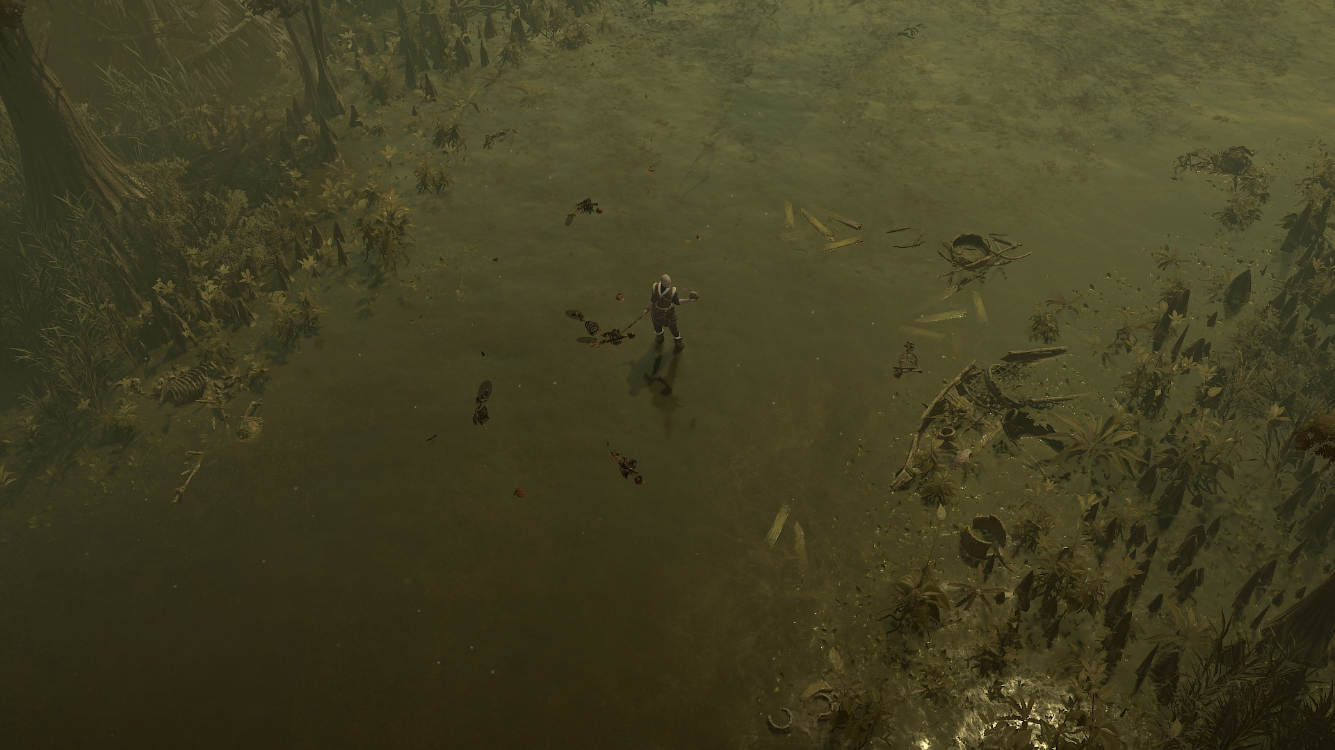
Notes:
One very good example of this is reflections. Diablo is a top down game, so the vast majority of visual contribution of reflections is going to come from the ground. However, reflections also represent a lot of visual noise and in the game without raytracing, were generally considered undesirable because of this extra noise. It was a gameplay decision to limit them.

Slide 72
Notes:
So the materials on the ground or other surfaces like water intentionally modify the reflectivity away from a physically-based value, which has a downstream effect on a feature like raytracing which would also use such a value to determine the overall contribution of a reflected ray result to the surface color. We chose to accept the added visual depth that reflections add to some ground materials because it's just look really, really good, but it does incorporate some of the same reflectivity and fresnel adjustments that art controls to tweak screenspace reflections.

Slide 73
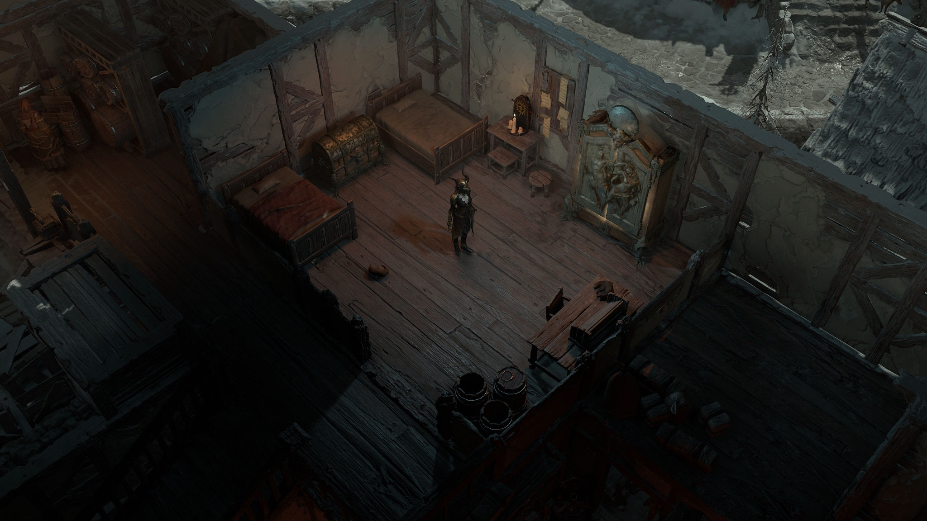
[image here of light leaking]
Notes:
And with shadows, an upside is that light leaking artifacts are fixed, which was one of Art's favorite aspects of the implementation. Here we can see a scene where there are several light leaks in the raster version of the game, which are fixed when raytracing is on.

Slide 74
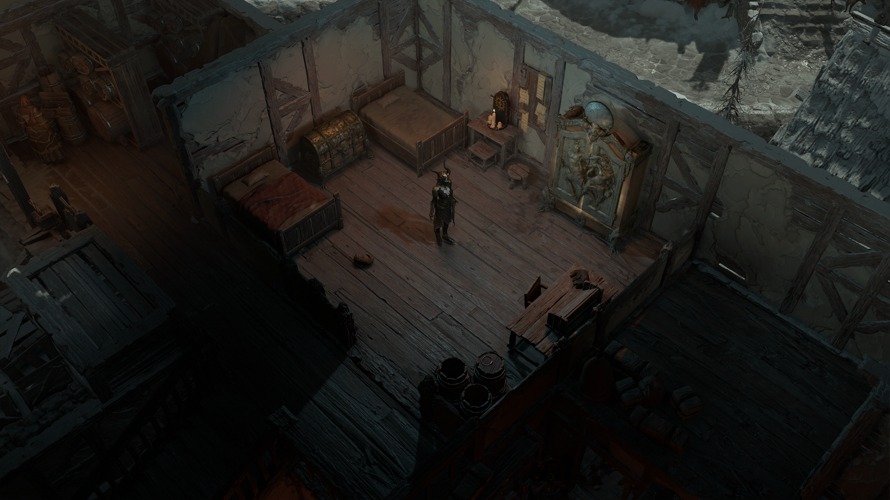
[image here of light leaking]
Notes:
And with shadows, an upside is that light leaking artifacts are fixed, which was one of Art's favorite aspects of the implementation. Here we can see a scene where there are several light leaks in the raster version of the game, which are fixed when raytracing is on.

Slide 75
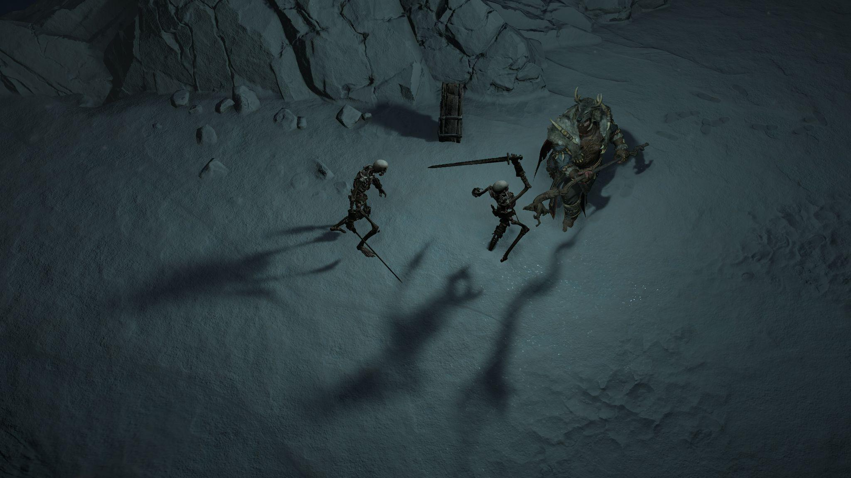
[image of changing shadow softness and shape]
Notes:
But changes to the shape and hardness of shadows are a departure from the look of the rastered game, and so a bit in opposition to the idea of keeping the overall look the same. Fortunately, Art did like the effect on the shadows so these differences were considered acceptable.

Slide 76
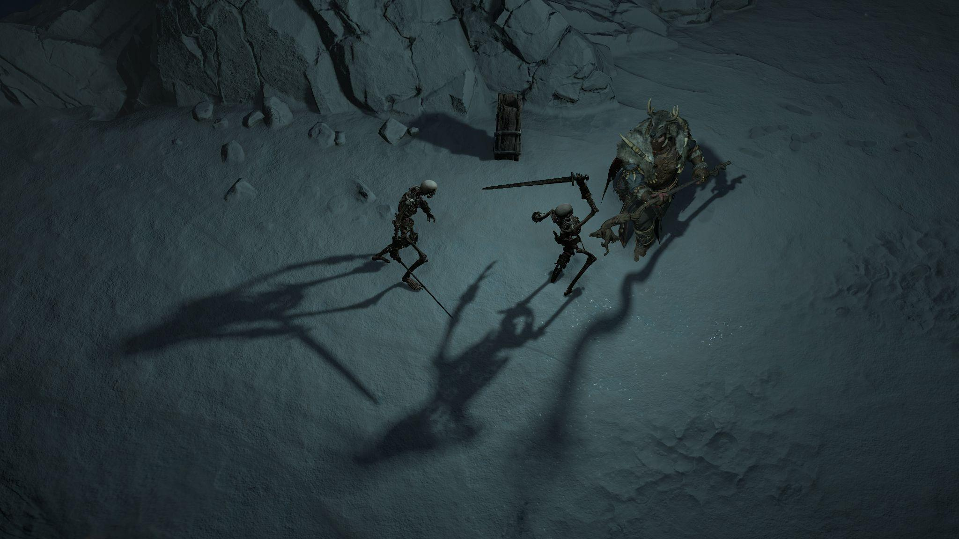
[image of changing shadow softness and shape]
Notes:
But changes to the shape and hardness of shadows are a departure from the look of the rastered game, and so a bit in opposition to the idea of keeping the overall look the same. Fortunately, Art did like the effect on the shadows so these differences were considered acceptable.

Slide 77
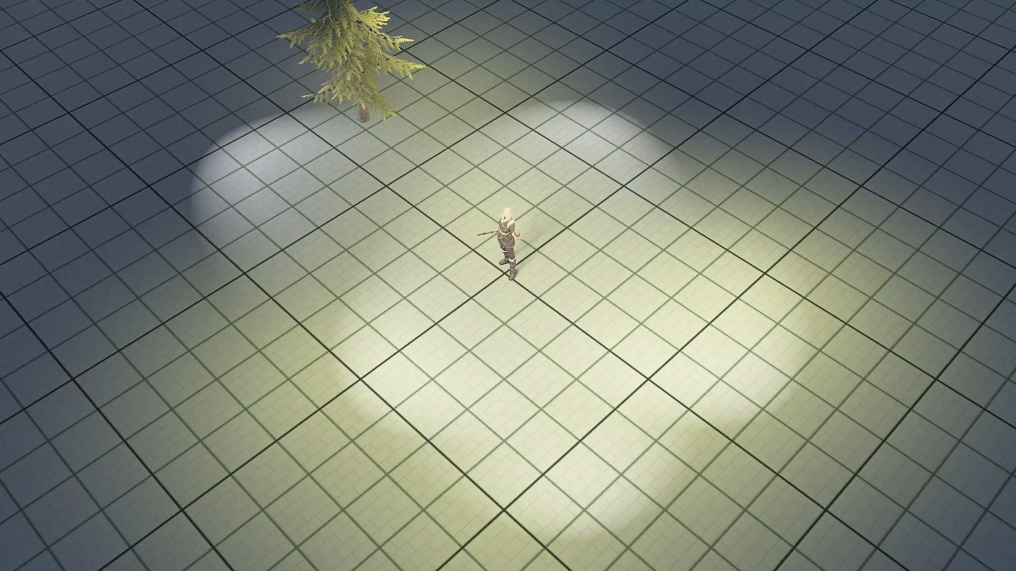
Notes:
And a final benefit afforded to us by raytracing has to do with the number of shadows overall that we can support. With raster shadows, we are limited by the number of shadow maps we can capture at any given time, or even cache away for use later. The game attempts to promote some lights to dynamic casters when it can, which depends on proximity as well as overall contribution to the frame. As a result of this, enough lights in one area can create some popping as seen in this video here.
Now, spotting these artifacts in real content is harder because our artists go through great efforts to avoid these scenarios, but they do happen sometimes.

Slide 78
[same content with raytracing on and no shadow popping]
Notes:
By raytracing every eligible light, we can get smooth continuous shadows while moving from under one light to the next, eliminating the popping.

Slide 79
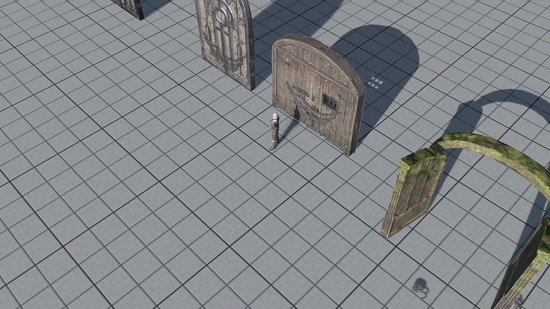
[video of VATs]
Notes:
Then, there are a lot of scenarios where content in the game simply can't be raytraced. We have two prominent examples of this: vertex animated textures and the player character.
Vertex animated textures bake simulations, usually from Houdini, into textures to be played back via a vertex shader. Since raytracing APIs do not offer a way to manipulate vertex positions as part of the pipeline (for obvious reasons), this means that the results of any vertex animation need to be precomputed and stored before being pushed as an update to a BVH. Indeed we did this for foliage, but after a lot of consideration on the potential impact to memory and time required to fully support them, VATs were considered out of scope and cost prohibitive.

Slide 80
[image of changing shadow softness and shape]
Notes:
For the player character, there is no problem including the character in raytraced directional shadows, but shadowing from the player light is more complicated. Artistic direction on the mechanics of the player light led us much earlier in development to a solution that "warps" the player shadow so it does not appear to be shadowed directly from above, but instead from in front. This warping is done - you guessed it - in a vertex shader.

Slide 81
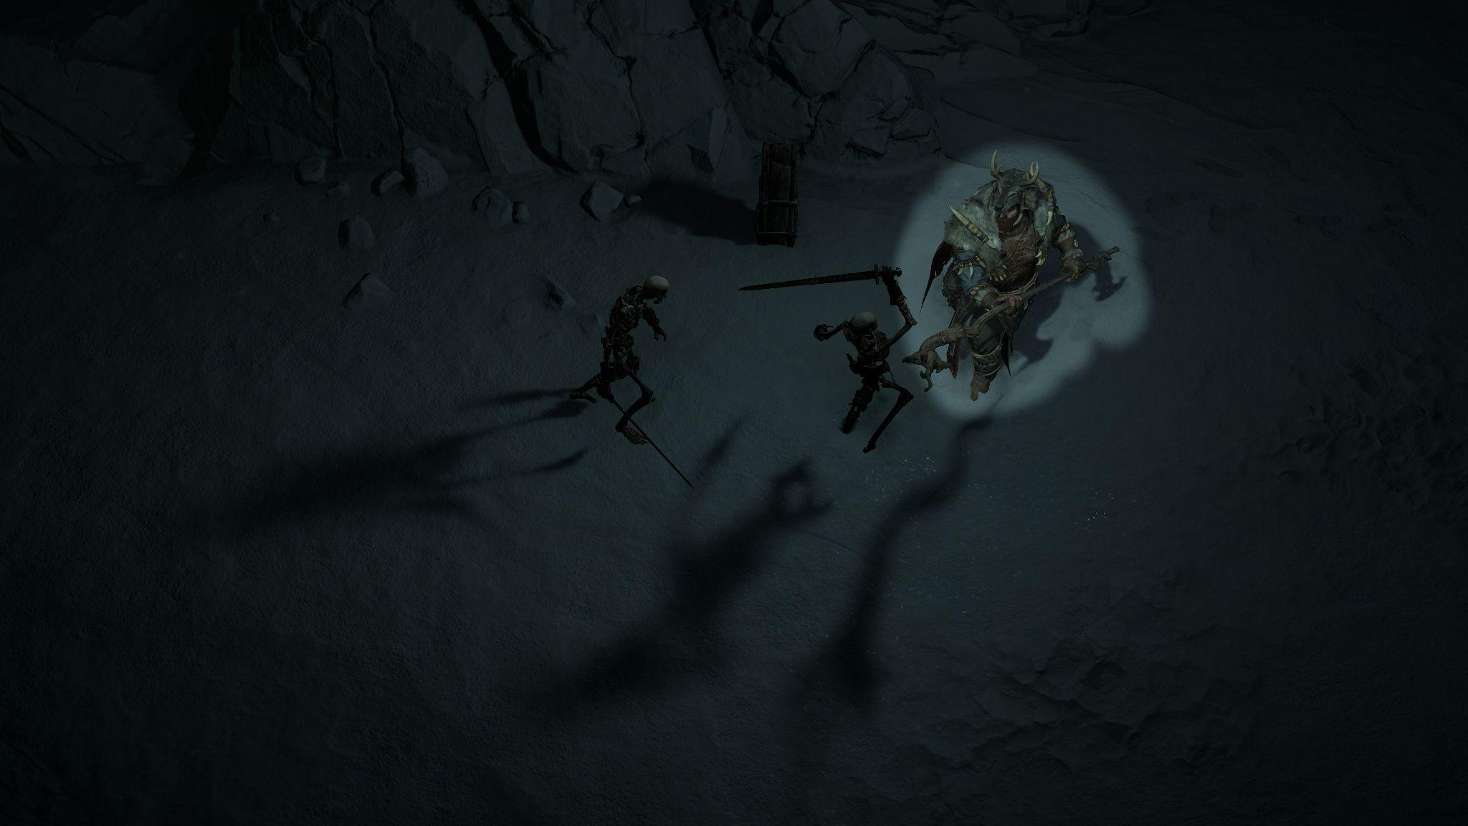
[image of the player in a dark area, highlight the player shadow]
Notes:
Pay close attention to the shadow of the player in the top right.

Slide 82
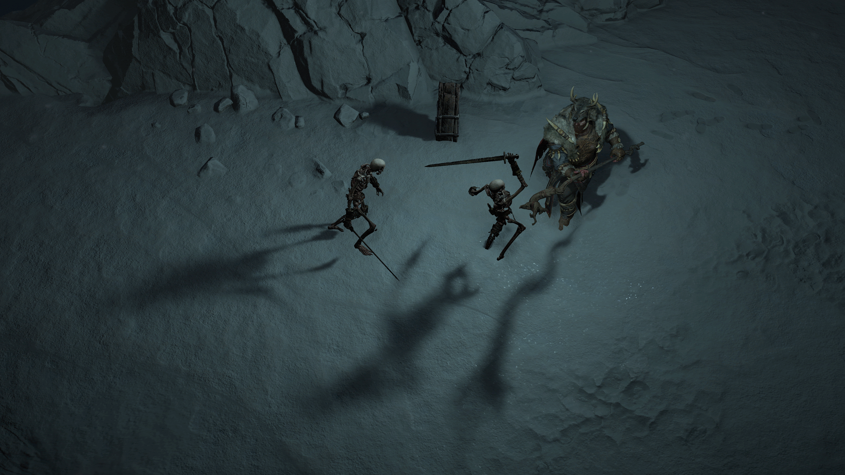
[gif comparing original player shadow to PCSS filter shadow]
Notes:
Instead of precomputing this result as we would need to, the character is simply excluded from the raytracing of the player light and a PCSS filter is used on the rasterized version of this shadow in order to fit it closer visually to the other raytraced shadows around it.

Slide 83
Renderable Types
 | Directional Shadows | Local Shadows | Reflections
Opaque Objects | ✔ | ✔ | ✔
Player | ✔ | ✖ | ✔
SpeedTree | ✔* | ✔* | ✔*
Particles | ✖ | ✖ | ✔
Decals | ✖ | ✖ | ✖
VAT | ✖ | ✖ | ✖
* Only on PC
Notes:
These exclusions meant we needed a robust system for deciding during scene gather whether an object should be included in a raytracing technique or whether it should fall back to rasterization techniques. The solution we came up with what we called hybrid rendering. It exists for shadows, but not so much for reflections. For reflections, the object simply doesn't appear in the reflected scene, and for the most part it's not as apparent.
At a high level, every renderable base type in the engine defines a series of functions which evaluate an instance of that type for inclusion in different raytracing techniques.

Slide 84
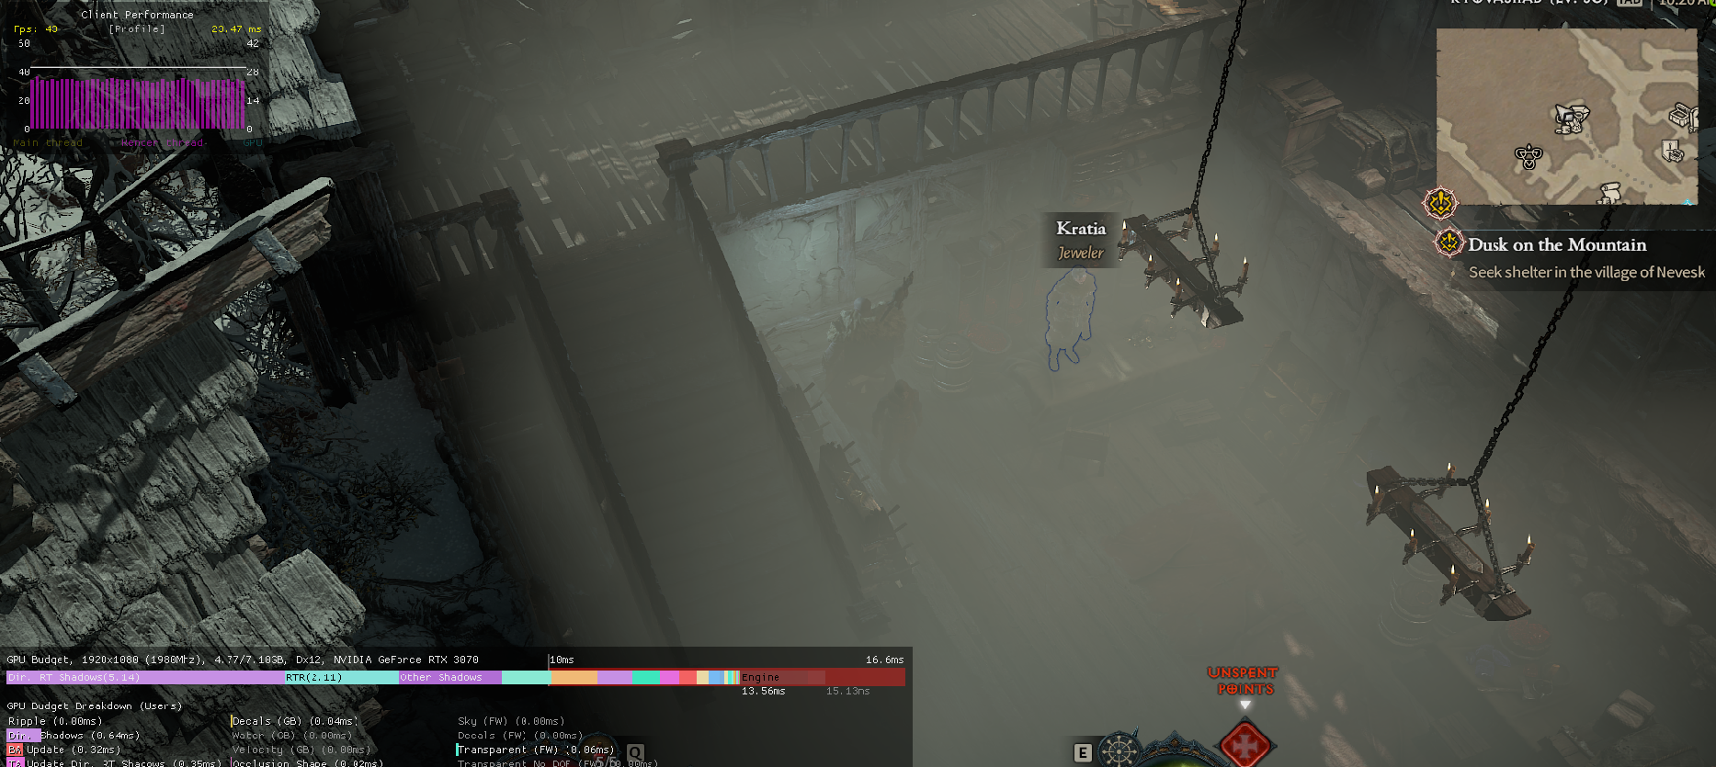
[image of volumetric fog appearing in interiors]
Notes:
Things get more complicated when we consider post process techniques like volumetric fog. Volumetric fog relies heavily on raster shadow results, particularly to determine interior vs. exterior spaces. If that information is not straight, you can get dense fogging in interiors, like this. The trouble here is that the roof of the building appearing in the directional shadow map is what helps the fog algorithm determine it's operating in an interior space. But since the roof can be raytraced, it no longer appears in that raster shadow map. And, with the raytrace shadow map being screenspace, it's ineligible to be used in the fog algorithm – it represents results, not obstructions.
One very obvious approach is "raytrace the fog, too." And, yes, this would work. But it was work we could not afford to invest in, given the complexities of the impact it would have on performance, like it would be required to run on top of even the lowest tier of raytraced shadows being turned on.
There are also techniques like light transmission which were only designed to work with raster shadow maps.

Slide 85
Hybrid Shadows
Require three maps
Ray traced shadow map (done in screen space)
Raster shadow map of non-raytraced objects
Raster shadow map of all objects
An object is considered hybrid if it can be raytraced.
An object is considered non-hybrid if it can only be rastered.
We're not going to consider cached shadow maps and static vs. dynamic objects.
Notes:
So we have this situation where most objects are eligible to have raytraced shadows, some objects are not, and some features still require complete raster shadow maps to function. To solve this, we had to create perhaps our most complex high-level system in our raytracing implementation, which we call hybrid shadows.
Our end goal here is to have three maps: the raytraced shadow map for a light, a shadow map of non-raytraced objects, and a shadow map of all objects.
To assemble these, we classify each object casting a shadow in the scene. An object is considered hybrid if it's included in raytraced shadows; that is, it is raytraced but will need to appear in a raster map, too. An object is considered non-hybrid if it is not raytraced and only appears in a raster shadow map.
I won't include details here like how cached static shadow maps and treatment of static vs. dynamic objects affect this system, as that would take up much more time.

Slide 86
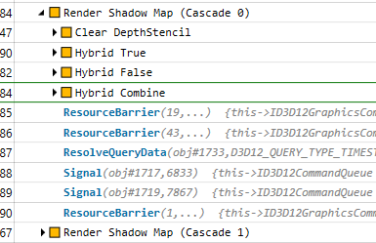
Hybrid Shadows
Hybrid
Non-hybrid
Combined
Notes:
After classifying objects, we raster both categories. First, hybrid objects into one map, then non-hybrid objects into a different map. Finally, both shadow maps are combined in a custom shader.

Slide 87
Hybrid Shadows
Ray traced light:
min(
,
) and
Non-hybrid
Combined
Non-ray traced light or Volumetrics:
Combined
Notes:
Later, during deferred lighting when we render a light, if it's raytraced, we can bind the raytraced shadow map, the raster shadow map of non-hybrid objects, and finally the combined shadow map. A traditional shadow sample is a min operation between the raytraced map and the non-hybrid raster map. For materials using light transmission, the combined shadow map can be sampled.
Likewise, for any non-raytraced light or for volumetrics, only the combined shadow map needs to be sampled.
It's true that overall this scheme requires all shadows to be rastered out as they were, with raytraced shadows being purely additive, but this was the cost of maintaining these existing rendering techniques, and can thus be seen as a cost to be absorbed when integrating raytracing into a rendering engine that wasn't originally designed for it.
Which... seems like a really nice segue into our conclusions.

Slide 88
Summing Up
Visual Impact
Areas for Improvement
Naive design is costly
But would that really change if designed for ray tracing?
Conceptual challenges permeate down to technology
Foundational work is costly
Notes:
So, summing up, clearly introducing ray tracing had a big impact on our technology and how we think about its future, but what about our players? I think it's important for us to take an honest look at the cost/benefit of the features from a player perspective. Yes, ray tracing eliminated many shadow artifacts and gave us an excellent visual boost in areas of the game with reflective surfaces, but in this engine it also has a relatively high cost and people don't always like that for what they might consider is a minimal visual gain. The things we look at as graphics programmers or artists tend to be more detailed, more nuanced, than what a player sees.
This tells me that there are perhaps better areas of application for the technology which can increase visual impact but in turn would require greater investment and further consideration of ray tracing in our artistic direction. The potential is out there, the next step isn't so much of a step as it is a leap forward into embracing it.
Technologically speaking, I think it's interesting how, as I hope I've demonstrated here, the conceptual idea of fitting ray tracing into a game not designed or art directed for it actually permeates down into the technology - as above, so below, in a manner of speaking. We find ourselves with architectural patterns that sometimes work against the shift in paradigms that ray tracing introduces.
And finally, the foundational work of ray tracing is not to be underestimated. Having a robust foundation is central to any successful technological effort, and this is no different. It can, will, and did take up a large bulk of the work. Once that foundation is in place, more opportunities open up to explore new applications and techniques that have greater impact on the game.

Slide 89
Thank You
Keven Cantin
Michael Bukowski
John Buckley
Samuel Delmont
Jon Lee
Zach Vinless
Alexander Demyanenko
Justin Williams
Fernando Urquijo
Ben Hutchings
Gustavo Samour Lopez
Charles Zhang
Zach Schecter
Joel Peters
Kevin Bell
Chad Layton
Lorenzo Di Spina
Alex Mueller
REAC Organizers
Notes:
I would like to take the opportunity to thank all of the many people who contributed in some way, large or small, to bringing ray tracing to Diablo IV as well as those who helped create this talk and gave feedback on it. And of course, a big thank you to the conference organizers – Michael, Natalya, Steven, Angelo, and Stephanie – for putting together another great iteration of REAC.

Slide 90
Questions?
Questions fielded by Keven Cantin - Thanks Keven!
@kevintodisco
Notes:
At this time, I will hand it over to Keven to answer any questions. Thank you so much for listening, ask away.

