Slide 1
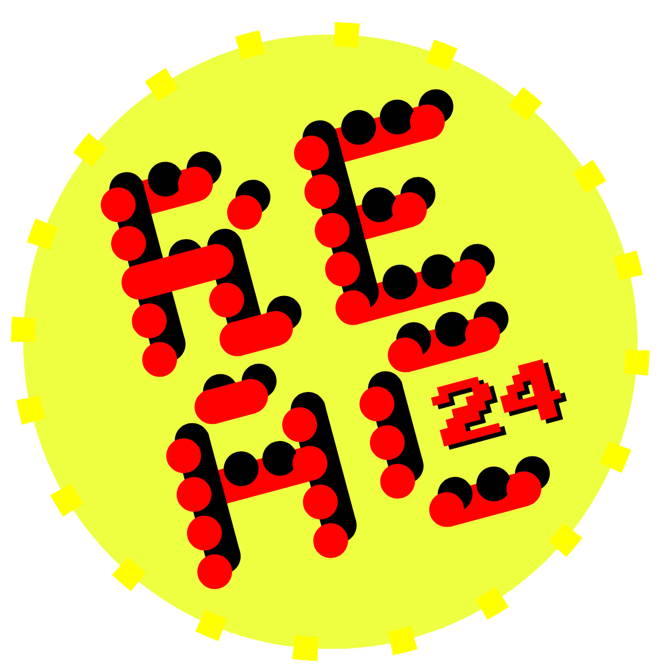
Optimizing the ui’S cpu bound framerate in call of duty
OPERATION ui code
SIMON ESCHBACH | SLEDGEHAMMER GAMES
Notes:
Hi, I’m Simon Eschbach from Sledgehammer Games Melbourne. Today I’m going to be talking to you about Optimizing the UIs CPU bound framerate in Call of Duty
Also known as……
[CLICK] Operation UI Code

Slide 2
Operation ui code
THE CALL TO ARMS
_
HELLO?
8:06
HEY IT’S DAN. WE’VE UH.. WE’VE GOT A PROBLEM.
Dan “Ghost” Nelson
WHAT IS IT?
CTO, Infinity Ward
IT’S THE UI. IT’S INFILTRATED OUR BORDERS.
ALRIGHT. I CAN HELP. BUT I’M GOING TO NEED A TEAM.
ASSEMBLE IT.
Notes:
NO SPEAKING ON THIS SLIDE

Slide 3
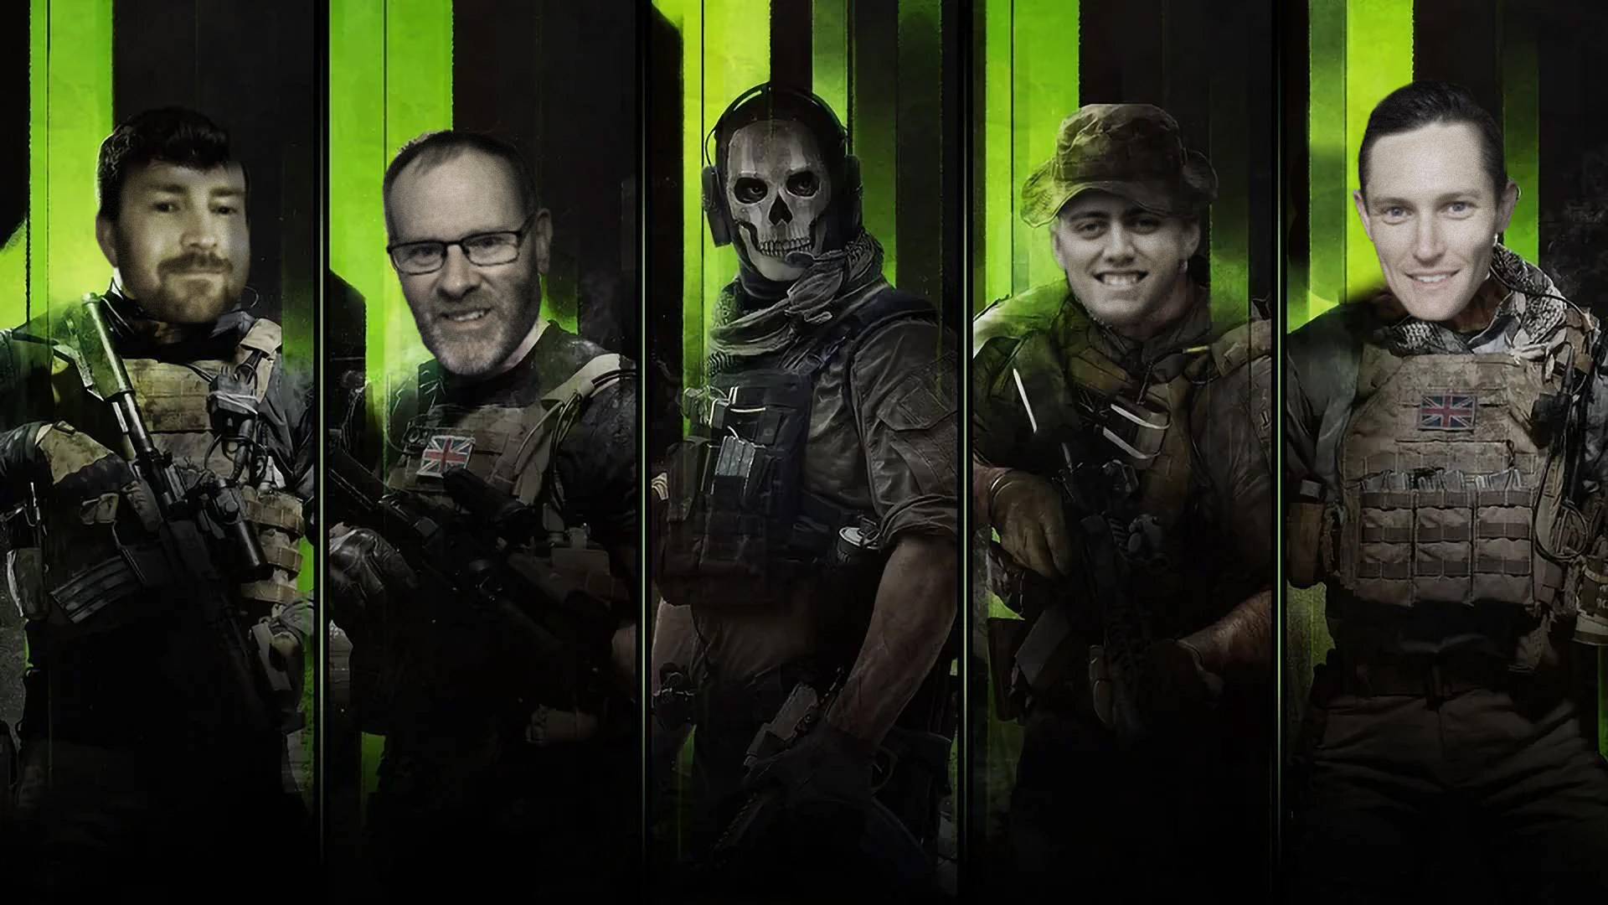
ALISTER HATT
STEPHEN WHITE
DAN NELSON
JARROD DOWSEY
SIMON ESCHBACH
Notes:
I must admit, making this sequence in PowerPoint was far more difficult than I could have anticipated.
[CLICK]
This image depicts ghost aiming down the sight of a sniper rifle.
This image also depicts what I imagine rendering and engine programmers look like when they start sifting through their engines user interface code.
[PAUSE]
I've made an entire career out taking that look under the covers of user interface systems and I can assure you.... I've seen some things...
Today I am going to tell you a story of how we had had one of those classic game development moments when you are working really really hard to get a game ready to ship, and you get a message – in this case from ghost – informing you that the game performance has atrophied to a point where the frame rate was no longer hitting its vital 60FPS target, and that the UI has a large part to play in that problem.
The mandate was simple. Assemble a team, and fix it. Quickly.
[CLICK]
And so it was done.
The UI Systems “Spec Ops” ensemble, also known as “task force 141”, was a specialist team armed with various profilers to obliterate poor CPU performance and take no hostages.
The team was assembled specifically for this one purpose – Operation UI Code – and it consisted of:
[CLICK] Alister Hatt
[CLICK] Stephen White
[CLICK] Jarrod Dowsey
[CLICK] Myself
[CLICK] and Dan Nelson, also known as Ghost.

Slide 4
PART 1: THE STATE OF AFFAIRS
Notes:
Part 1: The state of affairs.
--------------------------
The engineering of user interface systems is often one of the most overlooked parts of a game engine.
What’s worse is that these systems can be deceiving:
Time and time again I've seen UI systems written with the best of intentions - to empower design with powerful and flexible editors - often including a scripting language - that allows menus and gameplay to be quickly brought to life!
And the thing is... It works!
[PAUSE]
At least for the first release.
Herein lies the deceiving nature of it all.
- Over time complexity increases
- Features need to be quickly developed and iterated over
- Widgets start to get copied and pasted both along-side and inside of each other
- The UI scene hierarchy gets wider, deeper and more complicated
- The scripts bloat and spaghettify.
Before you know the system that used to empower designers with the ability to modify the UI with high quality and at high velocity becomes slow, bloated and brittle.
And performance wise? Well. That's what this talk is about.
This talk details my experiences shipping various Call of Duty titles.
As can often happen during the development of the games we make, the rush to reach feature completion can take precedence over optimization until the very tail end of development.
This is the story of that day I was called by ghost. He was right. We had a problem.

Slide 5
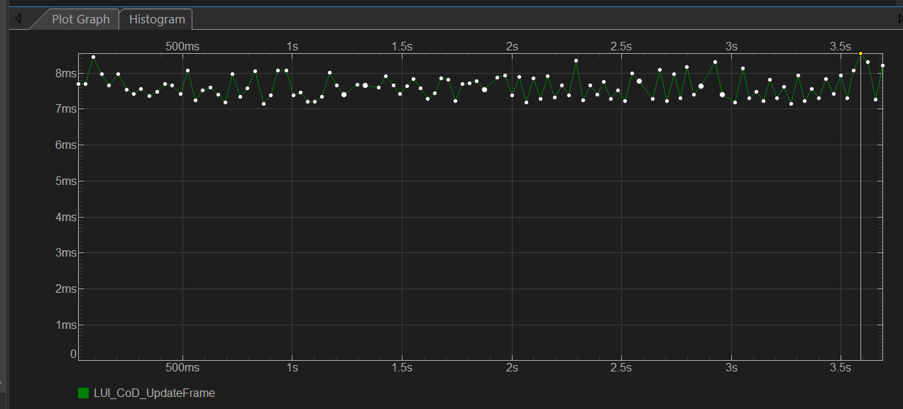
Sustained hud frame time
7-8.5ms
7-8.5ms
8.578ms
Main thread. Ground war, local capture, 25 bots (PS4 base).
Notes:
The UI was taking over half of our 16ms budget on gen 8 platforms.
We were heavily CPU bound and this was impacting our ability to keep the game running at 60FPS.
Hoping that I perhaps took a bad profile, I took a look at the
[CLICK]
profile histogram to make sure this wasn’t an intermittent frame spike due to some kind of processing.
As you can see from the histogram, this wasn’t the case. The UI was consistently taking this long to process.
------------------------
This capture wasn’t even a particularly complex use case. It was nothing more than a local capture with a few bots!
Original profiles showed our more complex game modes chewing as much as 12ms in playtests!
This was not good.

Slide 6
How could we spend so much time
RENDERING QUADS?
Notes:
[PAUSE]
8 milliseconds….
[CLICK]
HOW COULD WE SPEND SO MUCH TIME
[SHORT PAUSE]
[CLICK]
RENDERING QUADS?

Slide 7
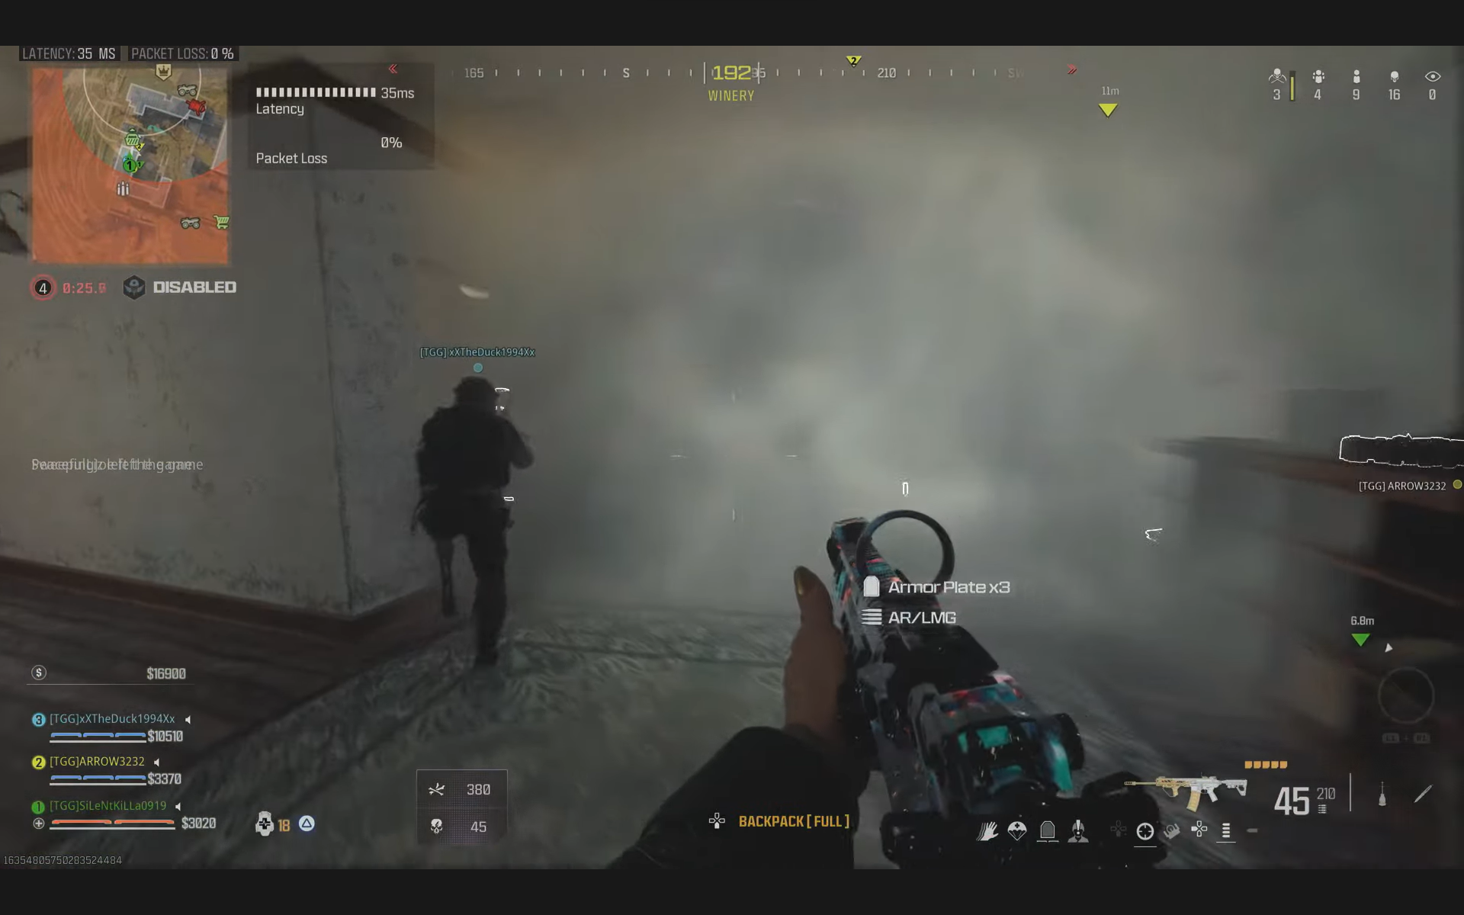
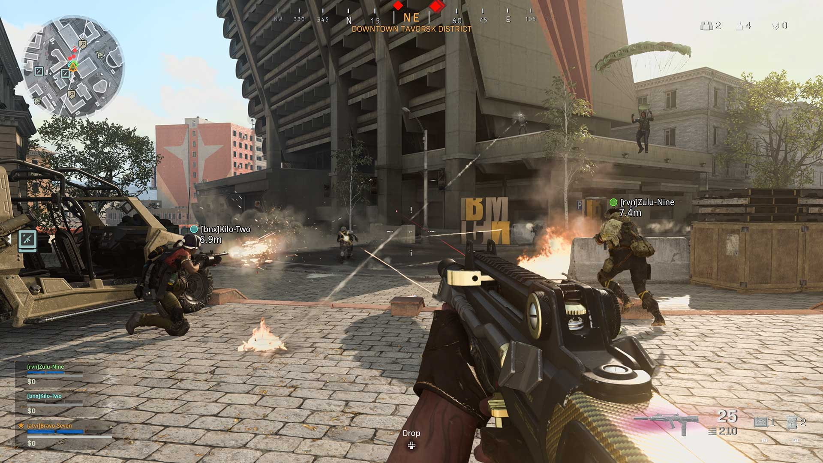
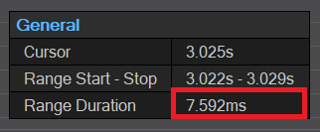
THREAD CONTENTION
DATA BINDING
CALLBACKS
RENDER
DATA BINDING
EVENT PROCESSING
LAYOUT
DRAW LIST GENERATION
ANIMATION
(TWEENS)
Notes:
Here is a typical Call of Duty gameplay HUD.
[CLICK] And this is what the Uis CPU frame step looks like on Call of Duty to get those quads ready to render:
[CLICK] It starts by ticking its tweens,
[CLICK] then it binds data from the game,
[CLICK] after this the Lua runs callbacks on any modified data that requires pre-processing before display.
[CLICK] Input and other events are then processed.
[CLICK] We then perform the layout step where layout logic is applied.
[CLICK] The draw list is then built based on the results of this layout step.
[CLICK] In this capture we have some thread contention which was since fixed
[CLICK] and after that the quads are finally sent to the GPU for render.
---------------
A few things to note regarding an optimization strategy for this:
- Our UI frame step is monolithic and runs on the main thread. As such, it is a prime contender to block the critical path to render.
- The dependency chain of our process leads to limited options for parallelization.
- And as our UI is highly dependent on displaying up to date data from virtually all other game systems, it needs to run at the end of the frame step.
- Moving this monolith onto a worker thread gains no real benefit as it simply creates main thread contention as it sits and waits for the UI processing on the worker to finish.
- Running one frame behind so we could process the UI in parallel at the start of the next frame to avoid such contention simply isn’t an option.
This is Call of Duty. Our players can tell if we show the enemy nameplates one frame late – if we delayed the entire UI a frame and desynced the HUD elements by a frame from world space … I can say with a high degree of certainty that all hell would break loose.
[CLICK]
This was just a long way of me saying: We investigated our options.
There was nothing we could change outside of the process itself to stop this from blocking the critical path to render.
------------------------
I always like to boil a UI down to this:
How many quads is the UI rendering to the screen in any given frame?
How many of those quads actually changed state in the last frame?
Thinking about it this way, the HUD should theoretically be computed in nothing more than say…. A millisecond? Provided we pushed our data efficiently of course.
Unfortunately, years of scripting has paved the way to high levels of complexity.
It’s important to remember that this game has 20 years of iterations under tight deadlines and has bounced between a lot of studios and even more engineers in that time.
This is what has paved the way for the complexity we need to detangle today.

Slide 8
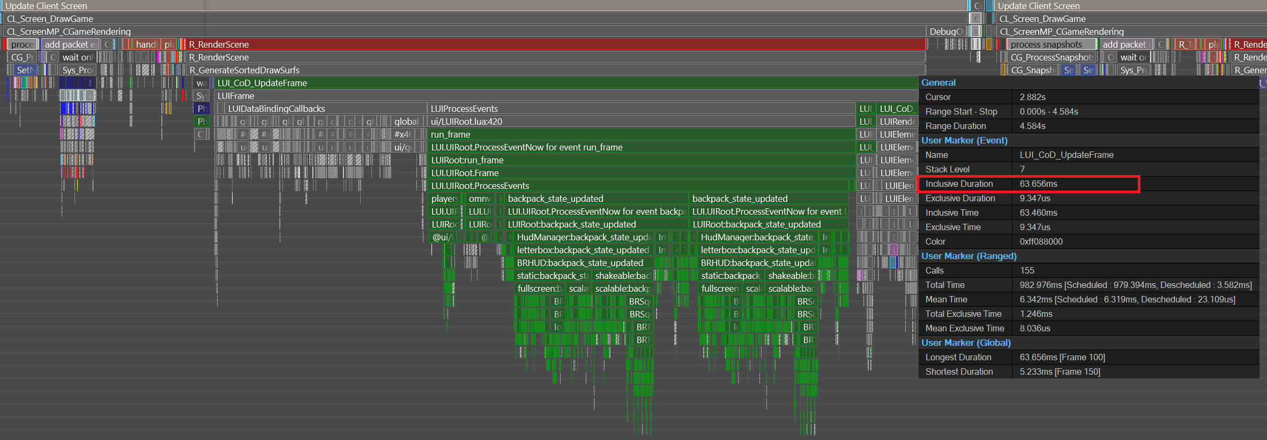
Spike frames
63.656ms
5 frames dropped when a Party member dies.
Notes:
So far, I’ve spoken of the sustained frame time. But now I want to take a moment to talk about spike frames.
Spike frames in the context of this presentation are defined as being long enough in duration to cause the game to visibly stutter - or drop frames.
In this example as we are taking far longer than our 16ms target to render a frame, we end up showing the same frame 5 times in a row as we wait for the CPU to finish its work.
Not ideal.

Slide 9
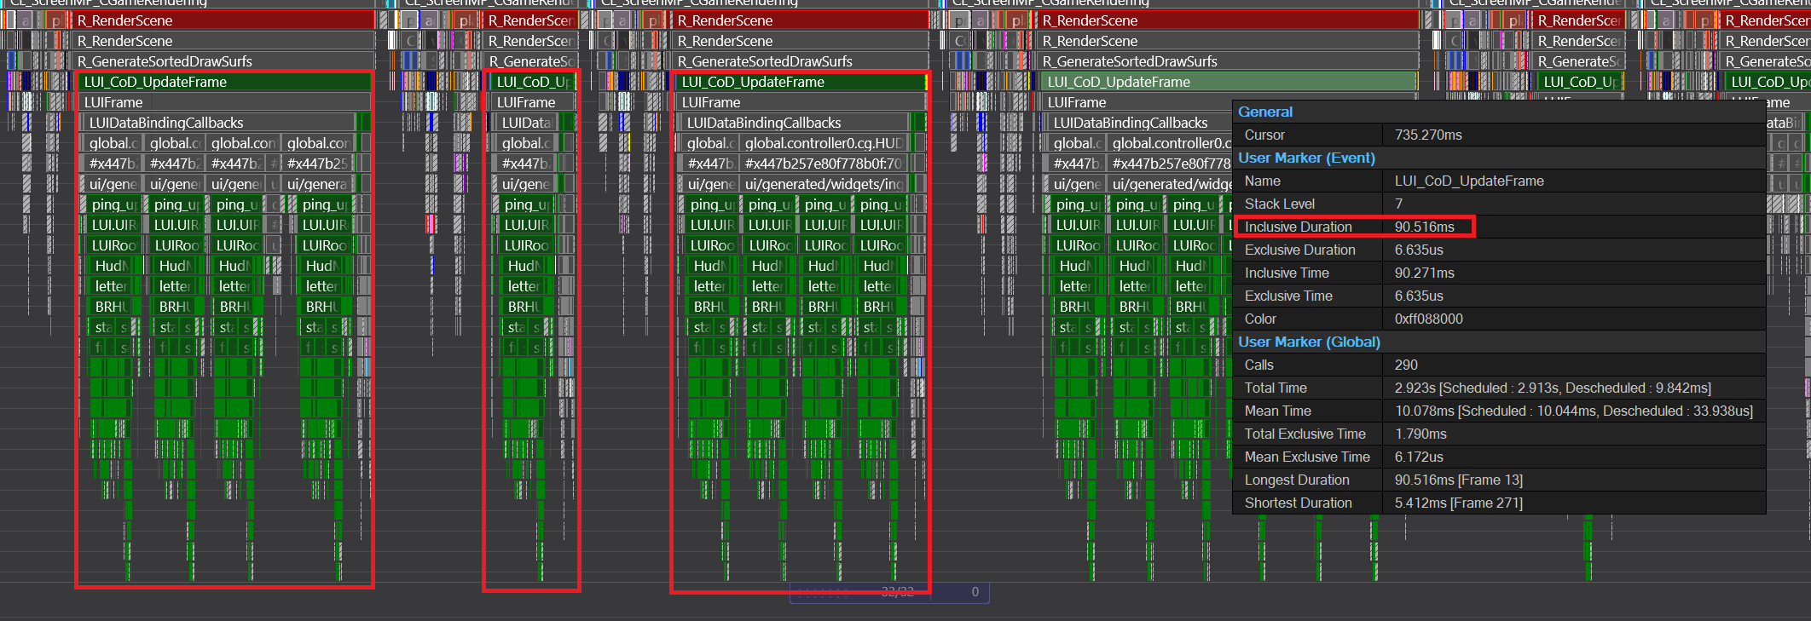
Spike frames in succession
90ms
6 frames dropped over multiple frames in succession when pinging
Notes:
While performing further reconnaissance I found significant frame instability by spikes being caused by all kinds of different things, for all kinds of different reasons.
Here is an example with a 90ms spike occurring multiple frames in a row.
The player experience of this example is a persistent stuttering feeling when frames are dropped multiple times in succession.

Slide 10
Dropped frames
Make US sad
Notes:
Freezing, stuttering, chugging – it doesn’t matter what you call it.
In an FPS the player experience is severely compromised by dropped frames.
[PAUSE]
[CLICK]
And they make us sad!
Well… [PAUSE]
I know they make me sad.
When I play a game, I expect it to be PERFECTLY SMOOTH at 60 FPS as a minimum.
I don’t want to see a single stutter. Not a single dropped frame.
Even when using a smart phone, I notice every little bit of lag. The iPhone keyboard lags sometimes. I want to profile it so badly.
But this is more important than texting my Mum.
This is Call of Duty – and in this game dropped frames can be the difference between getting a kill, or being one.

Slide 11
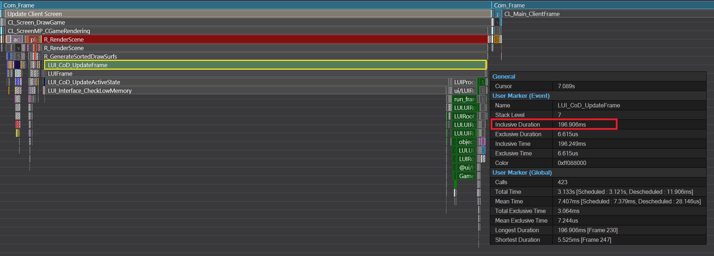
Stall frames
196.906ms
12 frames dropped when objectives update in warzone
Notes:
For the purposes of Operation UI Code, I defined stutters one step further.
Stall frames.
Stalls are perceived as more than a stutter – they’re a flat-out freeze in the gameplay.
In our UI system these were often caused by Lua performing emergency garbage collection because of the VM running out of memory.
When we had these emergency garbage collections cycles in succession, we experienced stalls in the realm of 500ms up to an entire second.
Such a problem was exhibiting itself frequently during gameplay and destroying the player experience.

Slide 12
Notes:
Here is one such example.
Albeit this was a worst-case example, this is what we were dealing with on the PS4 right up until the wire.
This example will stand out in my mind for a long time for reasons I will explain later in this presentation.
Once performance has degraded to this point, the game is virtually unplayable.

Slide 13
Hard stalls
Dangerous for televisions
Notes:
Hard stalls.
These are what can really make players rage.
They might get you killed right towards the pointy end of a game; they are dangerous for both your kill-death ratio,
[CLICK]
And for televisions.
[PAUSE]

Slide 14
PART 2: THE OFFENSIVE
Notes:
Part 2: The Offensive
The enemy infiltration was strategic.
We were attacked at a very inopportune time, right when our defences were weakest, right before we shipped.
This is why the 141 was called in.

Slide 15
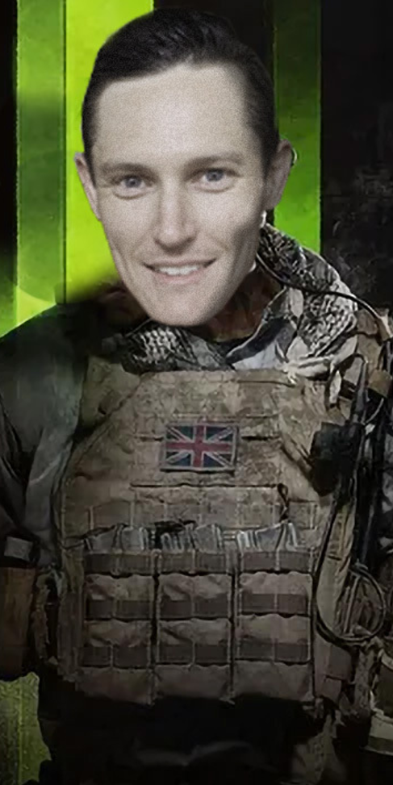
Cpu performance definitions
SUSTAINED FRAMES:
< 10ms
SPIKE FRAMES:
10-100ms
STALL FRAMES:
> 100ms
Notes:
I’m going to be honest with you – in the context of where our UI system had gotten - trying to fix the frame rate in time for launch was an absolute scramble.
But there were some mechanisms that we could employ in the short term to at least organise ourselves and classify the problems.
We also had 4 of us, so we could afford to split our efforts into different locations.
Let’s define some basics based on where the initial numbers were at.
[CLICK]
Sustained frames were considered anything under 10ms.
[CLICK]
Spike frames were considered from 10 to 100ms in duration
[CLICK]
Stall frames were anything longer than 100ms.
Separating our frames into these categories helped us to classify the likelihood of where problems lay, which by extension allowed us to group and triage the types of problems between us.
[CLICK]
When it came to the sustained frame time, this was where Stephen and I lived. Sustained frame time tends to be addressed through systemic fixes as it’s the system that is either being inefficient or simply malfunctioning on a persistent basis.
[CLICK]
When it came to the spike frames, this is where Alister and Jarrod mostly worked. Spikes tend to be best addressed in a longest-spike-first triage process which then leads the way to understanding different classes of spikes within each subsystem.
[CLICK]
Stall frames like the one in the video I showed you were solved by a team effort I’ll explain later in this presentation.

Slide 16
OPTIMIZING IN A PINCH
BETTER SUITED TO SUSTAINED FRAMES (<10ms)
BETTER SUITED TO SPIKES AND STALLS (>10ms)
UI SYSTEM ANALYSIS
ELEMENT INVALIDATION
QUAD CACHING
ELEMENT TRAVERSAL
HOT CODE PATH OPTIMIZATION
GARBAGE COLLECTION TUNING
LAZY INITIALIZATION
STAGGERED PROCESSING
ALGORITHMIC COMPLEXITY REDUCTION
DATA CACHING (MEMORY TRADEOFF)
DIRECT EVENT DISPATCHING
FONT CACHE PRIMING
HAND OPTIMIZATION
Notes:
We had to work fast. Given the stakes all optimization types were on the table. This was a matter of fix it, ship it.
After having spent many years optimising the CPU I’ve found certain classes of optimizations to be useful in particular situations. While these classifications are not hard and fast rules and each optimization type helps both sides of the fence, they did help us to work down the CPU cost pretty quickly.
[CLICK] Sustained frame time tends to be improved with analysis of the core C++ systems
[CLICK] This means investigating the validity of element invalidations
[CLICK] Ensuring our caching mechanisms are working properly
[CLICK] and doing what can be done to avoid costly element tree traversal.
By the way, when I say cache, I mean cash – this is just how we butcher words in Australia
[CLICK] Optimizing hot code paths are a contender for sustained frame time improvements for obvious reasons – big bang for buck there
[CLICK] While I’d never personally recommend using a memory managed language for a real-time application, here we are, and in our case tuning the garbage collector to step consistently and reliably was an important consideration
[CLICK] Lazy initialisation can often be used to avoid processing of objects or data which are not used. Alister Hatt found that about 50% of data bindings were unused due to the amount of data that was game mode specific at runtime.
[CLICK] staggered processing of some systems over multiple frames was also employed to get the game out the door, although I don’t recommend this approach for the long term and while using it is normally indicative of a larger architectural problem – it can cut processing into a half or a third depending on how many frames you space it out over. But I will say, it does tend to cause edge cases and artefacts down the line, but hey – in a pinch – you gotta do what you gotta do.
When it comes to the frame spikes:
[CLICK] algorithm complexity reduction is the first port of call. Unscalable algorithms love to spike frames and as data grows it obviously gets disproportionately worse depending on the order of complexity being dealt with
[CLICK] caching data can be an effective access pattern for costly calculations but this is a double-edged sword as it trades memory for CPU performance. Over time the caches grow to problematic sizes which are a feeling now – but – we have got to give them credit – they helped us in this pinch.
[CLICK] Stephen Crowe created a way to avoid large event broadcasting spikes with a system that provided a direct mechanism for event communication
[CLICK] Stephen White avoided font cache misses by writing diagnostic tools to better prime the font cache.
[CLICK] Finally, hand optimization of scripts is the time consuming and difficult task of addressing spikes in script on a case-by-case basis. Looking at what the code is doing and figuring out how to do it faster. Huge shout out to Jorge Morales as an expert in this.
Of course, there are many other ways to optimize code, but these were the main weapons in our arsenal on this project and in this short timeline.

Slide 17
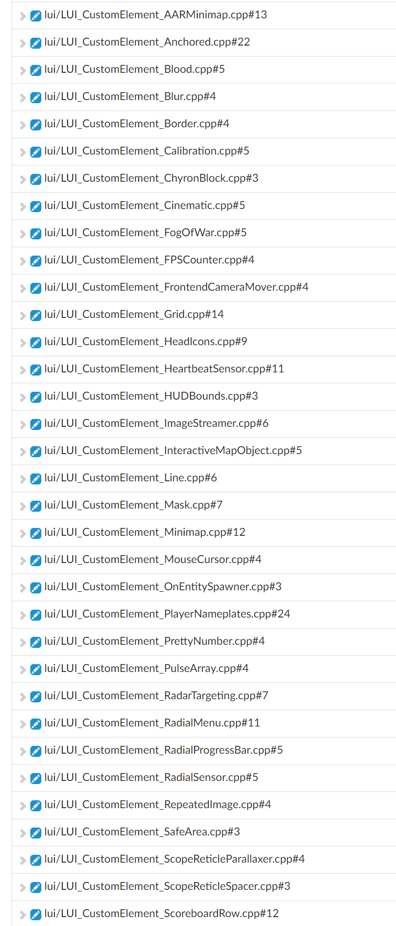
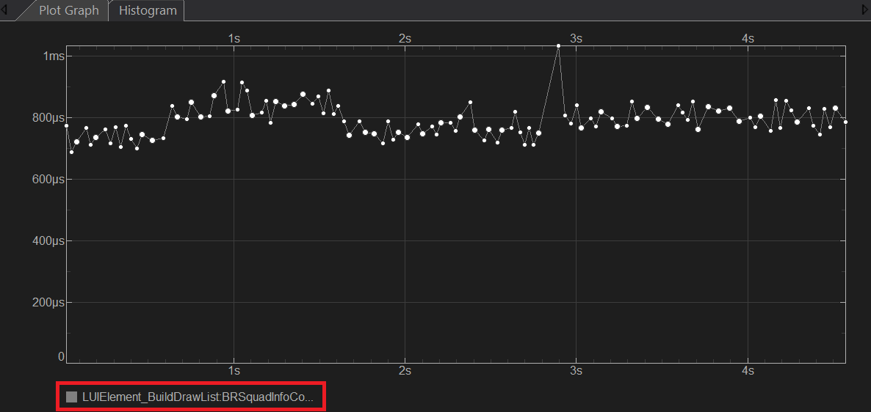
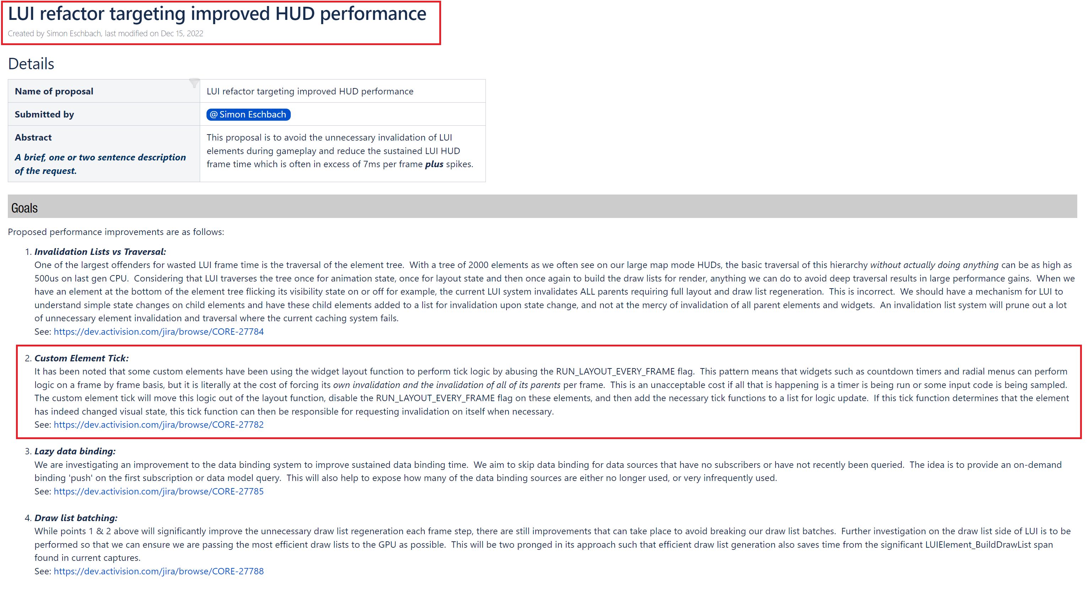
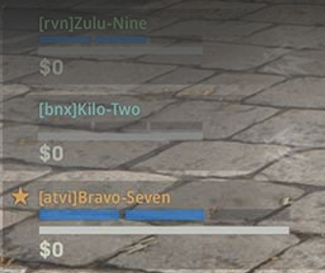
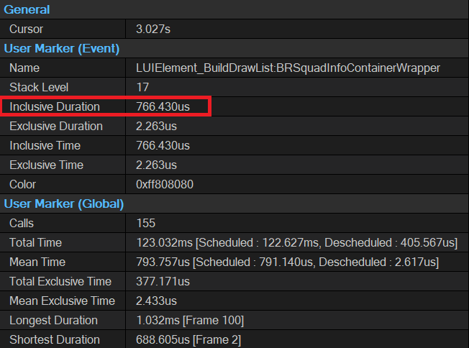
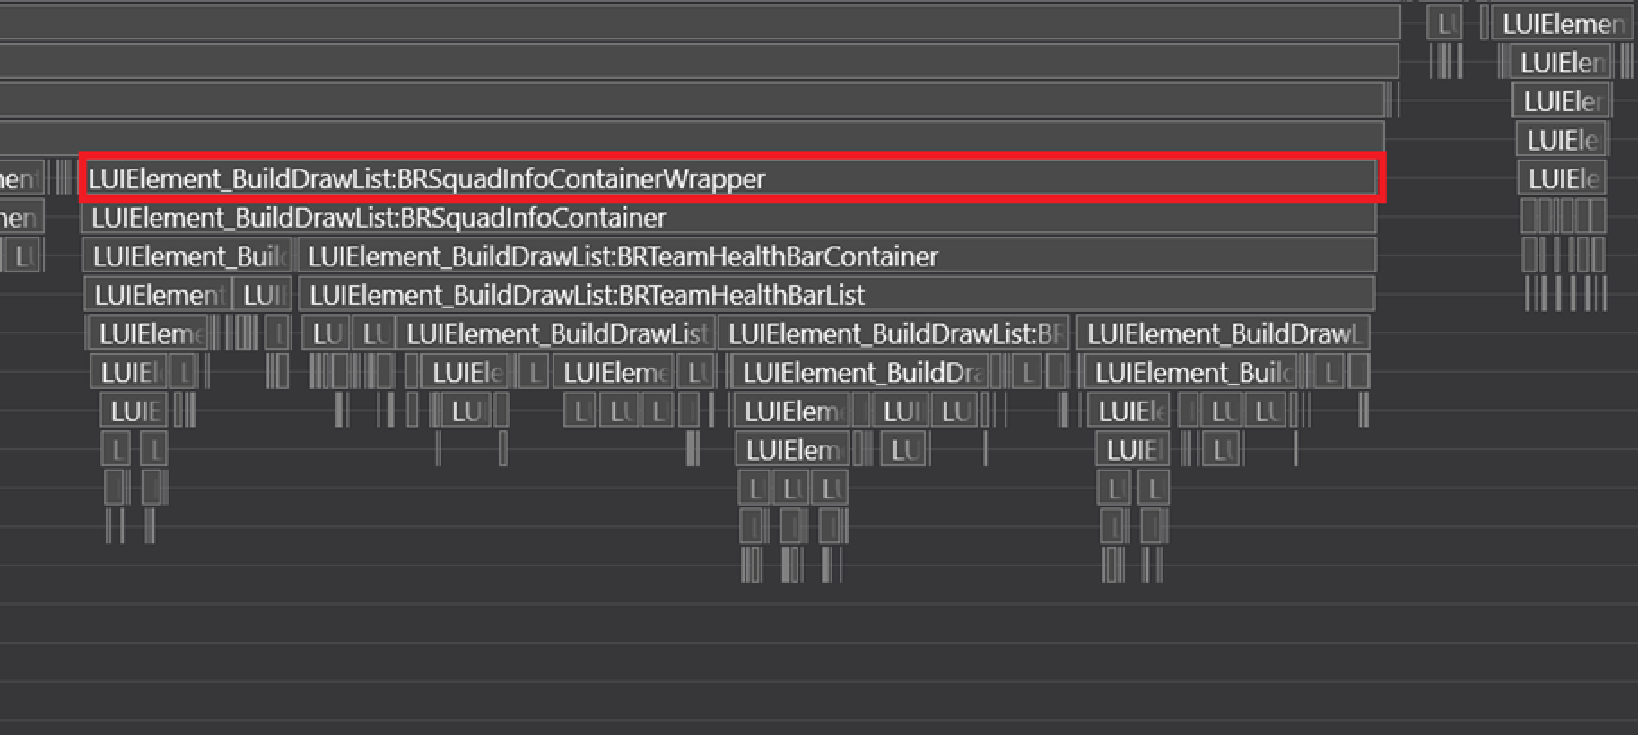
ui System ANALYSIS
40%
>20x
766us
Notes:
To illustrate an example of sustained frame optimization using UI system analysis, we turned our heads to
[CLICK]
this costly little squad status element that kept chewing huge CPU time even when nothing was updating.
[CLICK]
As you can see it was chewing a whopping 766us sitting in the corner of the screen doing seemingly nothing.
[CLICK]
The histogram showed that this element was a sustained frame problem and not a spike frame.
[CLICK]
Through some deeper digging we discovered it was continuously redrawing itself due to a bitflag that was enabled called RUN_LAYOUT_EVERY_FRAME. This sounded suspect to say the least.
After digging through the C++ and Perforce history it became apparent to us that this flag was added so that widgets could treat the layout function as a sort of element tick to run logic.
This was a bad idea as by tying an widgets logic tick to its layout process, the element needs to constantly runs its layout code to ensure the update code runs, thus invalidating its quad caches redrawing itself every frame. So elements with this flag enabled would redraw themselves every frame even when nothing was changing, or even if the element was invisible.
This flag was a hack to begin with, but it caused another problem by extension.
[CLICK]
Since the UI is hierarchical by nature, if a child element invalidates, it causes all of its parents to invalidate too.
Tracing these issues backwards, RUN_LAYOUT_EVERY_FRAME was introduced many years ago as a solution for updating countdown timer text in C++.
In this case the entire squad element was constantly redrawing itself because it had squad revive timers ticking away. Even when no squad member was down.
Over the years this flag was then copied and pasted
[CLICK]
FORTY times.
These elements were then proliferated using the design tool, and after a number of years half of the UI was redrawing itself every frame with no caching.
[CLICK]
Including the grid which meant the entire frontend would constantly invalidate.
There was no time to fix this properly for launch so we clawed some time back by removing the revive timers from the element hierarchy when they were not visible. This alone saved several hundred microseconds but didn’t fix the root of the problem.
[CLICK]
But from these learnings we added this to the following years roadmap.
[CLICK]
Stephen White worked tirelessly to made an impressive change when he corrected this and separated the layout logic from the tick logic. The result was a 40% reduction in gameplay layout and draw list duration, and a greater than 20x improvement in the front end since virtually everything existed inside of a grid.
This process of discovery, followed by a ship hack fix, followed by a roadmap to a proper solution became a standard workflow for my team. I mean taskforce 141.

Slide 18
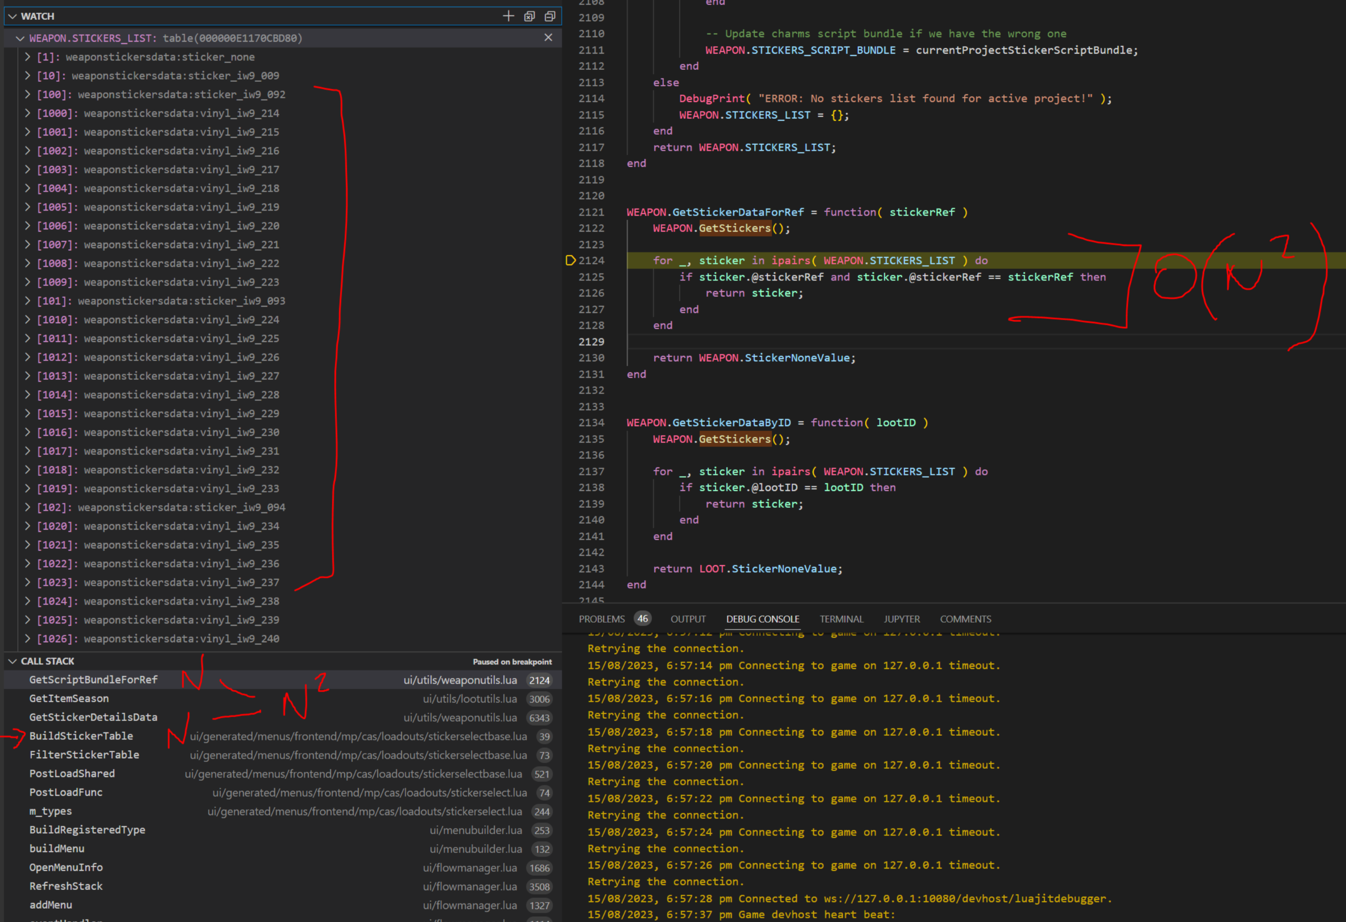
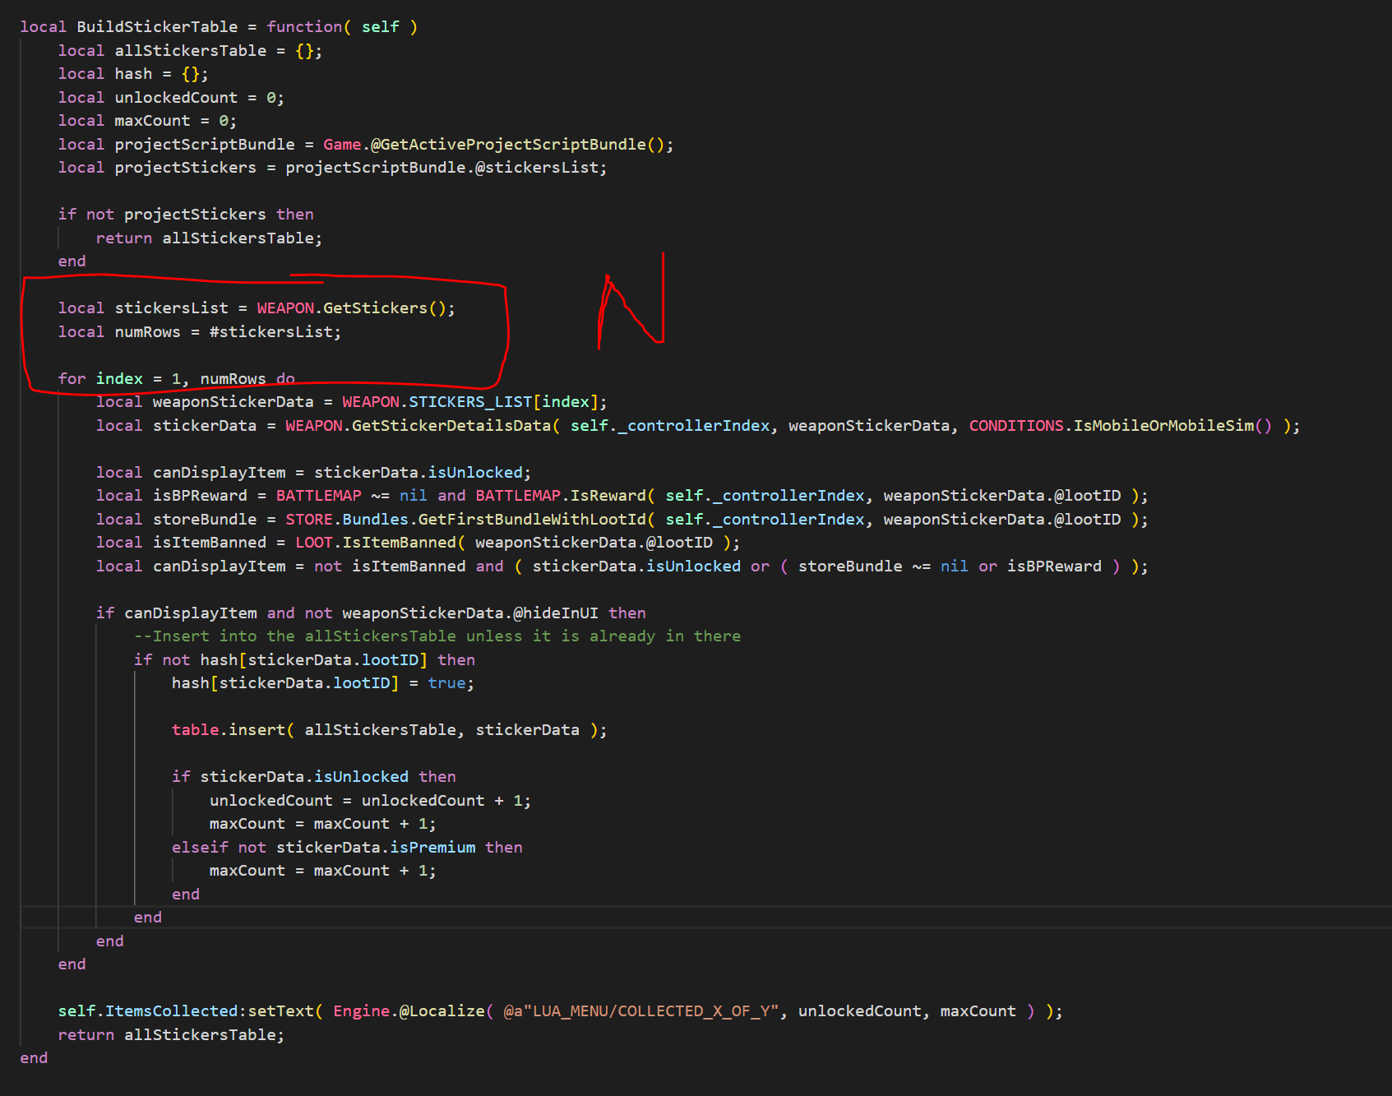
ALGORITHM COMPLEXITY REDUCTION
Weapon.GetStickers()
2 million iterations (20s)
SQRT( 2,000,000 ) = ~1414
2000 stickers = 4 million iterations (28s)
3000 stickers = 9 million iterations (63s)
OPTION 1: 200ms
OPTION 2: 500ms
OPTION 3: 1 second
20 SECONDS
Weapon.GetStickers()
2 million iterations
Notes:
To illustrate an example of stall frame optimization using algorithm complexity analysis, I can point to the simple and classic O(n^2) example. While there are many more interesting examples of complexity reduction, this one is a good one to demonstrate my point.
[CLICK].
Have a think about how long you think a stall that continuously trips the garbage collector could possibly take. I’m going to present 3 options for you think about:
[CLICK][CLICK]
Option 1: 200ms
[CLICK]
Option 2: 500ms (or half a second)
[CLICK]
Option 3: 1 entire second
[What was the largest response?]
I’m just trying to keep you on your toes. The answer was none of those.
[CLICK]
The stall was TWENTY seconds long. The game would literally freeze for 20 seconds and then come back to life.
You’d invariably come back to life too, because there was a 99% chance you were killed by an enemy while that happened.
While a lot of this stall was incessant looping, the real issue was that the memory would continuously run out during this process as the GC could not keep up with the allocations, thus leading the way to lengthy garbage collection cycles, so the game would essentially stall indefinitely.
While I’ve since stopped the GC from having the capability to take control of the machine like this, it was pretty disruptive to the player experience to say the least.
[CLICK]
So essentially what is happening here is that we are looping though all of the
[CLICK]
stickers.
[PAUSE]
[CLICK]
Then we were going two functions deep
[CLICK]
[CLICK]
and then looping through all of the
[CLICK]
stickers again.
Of course, with an O(n^2) algorithm it doesn’t take much data for things to get out of control.
[CLICK]
[CLICK]
So how many stickers do there need to be for 2 million iterations at O(n^2)?
Square root of 2 million?
[CLICK]
In this case, there were only 1414 stickers.
Now imagine what happens to that stall as the live season progresses and even more stickers are added.
[CLICK]
Add just shy of 600 stickers and we end up with 4 million iterations – or 28 seconds
[CLICK]
Add 1000 on top of that and we end up with 9 million iterations, which takes us to a stall spanning over an entire minute.
---------------------
Getting back to the code at hand - while it’s easy to visually pick out a nested for loop in the same function, when the loops cross file boundaries like this algorithm complexity can be harder to statically identify and even more difficult to pick up in code reviews.
In this case we had a nested loop achieving O(n^2) complexity across files.
While making proper use hash maps inside the inner loop took us from O(n^2) to O(n) and corrected other calling code from falling victim to this inefficiency, O(n) is still often not good enough if you really want to scale.
Irrespective of patching this particular example, everything I am saying right now is just a temporary fix. Going through spaghetti to reduce algorithm complexity is futile. You need to stop writing the spaghetti in the first place.
In addition to this, we shouldn’t be iterating entire lists of content at runtime in the first place. For example, data should be precomputed where possible, paged where possible, and otherwise be logarithmic where possible.

Slide 19
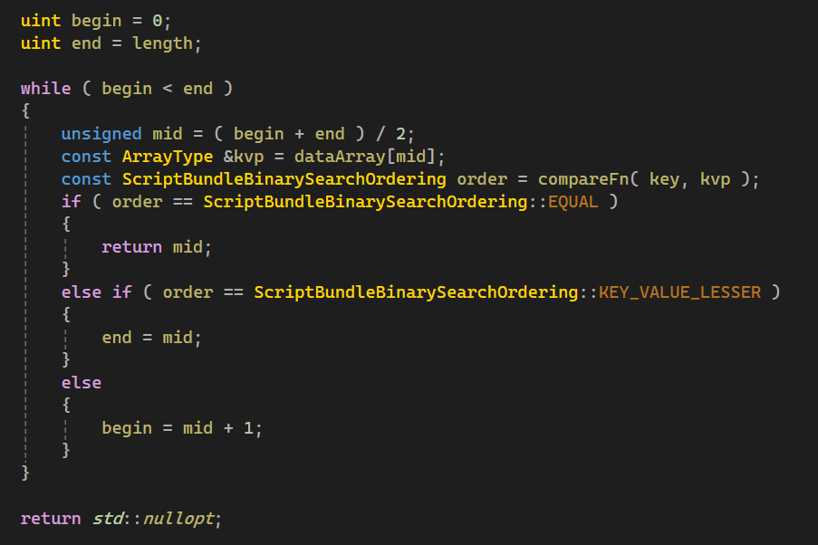
EFFICIENT RUNTIME DATA QUERYING
Lua O(n) iteration:
C++ O(log n) query:
Notes:
The two main issues I take with the prior example are the following:
Garbage collection being used in a real-time application
Runtime data processing and a distinct lack of language features or API for efficiently querying data
Let me start with the data:
Lua and for loops. Loops in loops. Loops in loops with if statements in them.
[CLICK]
No.
If this is what needs to happen in order for programmers and designers to get their work done, we have failed to provide a suitable platform for the development of a real time application.
We have failed to provide our engineers with the tools necessary to do their job.
They are doing earth works with a shovel. And they are working so hard to get their jobs done. But what they need is an excavator.
[CLICK]
We identified that a lot of our stalls were coming from excessive iteration which was in turn causing the GC to run wild. There is only so much GC tuning you can do to in this sort of situation.
To get away from these loops we needed to go back to the build pipeline and arrange our data in a format that would allow us to operate on it quickly. One simple example was adding an ordered index to our data so that we could perform binary searches on lists at runtime.
We then created a query system inside of the runtime that would allow us to query the data from Lua in native code.
So we went from this:
[CLICK]
Code in Lua iterating O(n) through our operator table to determine an operators index based on its reference
[CLICK]
The ability to query for this sort of information in a single line of Lua
[CLICK]
Which ultimately calls into C++ to perform a binary search on the data which was sequentially ordered in the build pipeline.
[CLICK]
As a result, of such a change we have achieved a few things:
1. The user code is simplified and less bug prone
2. The code now executes in C++ so it no longer needs to stress the garbage collector
3. The code has gone from O(n) to O(log n) using a binary search.
While this example is simple, this can be built upon. The query system can be extended to perform joins, filtration and ordering – all within a generic C++ implementation that keeps programmers making great user experiences and not debugging what becomes hard to follow and error prone code.
Big thanks to Jeff Colhan for his work on this!

Slide 20
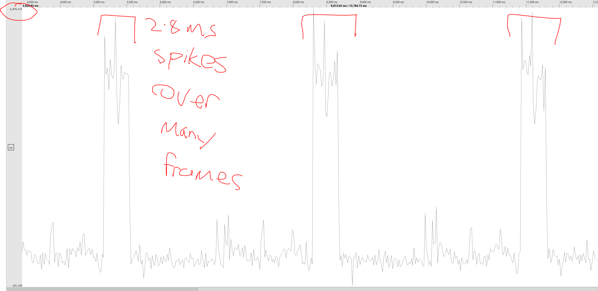
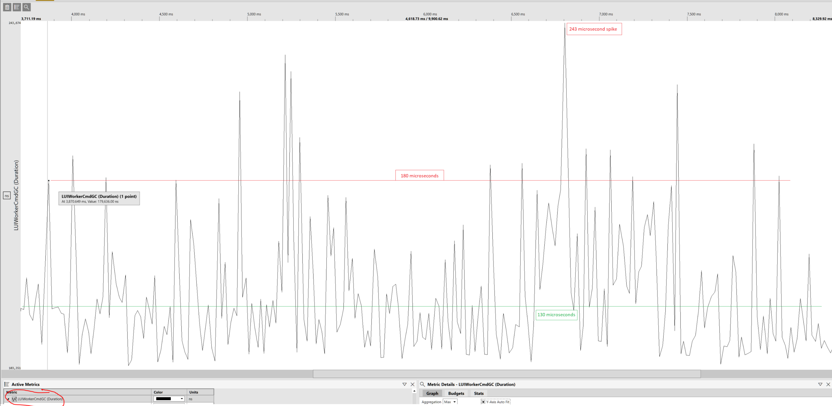
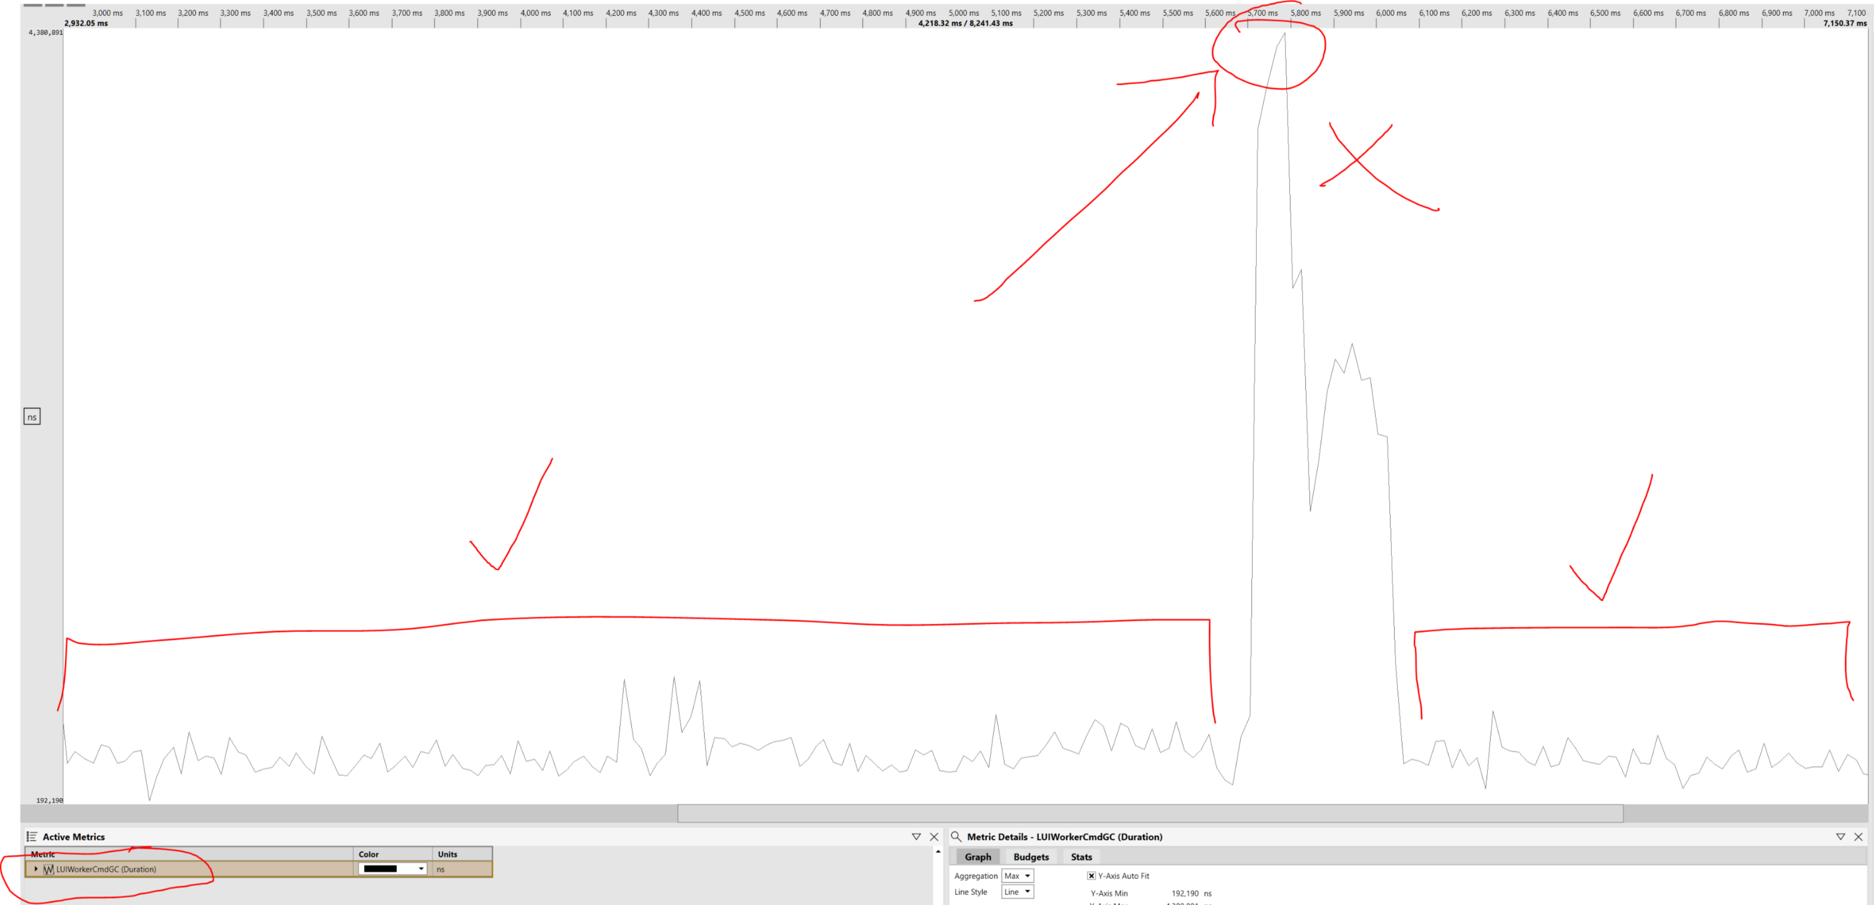
GARBAGE COLLECTION IN REAL TIME APPLICATIONS
//
// Time limited GC to 100us
//
#define MY_KB_THRESHOLD 0
#define MY_GC_TIME_SLOT 100
const uint64_t timer = Sys_Microseconds() + MY_GC_TIME_SLOT;
do
{
lua_gc( luaVM, LUA_GCSTEP, MY_KB_THRESHOLD )
}
while ( Sys_Microseconds() < timer );
// Minimally indivisible step:
#define MY_KB_THRESHOLD 0
lua_gc( luaVM, LUA_GCSTEP, MY_KB_THRESHOLD );
Step: lua_gc( luaVM, LUA_GCSTEP, MY_KB_THRESHOLD );
Full: lua_gc( luaVM, LUA_GCCOLLECT, 0 );
Notes:
Now, moving onto the garbage collection which I also take issue with:
[CLICK]
First, if you are thinking of introducing a garbage collector to your game, don’t do it.
If you never do it, you’ll never have to deal with this problem. So, my first piece of advice is, just don’t.
If you do a bit of Googling for garbage collection best practices, it is astounding the number of gotchas and caveats there are just waiting to catch you out. String concatenation, copying arrays, closures, anonymous methods, boxing, moving variables outside of loops – good luck keeping on top of this with a large development team!
There is only so much information a programmer can retain at once – is it not better for engineers to focus on the problem at hand vs following 100s of arbitrary rules in a coding standard that is simply in place to avoid the unsuitability of the system underpinning it? And then spend the better part of a day getting a review over the line? No.
[CLICK]
Sorry. That was a bit of a rant. Let’s just assume we’re using a garbage collector.
[CLICK]
And you notice this sort of thing happening: The garbage collector is humming along but unable to keep up with memory consumption, so it intermittently spikes to clear a bunch of memory out
What are our options here? Other than making sure nothing silly is going on of course.
Implementation wise I will be speaking to LuaJIT with a Two-Level Segregate Fit allocator.
Let me first pay credit where credit is due – LuaJIT paired with the TLSF allocator are impressively fast and work very well together.
The problem does not lie in the underlying technology. The problem lies in how we are using it and the use case we are applying it to.
When it comes to garbage collector tuning you have a few options.
[CLICK]
One option is a partial step that runs until it frees up to a certain kilobyte threshold.
[CLICK]
Another option is to go nuclear and just perform a full collection, which you see GCs do when they reach their emergency thresholds.
The problem with both options is that you end up relinquishing control of your CPU to the garbage collection algorithm until its finished its mandate of clearing a certain amount of memory.
This makes me very nervous. How could one ever give up control of the precious CPU to an algorithm that will take an indeterminate amount of time to run, in the context of a game engine? This is just such a bad idea!
[CLICK]
As you can see from my frustrated squiggles using my beloved snipping tool, trying to tune the GC using a memory threshold alone was unable to cope with the dynamic allocation patterns demanded by the UI and when it needed to, took its sweet time to iterate the pool and free the necessary blocks up to our predetermined step threshold.
[CLICK]
What if we did this though? Tell the GC to do the smallest, most atomic step it can possibly do? This way we can control it better and don’t need to relinquish control to the collection algorithm.
[CLICK]
Doesn’t this just instantly lower your anxiety? We are taking control of the CPU back here. With this strategy we are now in charge of the amount of time the GC takes. This number can either be statically defined for what works for your allocation pattern, or it can be rubber banded and allotted more time when the garbage collector is under duress.
[CLICK]
After time limiting the GC and using a minimally indivisible step, we end up with some quite nice results with the GC humming along at between 130 to 180 microseconds per frame, spiking in the worst case at around 240ms. As we process this garbage collection cycle on a worker thread outside of the LUI step, this work is achieved in parallel for no real cost to the frame rate.
[CLICK]
But just remember what I said. It’s easier not to go down this path, because all it takes is some inefficient code to…….
[CLICK]
Undo all of this hard work.

Slide 21
PART 3: THE CLUTCH
Notes:
PART 3: THE CLUTCH
--------------------------------------
While we were well on our way to optimizing our way out of this mess, we still had one blocking issue that was destroying us and we couldn’t work out what was going on or how to fix it.

Slide 22
4 DAYS TO LAUNCH
Notes:
[CLICK]
We were 4 days from launch.
[CLICK] *read the text*
[CLICK]
[CLICK]
[CLICK]
[CLICK]
Well, you heard ghost. Let’s get it done.

Slide 23
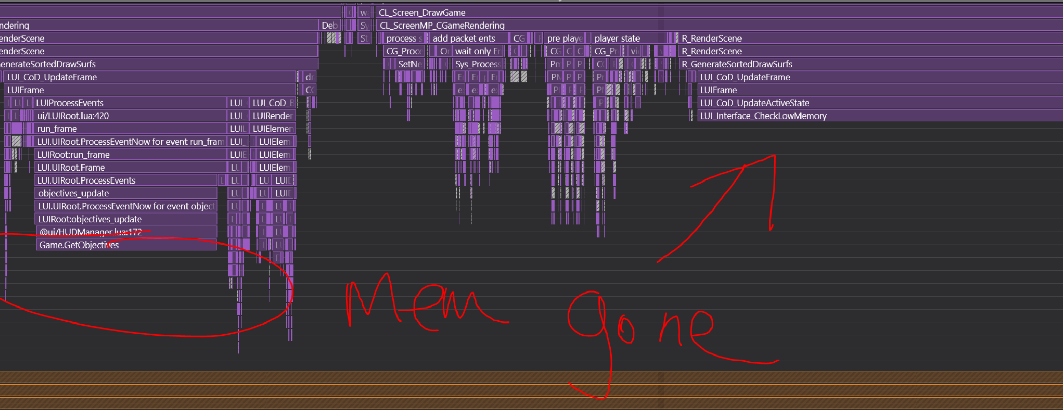
IN THE NICK OF TIME
Notes:
This was the video I showed you at the start of the presentation.
This was the classic Swiss cheese effect. As we were frantically trying to fix the frame stalls, we found a ticket that had been marked into the wrong bucket. Looking through the ticket history this problem had existed for some time, although we never saw it in our local captures because it was package only, release branch only.
This was happening with 100% reproduction for QA in playtests, but not for us running our local builds. I spent a sleepless week trying to reproduce this and fix it blind but to no avail.
We had 4 days left until launch. I called the 141 into a Zoom, I was desperate and couldn’t do it alone.
We immediately launched into a full-blown assault on the issue.
This was one of the most remarkable team efforts I have ever had the privilege of being a part of in my career:
With 4 days until ship:
Stephen White hammered away trying to get a local repro and managed to get the hitching started by hopping into a vehicle and re-fuelling it. I still to this day have no idea how this got us local reproduction, but I’ll take it as a gift from the gods.
Alister got the release branch and side loaded a special diagnostic profile build against the package that would give us the ability to further diagnose the problem.
He followed Stephen’s vehicle refuelling repro steps and took the capture
[CLICK] We analysed the capture and found that the offender was high order of complexity objectives code sending the LuaVM out of memory. It wasn’t immediately clear this was the cause as we were running out of memory on the next frame, but it showed us where to look and turned out that the incremental GC just couldn’t keep up.
It turns out this was only reproducible in the big map and never happened in a local test because there wasn’t enough players and objectives active when playing with only bots or a few dev kits.
[CLICK] With a few insights about objectives from Kyle Turchik, Jarrod created a C++ fix to eliminate the complexity from the objective's algorithm. In a nutshell, loads of data was being sent to Lua for processing as objectives contained 32 slots for locations and rarely used them all. In addition to this we could also prune objectives that were empty as well as objectives that were active as they didn’t need to be displayed in world space.
Alister then verified it worked against the package and took profiles to verify the fixes efficacy.
[CLICK] We put the code up for review and kicked off the ETU build to fix it 72 hours before launch.
[PAUSE]
[CLICK]
That… was close.
[PAUSE]

Slide 24
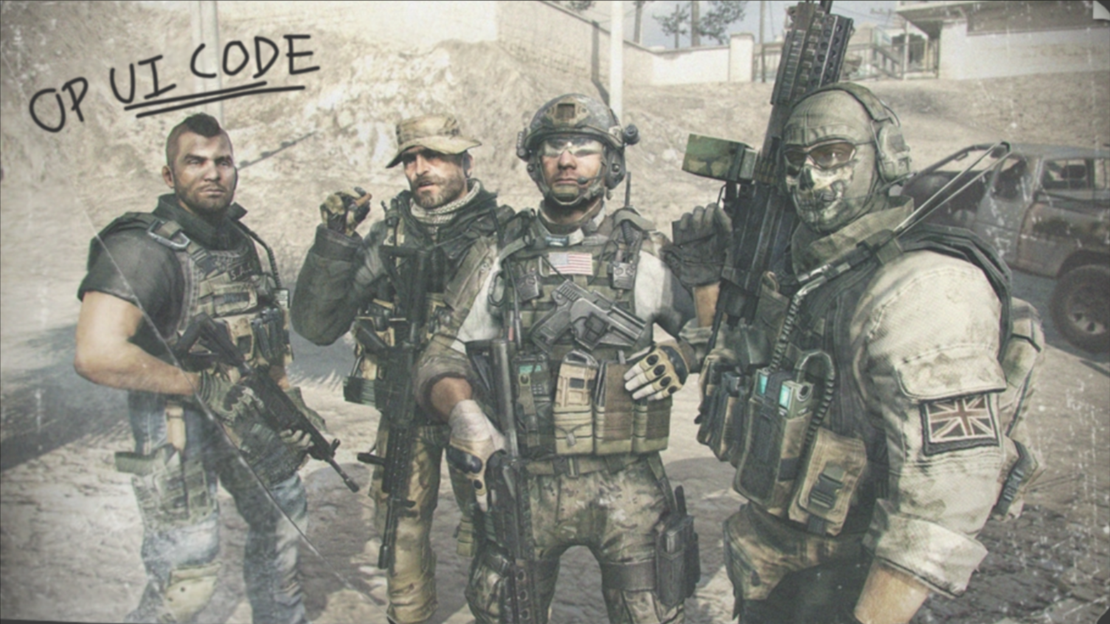
MISSION ACCOMPLISHED
OR WAS IT?
Notes:
Well, as you can probably guess – we did it. Call of Duty – as it always is – was released on time.
Many battles like this are fought across all departments to get our game out the door each year, and I have huge respect for all of the Activision studios that help to make our game a reality and such a commercial success.
--------------------------
[CLICK]
Now that we had put in the work to get the game out the door, without a solid plan performance atrophy would creep back in and this sort of ship risk would be a repeating occurrence.
This was a battle we were only going to fight once.

Slide 25
PART 4: BATTLE HARDENING
Notes:
Part 4: Battle Hardening
This close call exposed a huge vulnerability in the code base, but it also forced us to do a deep dive into it.
The goal posts had moved and this time to a more ambitious place.
The aim of the game was now to:
Further improve on framerate – get the worst-case and slowest platform frame time to under 4ms
Improve processes pertaining to CPU performance
Improve diagnostics
Automate performance testing

Slide 26
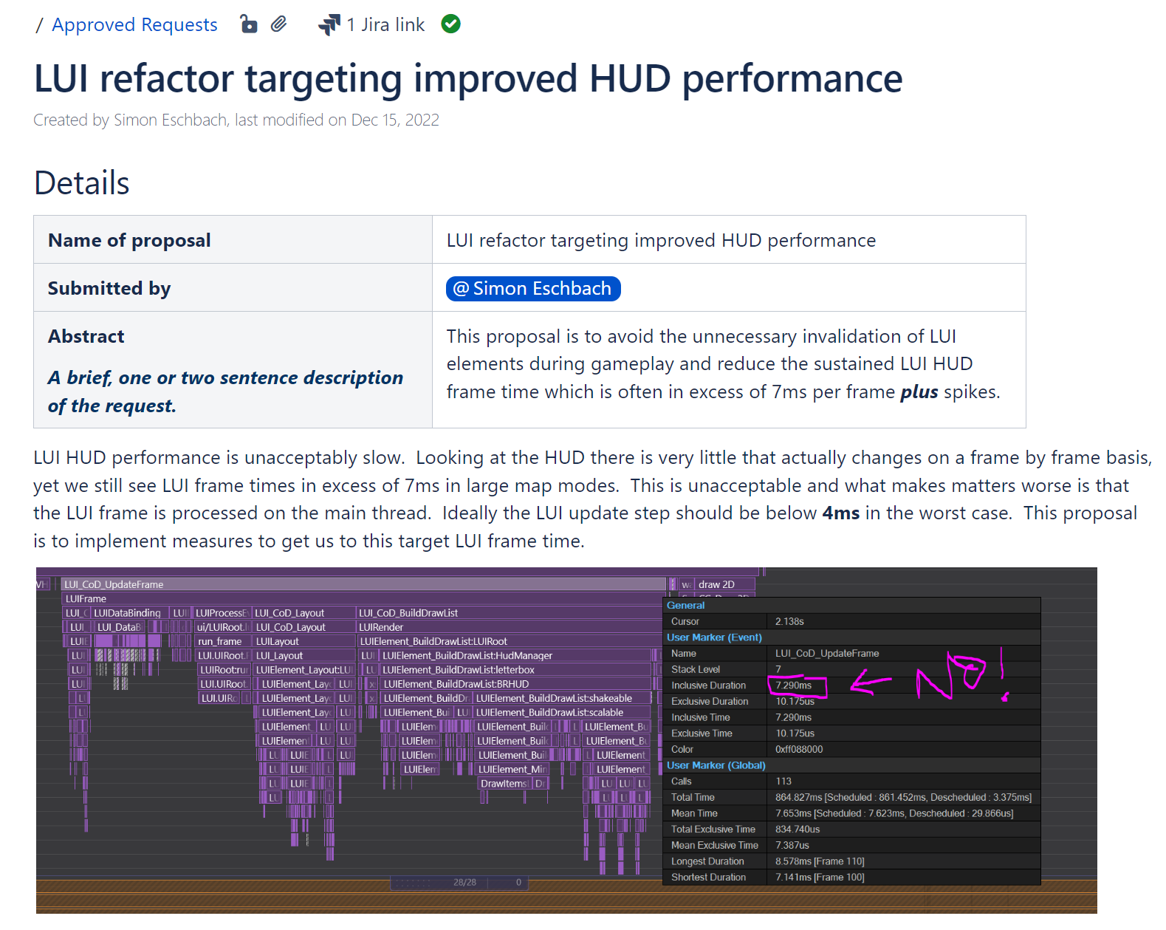
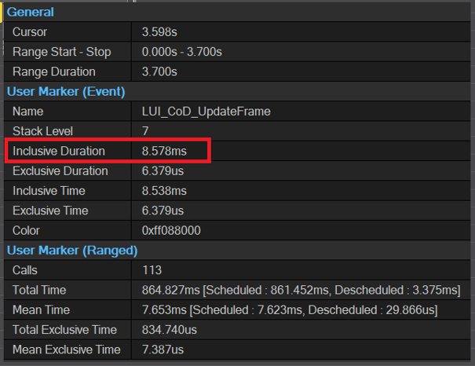
MEASUREMENT
MEAN FRAME TIME: (COLLAPSED) = 12.26ms
< 4ms
4ms
SUSTAINED: (50% MEDIAN) = 8.24ms
SPIKE: (99% MEDIAN or 1% WORST) = 15.42ms
STALL: (99.9% MEDIAN or 0.1% WORST) = 65.7ms
Notes:
We set an ambitious sustained frame target to
[CLICK]
4ms or less on base PS4 platform.
[CLICK]
This was an ambitious target considering we were sitting at over 7ms at the time, and the Playstation 4 CPU was released over 11 years ago with a dated CPU that clocks in at a meagre 1.6 GHz.
To put this into perspective, the smartphone in your pocket has a significantly more powerful CPU than the Playstation 4 does. It was actually considered underpowed in 2013 when the console itself was released!
---------------------------------
[PAUSE]
Regardless of the challenges, I delivered a roadmap to outline the way in which we would work towards our target.
The thing is, you can’t fix what you don’t have a metric for. In this last battle for 60 FPS I had loosely defined different types of hitches based on their duration and then tried to triage and work backwards from there.
The aim of the game was “get it shippable” which generally meant getting the frame time down to something that didn’t impact the baseline FPS too much and didn’t have obvious stalls.
Most of the work we carried out was stall related. While we made 1.5ms worth of progress on the sustained frame time, it wasn’t enough to fully unblock the main thread.
[CLICK]
One of the problems with our measurement technique was that it was taking the mean frame from short profiles we took on our own dev kits with bots.
These types of profiles are too granular and polluted to give an indication of an overall performance trajectory. Capturing actual playtest metrics is key.
But before even considering where performance should be measured, it is important to set up guidelines for how performance will be measured.
Taking the statistical mean of a play test capture is not a useful metric for generalised CPU performance. The reason for this is because the statistical mean in such a long capture will collapse the concepts of sustained frames and spike frame times into a single metric. It is important to measure both of these metrics separately to ensure we eliminate the noise of frame spikes from the sustained frame time measurement.
[CLICK] [CLICK]
This is why medians are used for performance tracking. The 50% median provides an excellent metric for sustained frame performance, while the
[CLICK]
99th percentile median will give the 1% worst performing spike frames. This can go a step further to the
[CLICK]
99.9% percentile median, which will give an accurate representation of the duration experienced by the worst 0.1% performing frame offenders, or the frame types I previously referred to as stalls.
Using a metric based methodology like this not only defines a much better way to categorise and triage stall types, it provides accurate metrics for long term tracking of performance data.

Slide 27
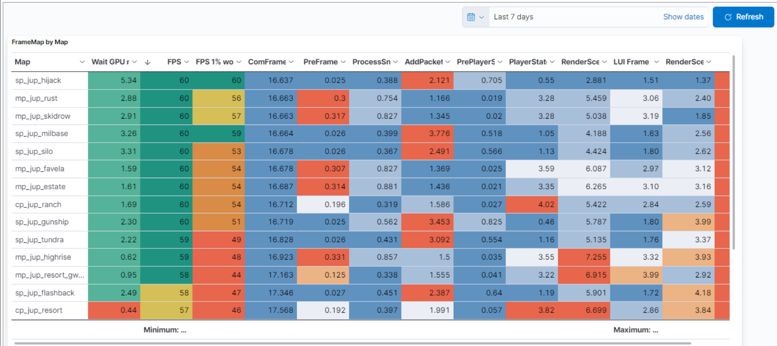
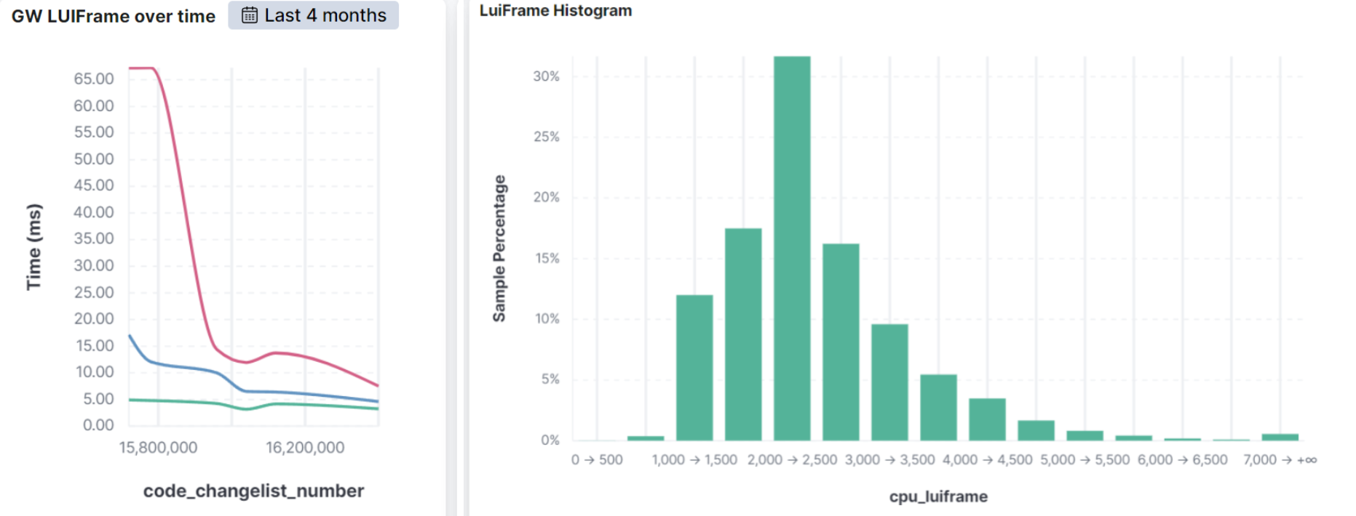
DASHBOARDS
Notes:
Which brings me to my next point: Measurement is of no use without accurate and consistent sampling.
A game changing development in our current process is the CPU performance dashboard set up by Liam Gilbride. The dashboard took existing FPS tool measurements from playtest builds and sent them to an elastic dashboard for analysis.
[CLICK]
This allowed us to track CPU performance for each part of the frame step for each level, over time. This was ultimately how we defined progress and success criteria for CPU performance well beyond the scope of just the UI.
[CLICK]
But using it specifically for the UI was a godsend and we could view our progress over time visually and with great accuracy. On the left you can see stall frames in red, spike frames in blue and sustained frames in green. On the right you can see a histogram of frame time distribution. This is filtered to a 4-month period, although the dashboard can be customised to any chart, query or time span to create any chart desired.
[PAUSE]
A dashboards efficacy is only as reliable as the data you send it. This is why establishing reliable processes for capturing this data is so important.
Establishing processes for QA to perform 2 playtests a week in the profile build - tested across a variety of game modes and levels – ensured that we had a steady stream of data flowing into the dashboard.
In addition to this, we educated QA on taking razor captures for closer engineering analysis. It was in this channel we could also make QA requests for captures of spikes we needed more information on.

Slide 28
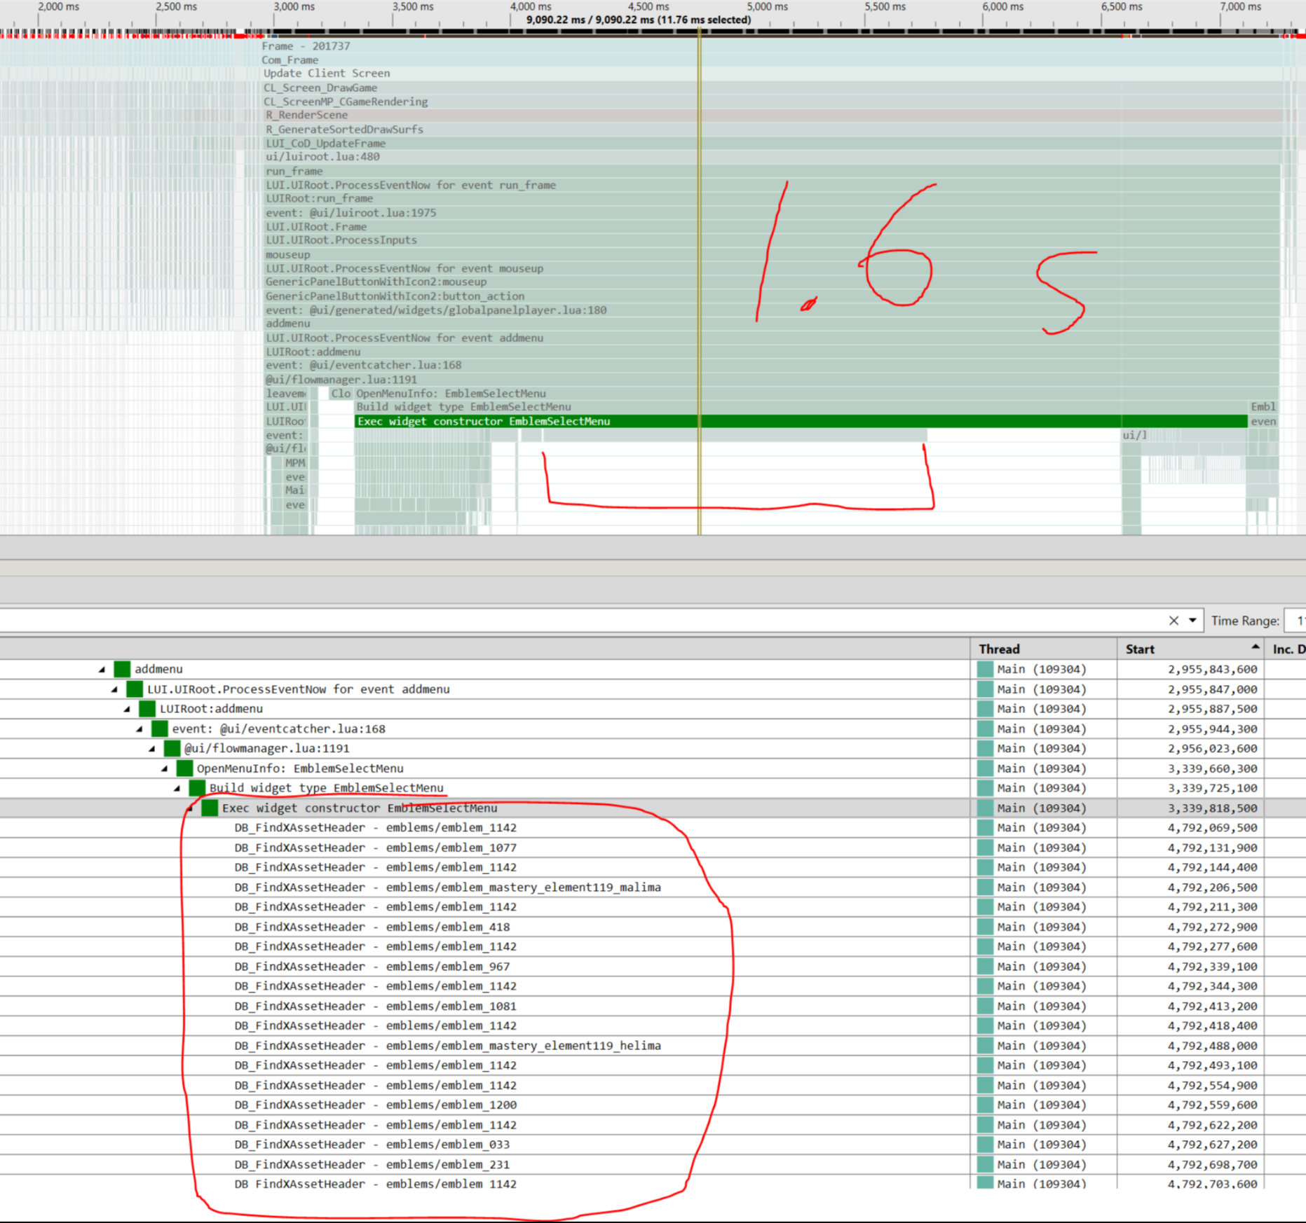
PROCESSESES AND DIAGNOSTICS
Notes:
So by now we have established how we will measure the data, where will we measure the data, and where the data will come from.
While this is all good and well, the data is useless unless we have the diagnostic tools and means to act on it.
[CLICK]
It was for this reason that profile marker verbosity was moved to a toggleable switch in the profile build. This meant that QA could flick various levels of user marker detail on and off based on our investigative requirements.
[CLICK]
If for example, I needed the highest level of granularity, I could ask for a short capture of the highest possible detail during gameplay to investigate the state of quad caching status as we color coded the user markers to get a glimpse into which of our quads were invalidating and if the invalidations were necessary.
[CLICK] Or I could use this mode to quickly run a local test to see what assets were being looked up on a lengthy menu transition.
Using the profiler in this manner made diagnosing problems much faster, and having established processes and support form QA meant that engineers didn’t need to spend their days working for a reproduction. We could simply ask QA to flick on a switch and take a capture of their reproduction for us – in the same way you might ask for a video of the problem, we would simply ask for a verbose capture. This would often point us to exactly where the problem was originating from.
I’d like to shout out Andrew Medlin for defining and driving these CPU performance processes so well on MW3.

Slide 29
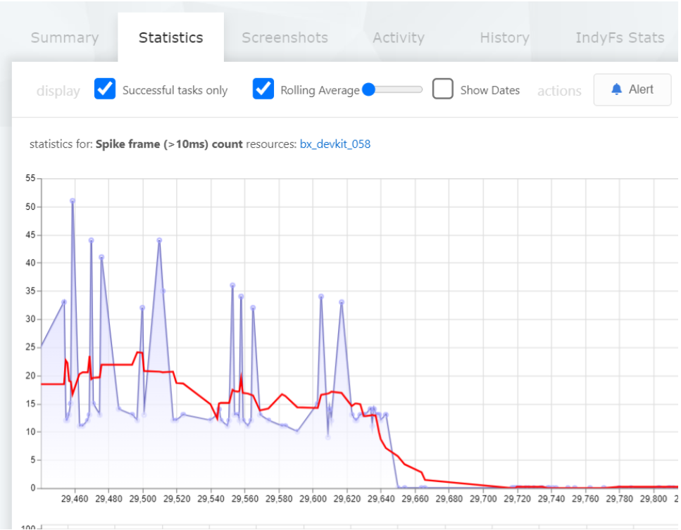
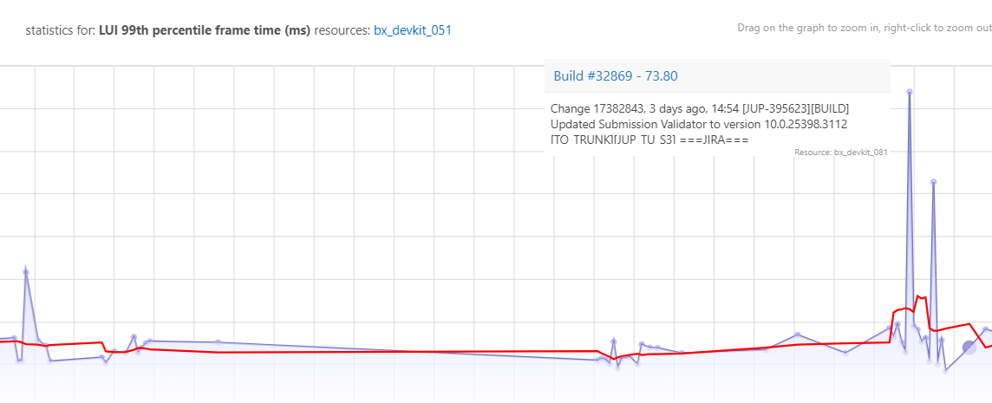
AUTOMATED PERFORMANCE TESTING
Notes:
While it all good and well to establish these processes to be able to deliver a stable product, we are now taking it a step further.
The roadmap for 2024 is to get performance tests running on CI per-commit, with thresholds set on automated performance tests which break and turn red when exceeded. This will allow us to immediately detect when slow code was added and roll back the change, and to also keep tabs on seasonal memory consumption and performance atrophy.
This has the added benefit of being a learning opportunity for the engineer responsible for the change with the idea being to coach engineers on the topic of performance, algorithms, data structures and other engineering first principals.
[CLICK]
Automated test performance metrics are already functional where we track of the internals of the UI system each commit. In the above example you can see the incidence of spike frames decreasing over time.
[CLICK]
Here is another example where a change has introduced a frame stall.
This is still a work in progress as we need to further build out tests and stabilise the data but even in its current state it has been really effective in catching performance and memory regressions.

Slide 30
RESULTS – PS4 BASE PLATFORM
SINGLEPLAYER: 1.2ms
MULTIPLAYER: 2.1ms
GROUND WAR: 3.1ms
WARZONE: 3.9ms
Notes:
Regarding our frame targets – did all of the stuff I just spoke about end up working? Did we hit our 4ms goal on PS4?
The answer is yes.
[CLICK][CLICK] We managed to get the sustained frame time down to 1.2ms for single player
[CLICK] 2.1ms for multiplayer
[CLICK] 3.1ms for ground war
[CLICK] And we literally just squeaked the warzone target by 100us at 3.9ms

Slide 31
THANK-YOU!
Sound: Mike Tornabene
Voice Over: Dan Nelson
Photoshop: Carl Prescott & Kyle Turchik
Notes:
I’d like to thank you all for coming and listening to my presentation today.
So many talented individuals were a part of this amazing battle and if there is one thing that I am truly proud of, it's the way in which we all work together across time zones, countries, language barriers, cultures and studios to pull this game together.
Call of Duty is a fantastic franchise and I’m very proud to be a part of it.
Thank-you.

